Slide 1
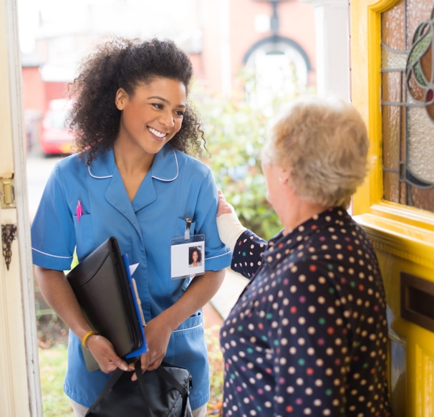
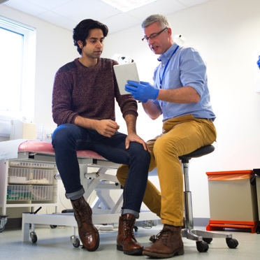

Home Care is Best Care campaign
November 2024

Slide 2
3
Introduction
8
External bulletin copy
4
Webpage copy
9
Social media graphics and copy
5
Webpage copy
10
Social media graphics and copy
6
Webpage copy
11
Social media graphics and copy
7
12
Internal staff bulletin copy
Social media graphics and copy

Slide 3
Introduction to this toolkit
In light of the findings of the Darzi report, which outlines that priority focus, care and funding is hospital-based, rather than outside these settings, NHS Staffordshire and Stoke-on-Trent ICB will campaign on: ​
Home Care is Best Care – any unnecessary hospital admissions, or stays which are longer than necessary, can have a negative impact on patient recovery. This can often cause serious harm and impact negatively on health and wellbeing (deconditioning), so benefits of being in the hospital must outweigh the risks. This will form the basis of the system-wide winter campaign, with all partners supporting the messaging and will help support the system’s continuing focus for UEC performance. This being:​
  76% of patients being admitted, transferred, or discharged within four hours by March 2025, with further improvement in 2025/26.​
  Ambulance response times for Category 2 incidents to 30 minutes on average over 2024/25.
Further messaging included in this toolkit to support winter pressures and partner messaging:
Pharmacy First – launched 31 January 2024, Pharmacy First adds to existing consultation services and enables community pharmacies to complete episodes of care for seven common conditions following defined clinical pathways.​ This is currently being updated and will be added to the toolkit in due course.
Vaccination Campaigns – childhood immunisation, flu and covid vaccination programmes are being promoted to keep our communities safe and well.​
NHS111 – a new campaign is being launched on 25 November and this will be added to the toolkit
Falls – working with partners including Midlands Partnership University NHS Foundation Trust, we will continue to raise awareness and educate families around preventing falls for the elderly and/or vulnerable.
Mental health – promoting 111 mental health service for those concerned for their welfare or that of another person
Local authority messaging – based around staying warm this winter.
Visit www.staffsstokeics.org.uk/home-care-is-best-care/ to download resources in this toolkit. Other resources are available on the national Campaign Resource Centre

Slide 4
Webpage copy feel free to use www.staffsstokeics.org.uk/home-care-is-best-care
Hospitals treat people during illness or injury. The needs of patients on the wards are different at different times of the day. This means that the environment is often very noisy and busy, with patients getting less rest during their stay. This can result in confusion and disorientation, especially when patients are elderly.
We all know how important rest is for recovery from an illness. That is why it is important to avoid going into hospital unnecessarily or being discharged as early as possible when you start to show improvement. Sometimes, the care can continue to be provided at home as well, which is better for you.
Being admitted to hospital unnecessarily, or staying longer than necessary, can have a negative impact on how well you recover. It can also often cause serious harm and impact negatively on your health and wellbeing. The benefits of being in the hospital must outweigh the risks.
It is important that we work together to ensure that the decision to admit, or for you to continue to stay in the hospital, is the result of a shared decision-making process. This means that you as a patient, your family members and/or other care givers make an informed decision after considering the benefits, risks and personal goals and expectations.
Ensuring that you are given the chance to continue your life at home is vital for long-term wellbeing. We want to empower you and your families with the confidence to continue your recovery in a familiar environment.
Please speak to your doctor or other clinical team member managing your care when you or your loved one is admitted into hospital, and then every day whilst in the hospital.
<Drop-down> Why not hospital?
Physical Strength
If you stay in bed for long periods of time you lose mobility, fitness and muscle strength, which makes it harder for you to regain your independence. This is known as deconditioning. It is a decline in function and for older people with frailty, this may start within hours of them lying on a trolley or bed.
This results in a large proportion of patients:
Experiencing a delay in being discharged
Not being able to do normal, every day activities and then becoming dependent on others
Needing to use walking aids
Losing bladder or bowel continence
By getting up, getting dressed and moving, you can help maintain muscle strength and your ability to do things for yourself. When you’re at home, just doing ordinary day-to-day activities like getting up to make a cup of tea helps to maintain muscle strength. In contrast, when you’re in an unfamiliar environment like a hospital ward, you may be more likely to fall because you don’t have those familiar things around you to steady yourself if you lose your balance for a moment.
Find out more about deconditioning and how to prevent it here.

Slide 5
Webpage copy
Rest
Good sleep is essential for a long and healthy life, but it’s even more important when you're recovering from an injury or illness. Hospitals are busy places with lights, talking and other noises from equipment, which can mean you don't sleep very well. There’s no bed like your own bed when it comes to getting a good night’s rest.
Mental Wellbeing
Being in familiar surroundings with support from your loved ones is one of the best things for mental wellbeing. Hospitals are unfamiliar and can be very confusing, which increases your risk of developing sudden confusion (delirium). When you are in hospital for a long period of time, you may also lose confidence in your own ability to manage your day-to-day needs. With the right support, many people can return to living their life the way that they want to.
Infection
When you're unwell your body is often less able to fight off infections. We do everything we can to prevent you from developing an infection, but the risk is usually lower at home where there are fewer unwell people under one roof.
Although there are robust measures in place to prevent infections in our hospitals, there is always the risk of getting infections in hospital. Data suggests that elderly people are more prone to infections than other people in the hospital.
Blood clots
When you get admitted to hospital, there is an increase in the risk of developing blood clots in the deep veins of the legs (hospital associated thrombosis). There are prevention measures in place to avoid thrombosis, however our data suggests a higher risk, especially in elderly patients.
<Drop-down> If not hospital, where?
Link to YouTube Videos:
https://youtu.be/TLxoehNRM3Q
https://youtu.be/lLrylow74qg
https://youtu.be/MDQaRKZlf3A

Slide 6
Webpage copy
<Drop-down> Working Together
Make decisions with you
We will talk to you about what is important to you. We will do our best to answer any questions or worries you may have and work with you and your family to achieve your goals.
Think about your care
The best place for your care and recovery is usually your own home.
We will talk to you about your options. We want to make sure that, if you do not need to admitted to hospital, the right care is in place to support you to get better.
Involve your family or carers
Where appropriate, and with your consent, we will involve your family or carers in making decisions about your health and care. You might find it helpful to include them in our discussions.
Checklist
Once you have had the care that you need in hospital, research shows that going home will help you get better much faster. If you need it, we will provide extra help for you at home or close by, to make sure you’re continuing to get better.
By asking questions, sharing information and following the advice of the doctors and nurses looking after you, we can help you get ready to go home quicker.
Before you leave hospital
Do you know where you are going (home, to interim care, to a community hospital)?
Do you have your own transport or someone who can take you home?
Do you have your medication and do you understand when to take it?
Do you have the equipment you need to go home?
At home
Is the heating on?
Are the lights on?
Is there basic food in the fridge?
Concerns
If you are unwell and need medical help, please call 111 or visit www.111.nhs.uk.
If you are unsure about your medication, please call 111 or ask at your local pharmacy.

Slide 7
Internal staff bulletin copy
Home Care is Best Care
The needs of patients on a ward can be different at different times of the day and this can create a noisy and busy environment. As a result, patients can get less rest during their stay and this can cause confusion and disorientation especially in elderly patients.
We know how important rest is for recovery from an illness. Being admitted to hospital unnecessarily or staying longer than necessary can have a negative impact on how well the patient recovers and can often cause serious harm which impacts on their health and wellbeing.
It is important that we work together to ensure that the decision to admit, or for patients to continue their stay in the hospital, is the result of a shared decision-making process. This means that the patient, their family members and/or other care givers make an informed decision after considering the benefits, risks and personal goals and expectations.
Ensuring that patients are given the chance to continue their life at home is vital for long-term wellbeing. We want to empower patients and their families with the confidence to continue their recovery in a familiar environment.
The NHS Staffordshire and Stoke-on-Trent Integrated Care Board (ICB) has developed a campaign to spread awareness about people across Staffordshire and Stoke-on-Trent receiving the care they need, when they need it and in the best place. You can find more information by visiting: www.staffsstokeics.org.uk/home-care-is-best-care/

Slide 8
External bulletin copy
Home Care is Best Care
The needs of patients on a ward can be different at different times of the day and this can create a noisy and busy environment. As a result, patients can get less rest during their stay, and this can cause confusion and disorientation especially in elderly patients.
We know how important rest is for recovery from an illness. Being admitted to hospital unnecessarily or staying longer than necessary can have a negative impact on how well the patient recovers and can often cause serious harm which impacts on their health and wellbeing.
Ensuring that patients are given the chance to continue their life at home is vital for long-term wellbeing. We want to empower patients and their families with the confidence to continue their recovery in a familiar environment.
The NHS Staffordshire and Stoke-on-Trent Integrated Care Board (ICB) has developed a campaign to spread awareness about people across Staffordshire and Stoke-on-Trent receiving the care they need, when they need it and in the best place. You can find more information by visiting: www.staffsstokeics.org.uk/home-care-is-best-care/

Slide 9
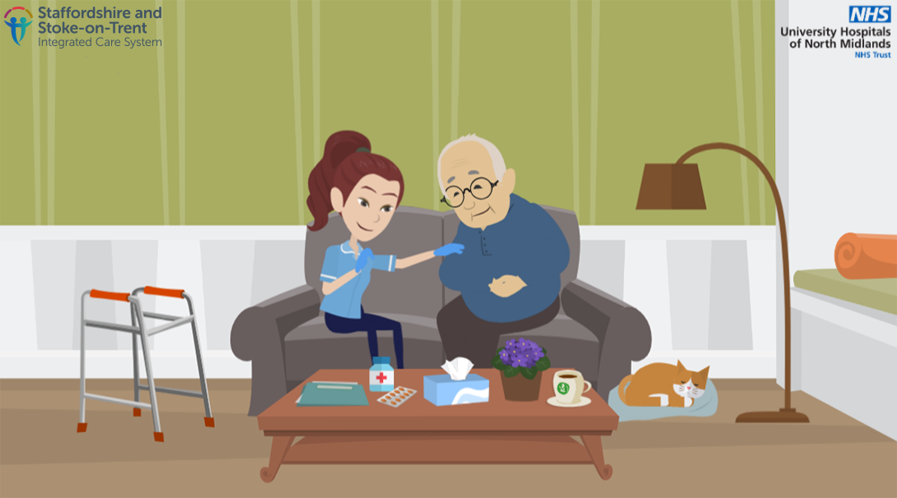
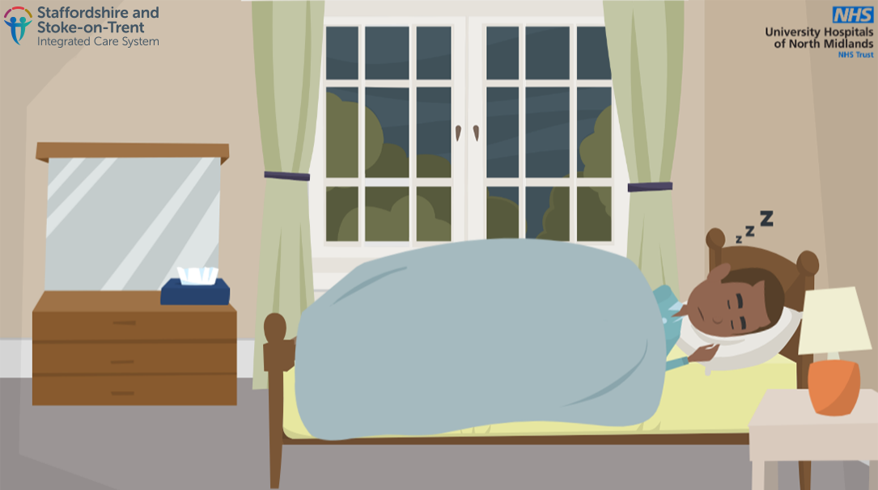
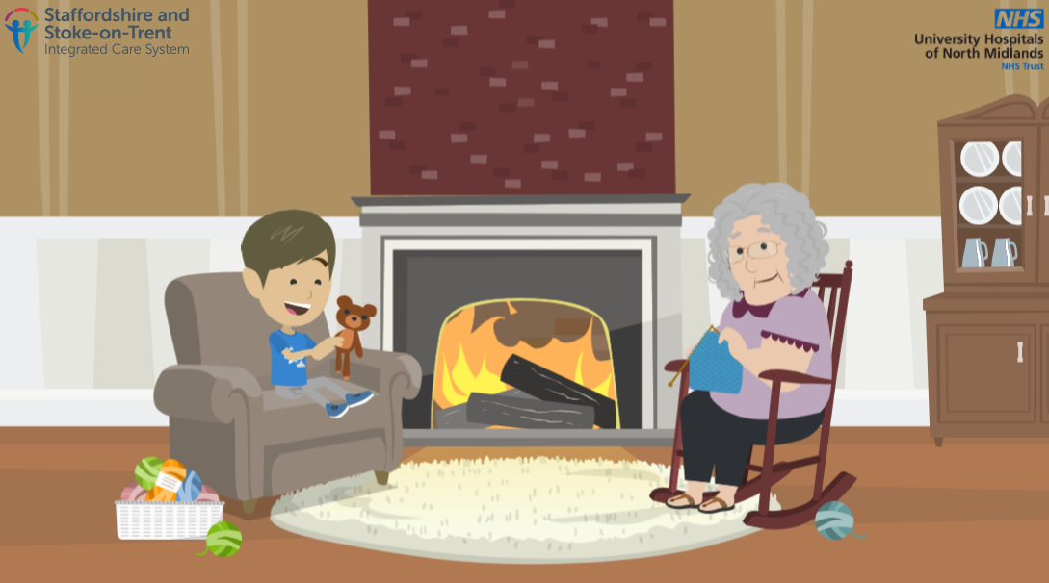
Social media graphic and copy
Please use one of the below options alongside these graphics:
Social media copy | Graphic to use
Home care is often the best care for older adults and must be the first choice. Hospital care should only be an option where treatment cannot be provided at home safely after considering all the alternatives. Visit www.staffsstokeics.org.uk/home-care-is-the-best-care to find out more.
Good sleep is essential when you're recovering from an injury or illness, so it’s often best if you can receive care in your own home, away from busy, noisy hospital environments. Visit www.staffsstokeics.org.uk/home-care-is-best-care to find out more.
Hospitals are unfamiliar and can be very confusing, which increases your risk of developing sudden confusion (delirium). With the right support, many people can return to living their life the way that they want to. Visit www.staffsstokeics.org.uk/home-care-is-best-care to find out more.

Slide 10
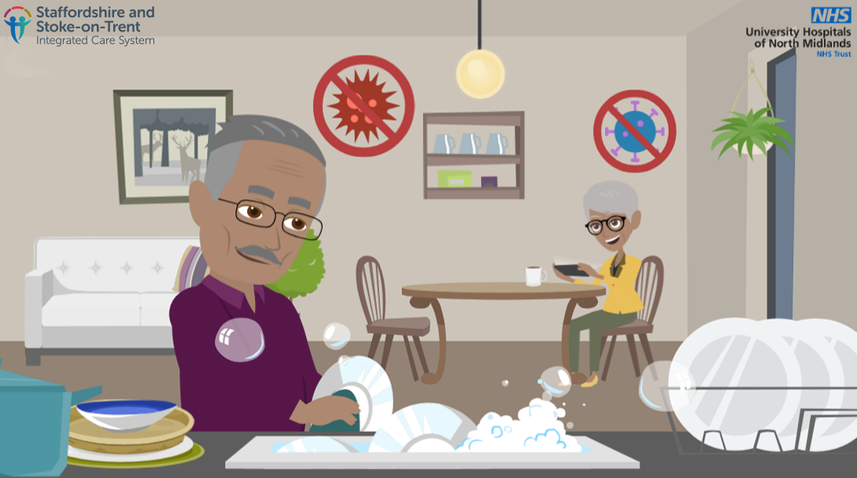
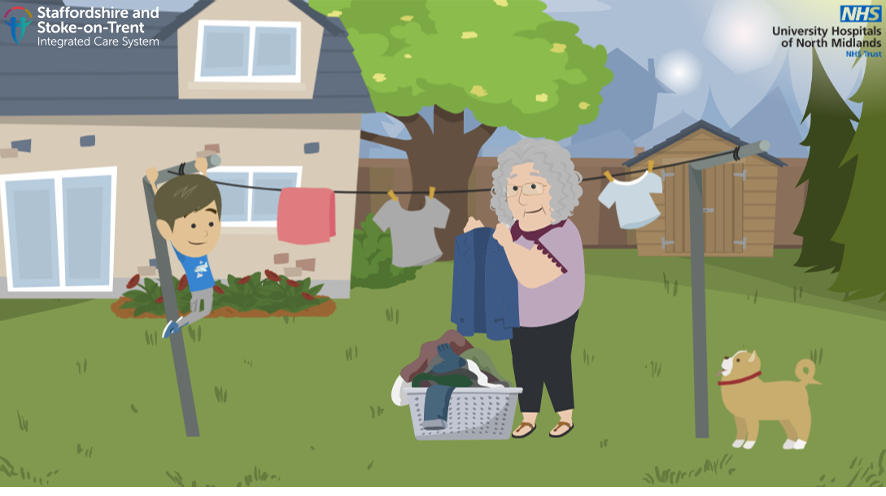
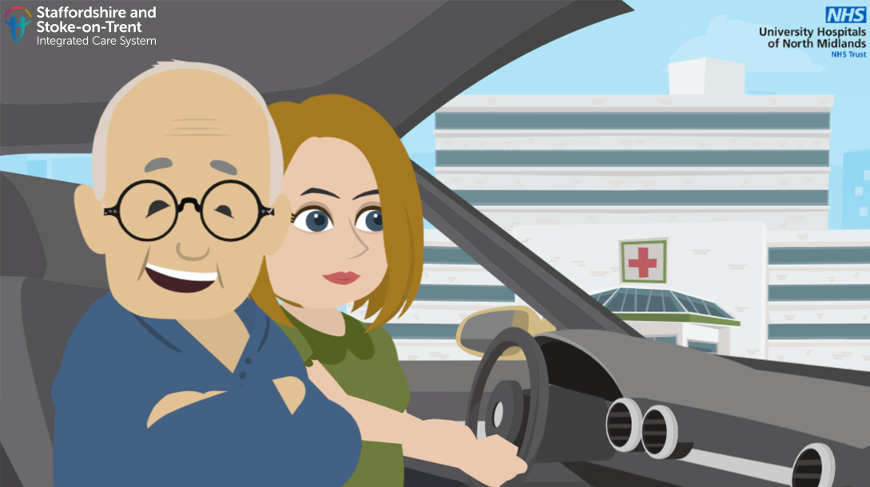
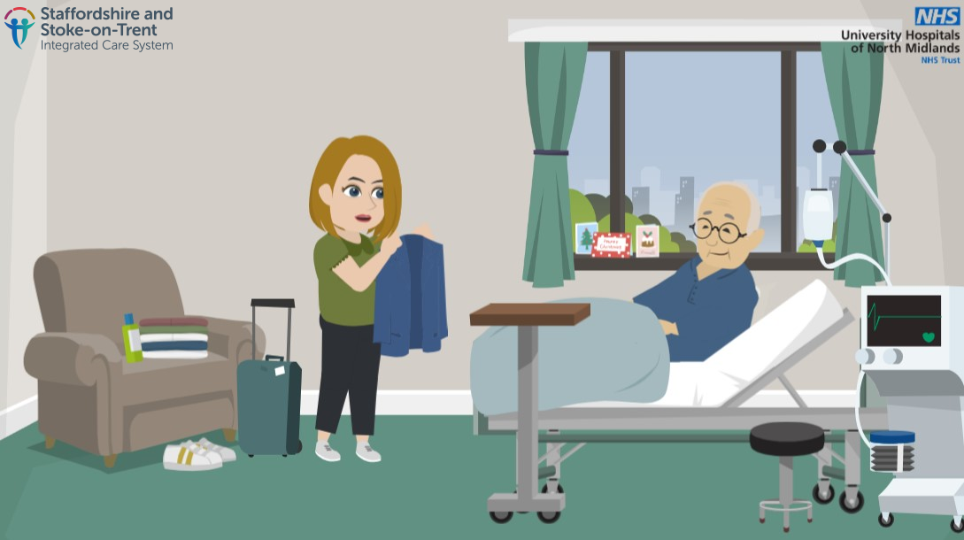
Social media graphic and copy
Please use one of the below options alongside these graphics:
Social media copy | Graphic to use
When you're unwell, you're often less resistant to infections. We do everything we can to prevent you from developing an infection, but the risk is usually lower at home where there are fewer unwell people under one roof. Visit www.staffsstokeics.org.uk/home-care-is-best-care to find out more.
There is an increased risk of developing blood clots in your legs if you are admitted to hospital. There are prevention measures in place to avoid this, but it’s better to stay active in your own environment if possible, especially for elderly people. Visit www.staffsstokeics.org.uk/home-care-is-best-care to find out more.
We want to get patients home quickly when they’re ready to be discharged, so our staff work really hard to support discharges when the time is right. You can help us by collecting your loved ones quickly and making sure their home is ready for them to return to. Visit www.staffsstokeics.org.uk/home-care-is-best-care to find out more.
Please support your friends and family to get home quickly when they’re ready to be discharged. It’s the best place for them and it helps our local hospitals to care for the next patients Visit www.staffsstokeics.org.uk/home-care-is-best-care to find out more.

Slide 11
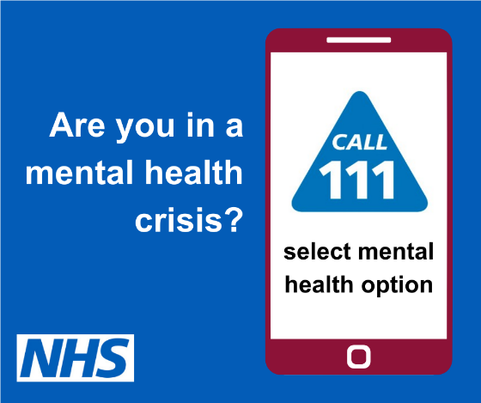

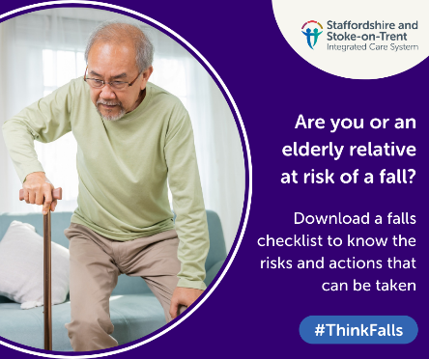
Social media graphic and copy
Please use one of the below options alongside these graphics:
Social media copy | Graphic to use
If you need urgent #mentalhealth support in Staffordshire and Stoke-on-Trent, you can now call 111 and select the mental health option to talk to a mental health professional and get help 24/7. More information is available on our website: https://staffsstoke.icb.nhs.uk/our-work/mental-health-2/crisis-mental-health-access-via-nhs-111/
It's time to get winter strong. Getting your vaccines means your symptoms will be milder and you’ll recover faster if you run into these viruses this winter. nhs.uk/wintervaccinations #GetWinterStrong
Falling as we get older is common, with a third of people aged 65+ and half of those 80+ experiencing at least one fall a year. Visit https://bit.ly/3V39BX4 for a helpful checklist of the risks associated with falls and what can be done to help prevent them. #ThinkFalls

Slide 12
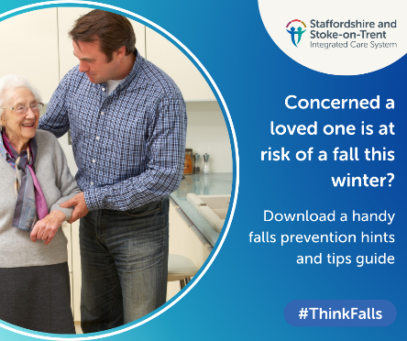
Social media graphic and copy
Please use one of the below options alongside these graphics:
Social media copy | Graphic to use
As the temperature drops, the risk of a fall can rise for many. If you’re concerned an elderly relative or friend may be at risk of a fall this handy guide offers tips on helping them stay steady on their feet this winter – https://bit.ly/3UOgvzz #ThinkFalls

Slide 13
Thank you for sharing this campaign across your channels. If you need any further information, please email the Integrated Care Board Communications and Engagement Team via ssotics.comms@staffsstoke.icb.nhs.uk

