Slide 1

Staffordshire and
Stoke-on-Trent Violence Reduction Alliance

Slide 2
Serious Violence - Context
Serious Violence is a national and local priority
Definition “homicide, knife crime and gun crime, and areas of criminality where serious violence or its threat is inherent, such as in county lines drug dealing… and other forms of serious assault’ (national and local strategies)
Please Note: the definition is not prohibitive and taking a public health approach broadens the impact beyond this topic – covered in more detail later).
County lines is a major, cross-cutting issue involving: drugs, violence, gangs, safeguarding, criminal and sexual exploitation, modern slavery and missing persons.
Nationally:
  Ending Gang and Youth Violence, 2014 and Serious Violence Strategy, 2018
  Advocate end-to-end approach, prevention / early intervention to law enforcement, supported by a strengthened partnership response.
  In 2019 the government invested £35m (p.a.) in 18 police forces areas to develop Violence Reduction Units (Staffordshire are not a funded area). VRU’s bring together police, local government, health, education professionals, community leaders and other key partners to ensure a multi-agency response to violence reduction.

Slide 3
Serious Violence - Context
Locally:
  Serious Violence Strategy, Staffordshire and Stoke on Trent, 2020-2023.
  Aim is to “work together to strengthen the visibility, early identification and partnership response to prevent serious violence and its associated harms”
  Concordat signed up to by local partners, demonstrating commitment to implementing the agreed multi-agency Strategy
  Established multi-agency Delivery Group (in line with Board direction).
  Predicated on a public health approach to violence reduction.

Slide 4
Why take a public health approach?
By taking a public health approach, addressing root causes and vulnerability, and the actions required to achieve this, positive impacts can be made across many areas:
  physical and mental health,
  improved attainment and life skills,
  reduced criminality (across various crime types, drugs and alcohol, domestic abuse, recognising that the risk / protective actors for these areas are often similar)
Adversity and traumatic experiences in early life can have a profound effect on a person’s life and preventing these experiences can improve someone’s life chances
Repeated or multiple trauma can alter a life course, increasing the risk of the adoption of unhealthy behaviours and poor physical and mental health and criminality
The Strategy has five priority areas:

Slide 5
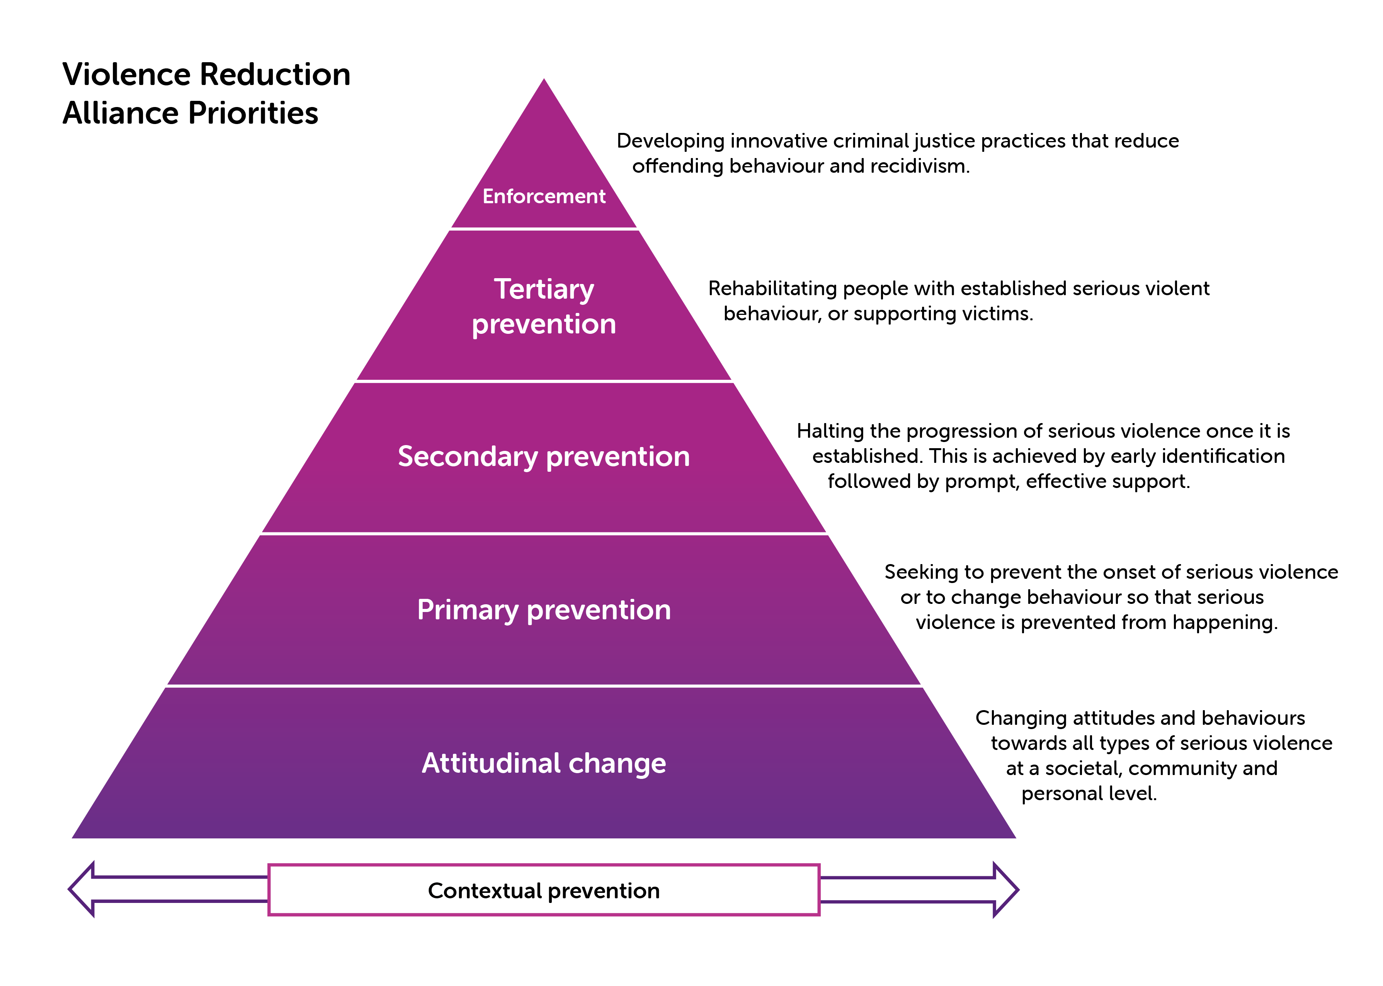

Slide 6
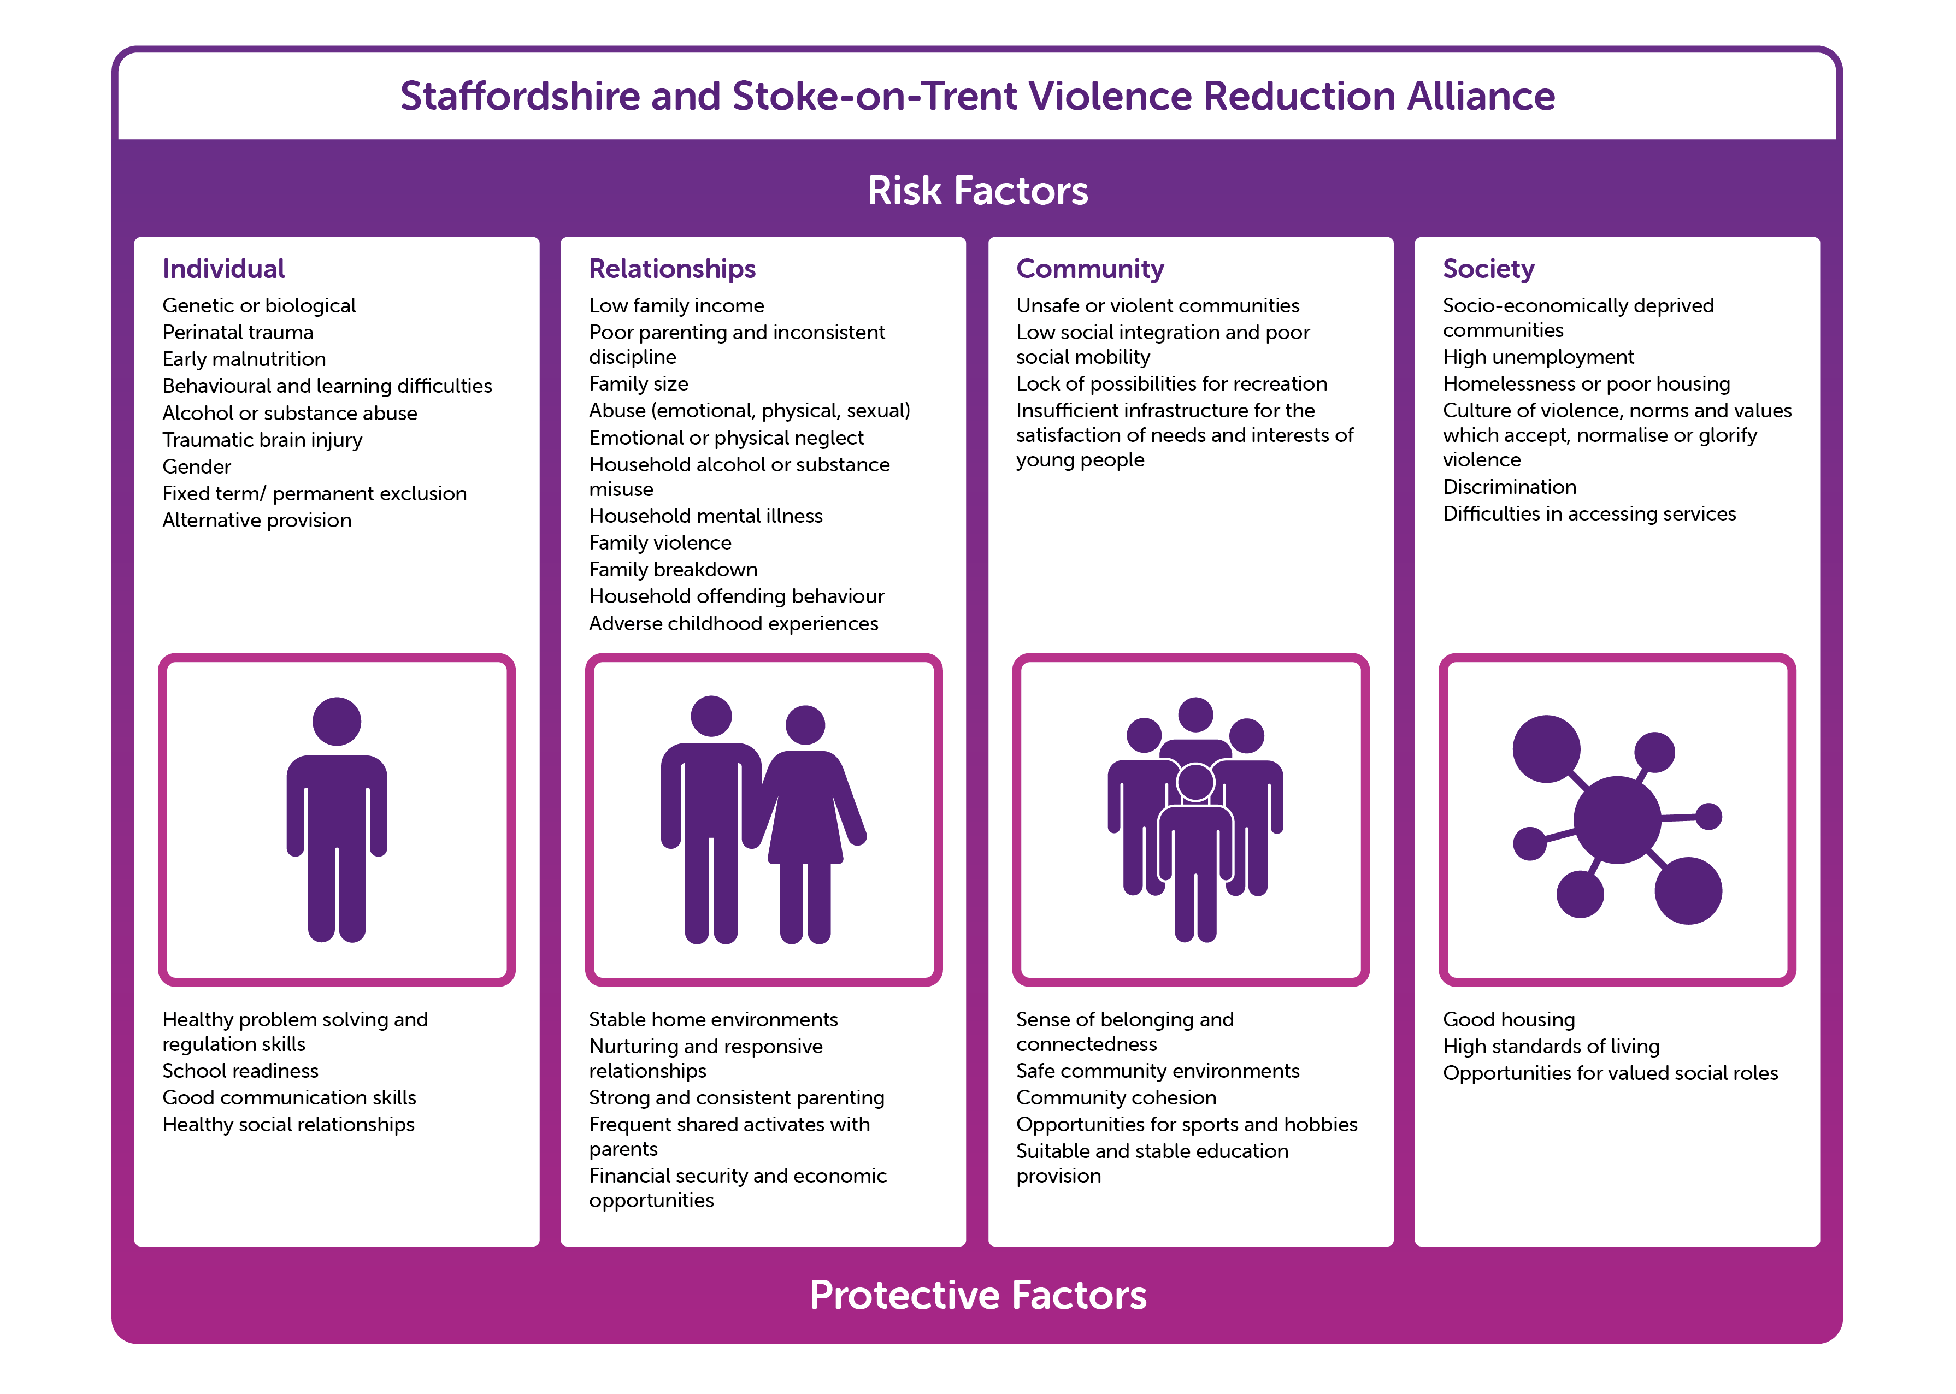

Slide 7
Importance of Development We have focussed predominantly on early intervention and prevention in our Roadshow as evidence suggests:
Early life experiences shape the development of brain circuitry and help to determine the makeup of a person’s intelligence, emotions, and personality.
Trauma exposure has been linked to a significantly increased risk of developing several mental and behavioral health issues—including post-traumatic stress disorder, depression, anxiety, bipolar disorder, aggression/violence and substance use disorders.
  Source: Child Welfare Information Gateway - https://www.childwelfare.gov/pubs/braindevtrauma/.
And research now suggests that Adolescence ‘extends to mid-20s
The Transition to Adulthood Alliance (T2A), in a submission to at 2016 Parliament justice select committee on young adult offenders said there was an “irrefutable body of evidence from advances in behavioural neuro-science that the typical adult male brain isn’t fully formed until at least the mid-20s, meaning that young adult males typically have more psycho-social similarities to children than to older adults”.
The justice select committee report added: “Those parts of the brain influencing maturity that are the last to develop are responsible for controlling how individuals weigh long-term gains and costs against short-term rewards.
This is related to offending behaviour however the issues of brain development are also relevant to young adult victims of exploitation. It is suggested that this is not reflected in services.

Slide 8
Trauma into adulthood
“The experience of adversity in childhood can make some adolescents particularly vulnerable to harm and that the effects of such harm can persist into adulthood, this means that there will likely be a proportion of adolescents who either need to transition directly into receiving support from adults’ services, or who are more likely to require them later in life”. Director of Research in practice
Young people who may have been both victims and perpetrators of exploitation during their childhood may be seen purely as perpetrators within adults’ services.
“Research shows that unresolved trauma (such as witnessing serious violence) can increase risks later in adulthood and we know that not responding to harms in early adulthood can mean that people have more difficult and painful lives, and may need more expensive support later.”
Some local authority areas have developed their work with police, trading standards, local housing providers, hospitals and GPs about the support needs of young adult victims. In addition there is a gradual move to looking at a 0-25 approach for children who have been criminally and sexually exploited, so it’s the same for young people with special education needs and disabilities.

Slide 9
County Lines target vulnerable people
The Home Office suggest some of the factors that heighten a person’s vulnerability include:
  having prior experience of neglect, physical and/or sexual abuse;
  lack of a safe/stable home environment, now or in the past (domestic violence or parental substance misuse, mental health issues or criminality, for example);
  social isolation or social difficulties;
  economic vulnerability;
  homelessness or insecure accommodation status;
  connections with other people involved in gangs;
  having a physical or learning disability;
  having mental health or substance misuse issues;
  being in care (particularly those in residential care and those with interrupted care; histories).
‘Cuckooing’ is also used as a form of exploitation of vulnerable adults.

Slide 10
Transitional and Adult Safeguarding
Nationally, chief social workers highlight gaps in support for young adult victims:
  The annual report (2020) from England’s chief social workers for adults suggest a priority of the need to safeguard young people when the turn 18, particularly from sexual and criminal exploitation.
  “Transitional safeguarding” is needed in order to raise awareness of the issue and ensure young victims of exploitation do not lose support when they are 18.
  Although arrangements exist to support the transition of young people receiving services under the Children Act to the Care Act to determine needs on turning 18 – this is more usually for children with disabilities rather than those who have been criminally/sexually exploited or experienced serious violence.
  There is a view that the Care Act allows Local Authorities to ‘do this work’ if they interpret the Care Act as such, on the basis that many victims do have care and support needs.

Slide 11
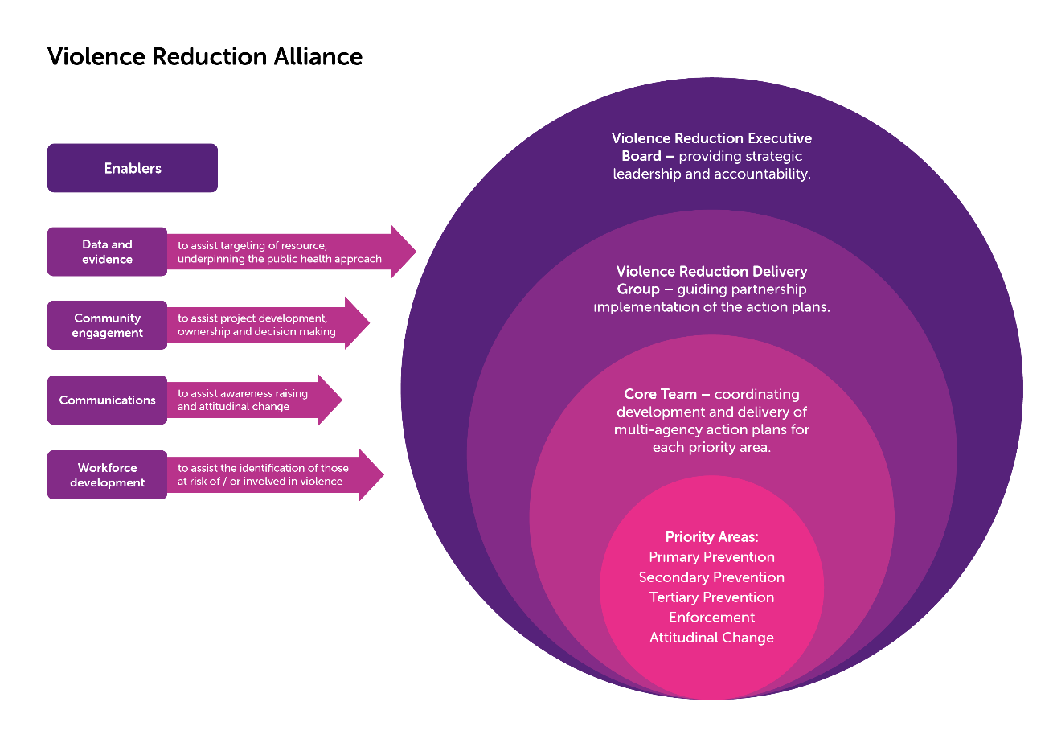

Slide 12
Progress Against the Strategy
Multi-agency Actions
Programme Lead and Analyst
Initial Needs Assessment
Child Criminal Exploitation Service and Lived Experience
Multi-Agency Exploitation Panels
Adverse Childhood Experience Conference
PSHE Education Coordinator
Communication Strategy
Policing Resource.
Other partner support

Slide 13
Next Steps
Establish a Core Strategic Team
  to further develop our local approach (in addition to the Executive Board and Delivery Group.
  Comprising Programme Lead, Police Team, Priority Leads for each priority area, Analyst, Community Engagement, Communications, Business Support, Voluntary, Community and Faith Sector, Workforce development, PSHE link - (PH, Education, Early Help, other public sector as appropriate)
The Core Strategic Team to:
  Use the work undertaken to date to build the approach and work plan
  Identify resource needs to meet gaps / work plan
  Engage academic input to aid research and evaluation
Approach:
    Provide strategic oversight, leadership
    Facilitate a co-ordinated, partnership approach, enabling earlier intervention / proactivity
    Balance bottom up / top down approach and promote community involvement.
    Take a targeted and needs led approach, balancing county-wide and geographical needs
    and responses
    Take account of imminent related legislation

Slide 14
The ‘Ask’
Sign up to the partnership approach to violence reduction, supporting both the Serious Violence Strategy and development of the Violence Reduction Alliance (taking through internal governance processes where appropriate).
Ensure that strategic needs assessments (e.g. JSNA, CSP), where appropriate, refer to risk factors, levels of violence and criminal exploitation.
Identify violence and exploitation reduction as a specific priority.
Recommend that this Board receives regular reports on the progress of delivery of the Serious Violence Strategy and development of the Violence Reduction Alliance.
Align current action plans and resource to provide a coordinated public health approach to violence reduction/exploitation.
Identify resource and/or funding to support the work of the Violence Reduction Alliance – addressing some of the identified gaps.
Proactively support and identify resources to implement the Serious Violence Strategy in phased manner, drawing on the collective resource of the partnership, adopting a proportionate and enabling approach against need and to deliver against the priorities.
To support the Alliance to act as a best practice exchange, supporting the partnership to build violence reduction evidence based practice into service provision.

Slide 15
Contact
Thank you
For listening
To the representatives from each of your organisations who have supported the progress this far.
Naomi Smith, Programme Lead – Serious Violence – naomi.smith@staffordshire-pfcc.pnn.gov.uk and Mobile -07766 092120
Jon Rouse – Chief Executive, Stoke-on-Trent City Council – jon.rouse@stoke.gov.uk

