Slide 1


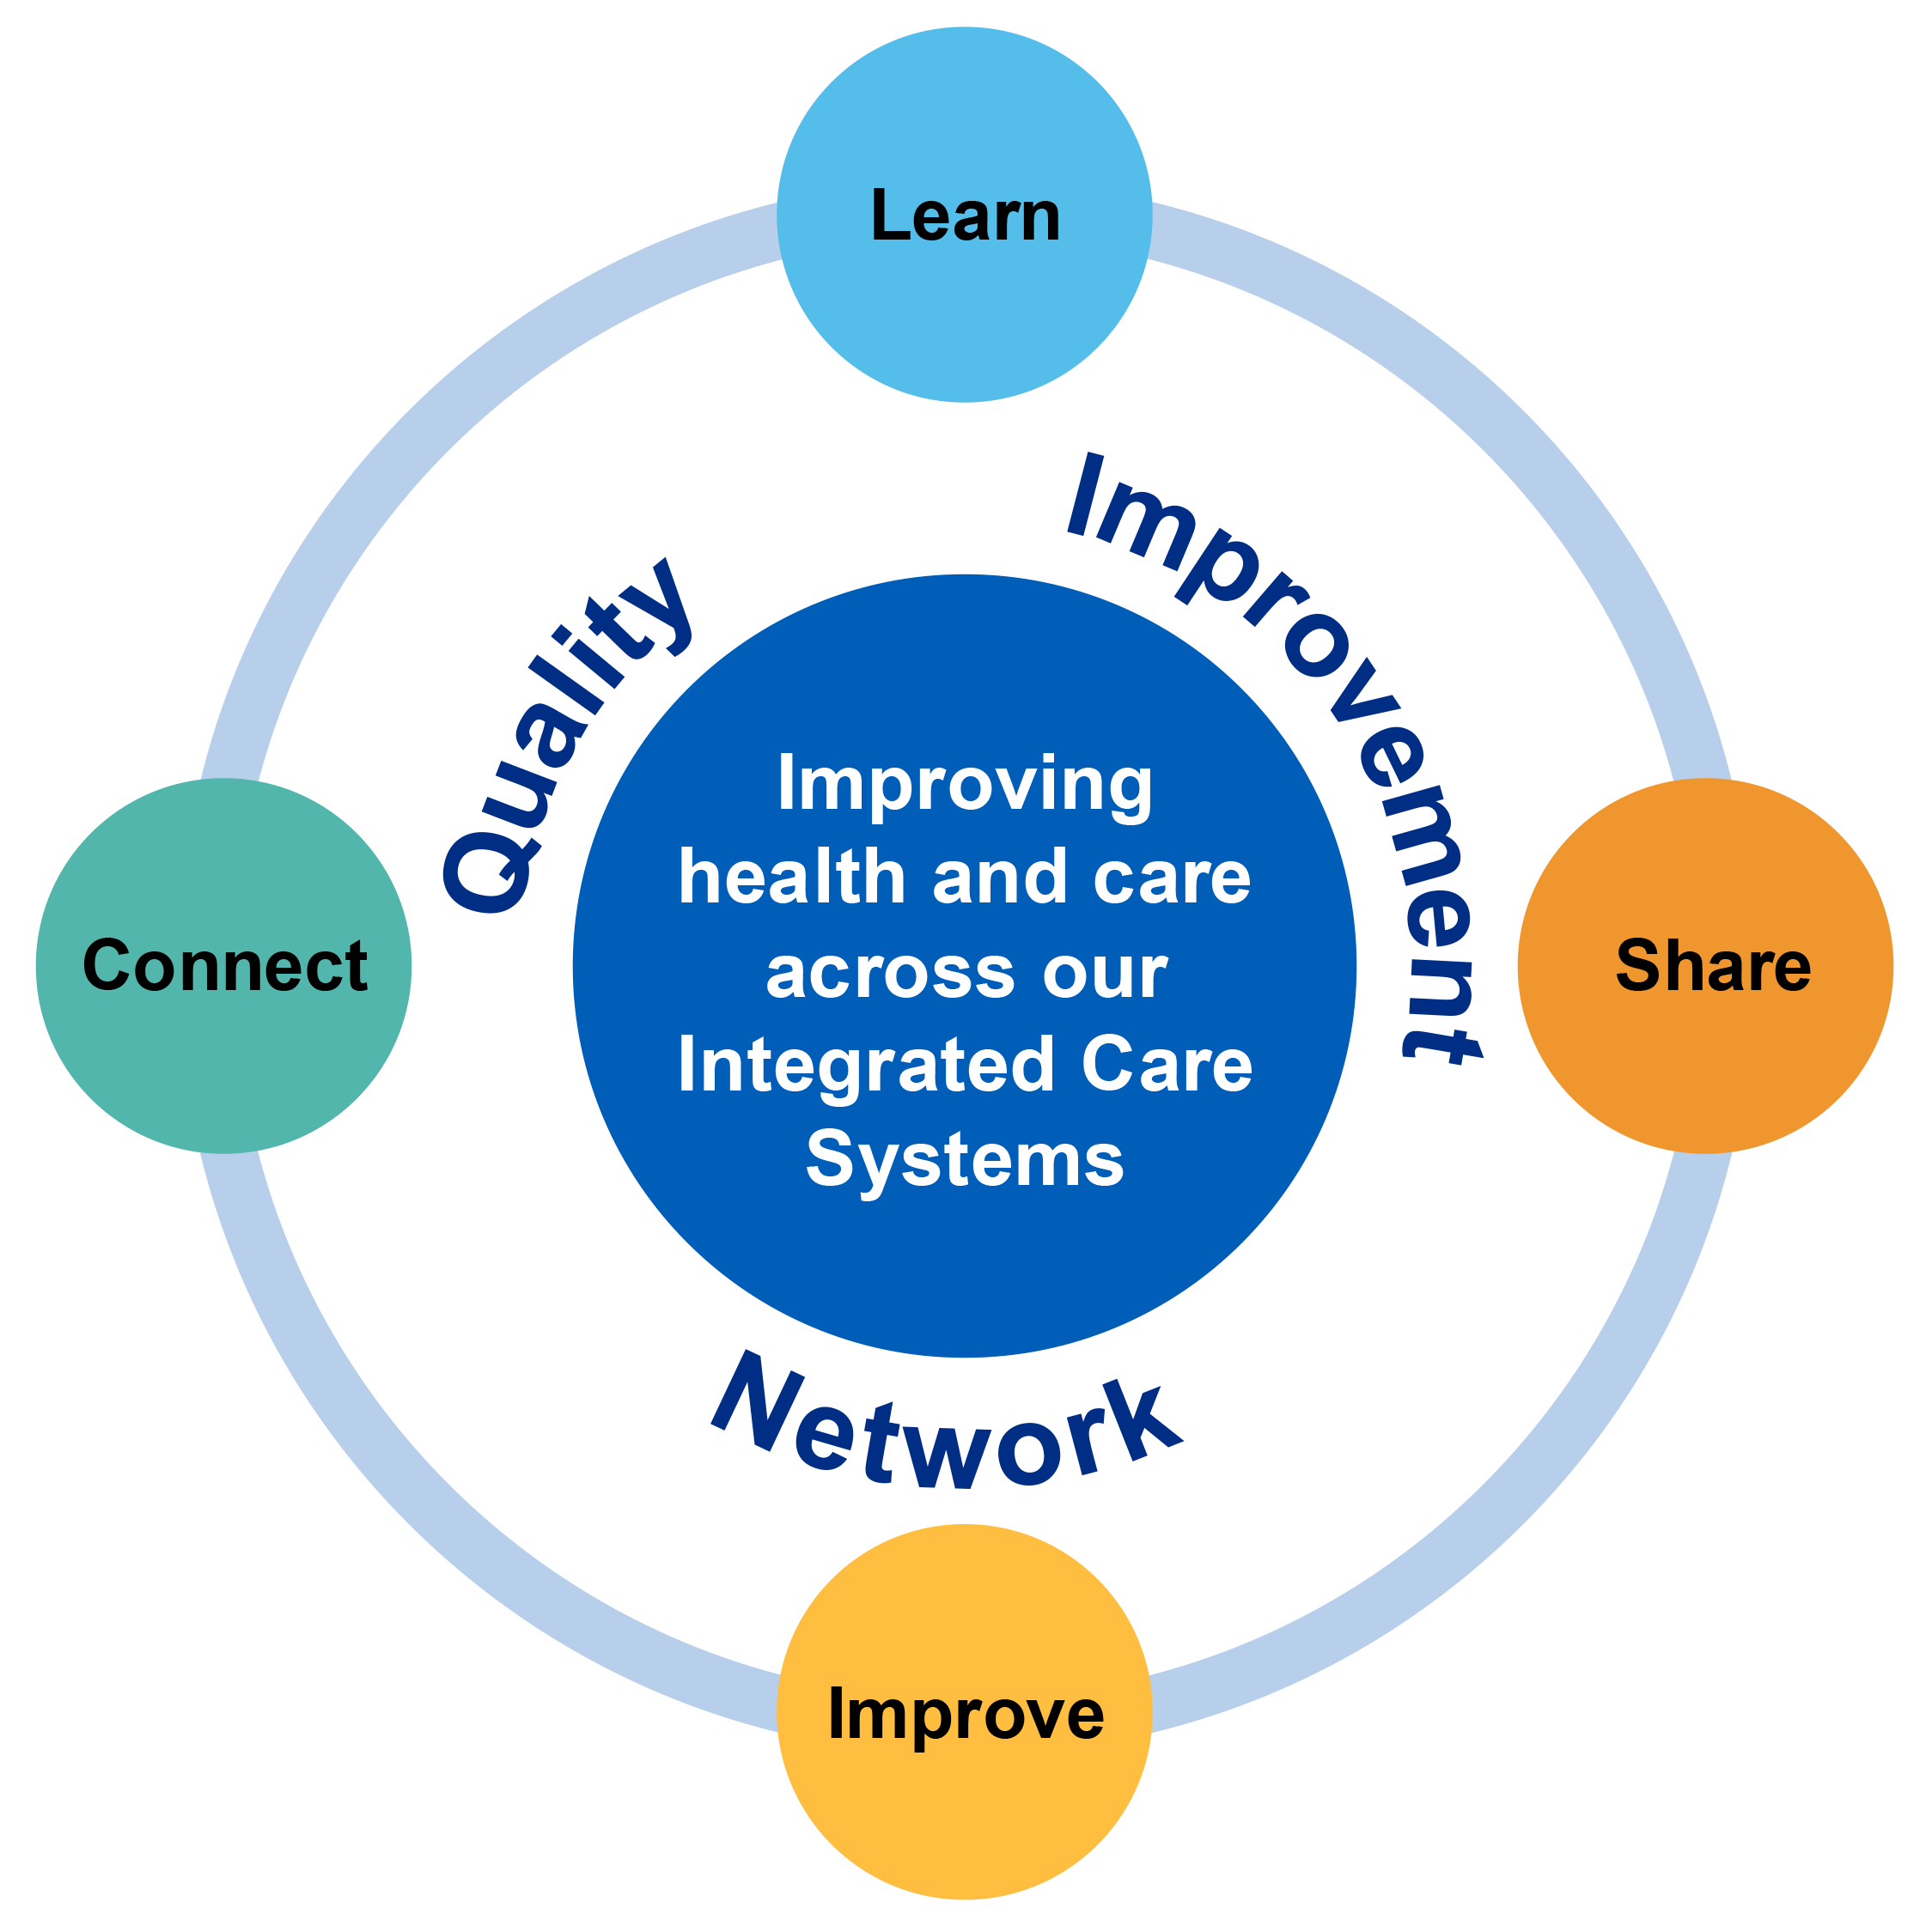

Quality improvement network
16 October 2025
11.00am to 12noon
An online MS Teams event
“Leading
Through
Change ”
Connect – with networking and breakouts
Learn – through our micro teach section
Share – conversations, case studies and story sharing together
Improve – striving to make things better
Join this growing networking by emailing
systemcqi@mpft.nhs.uk

