Slide 1
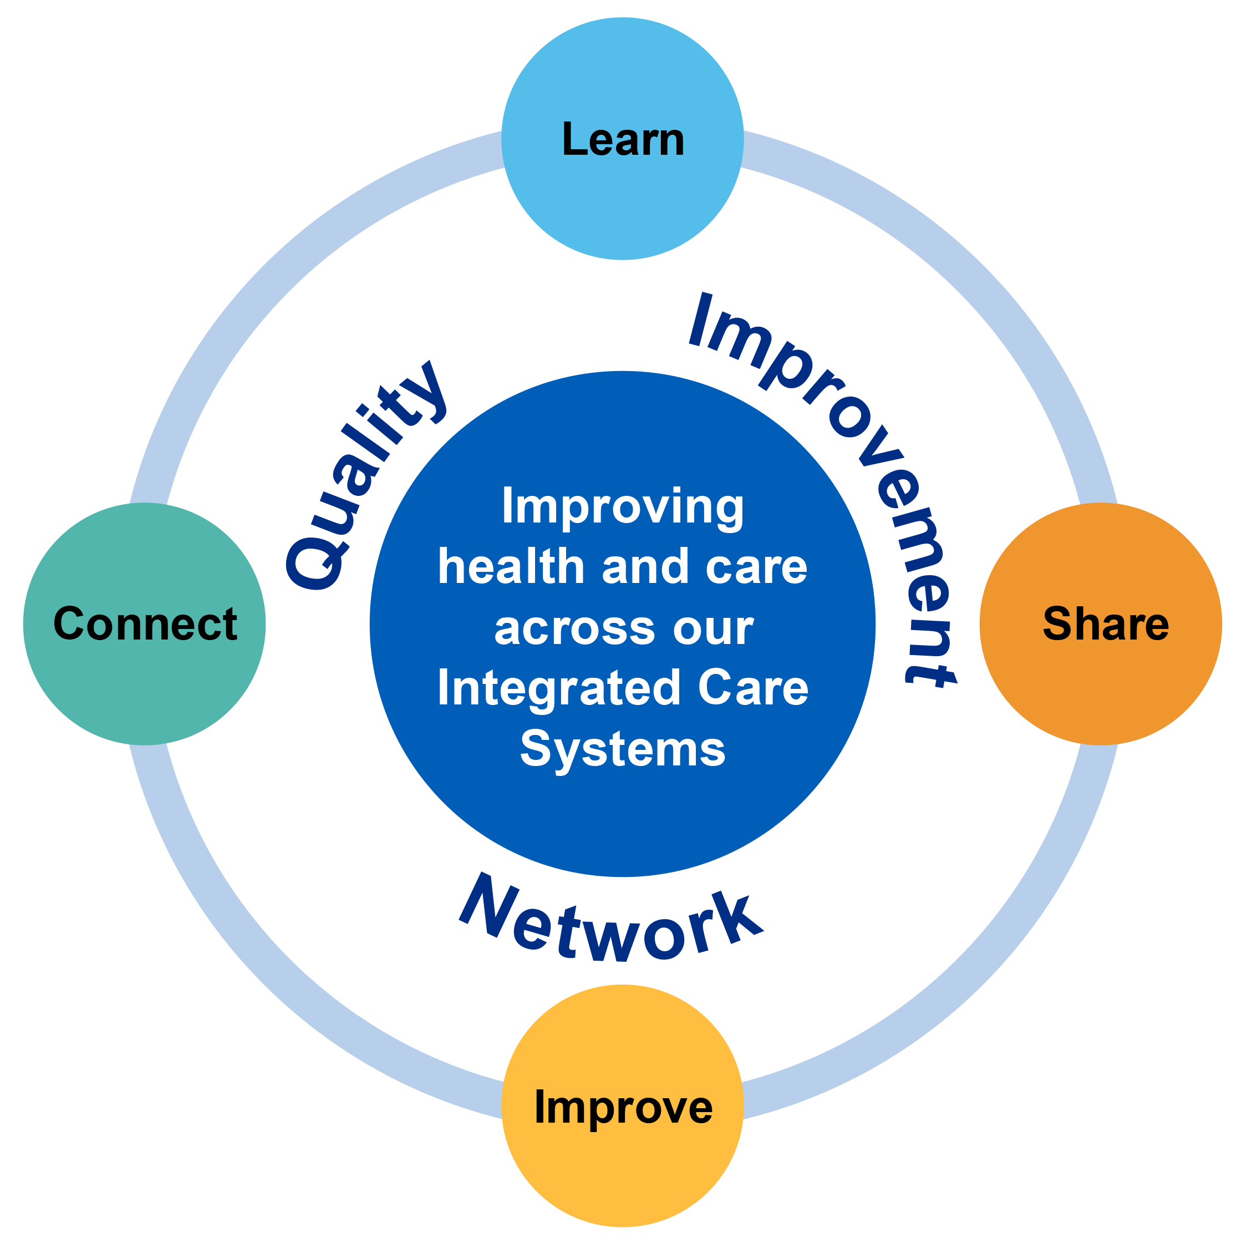
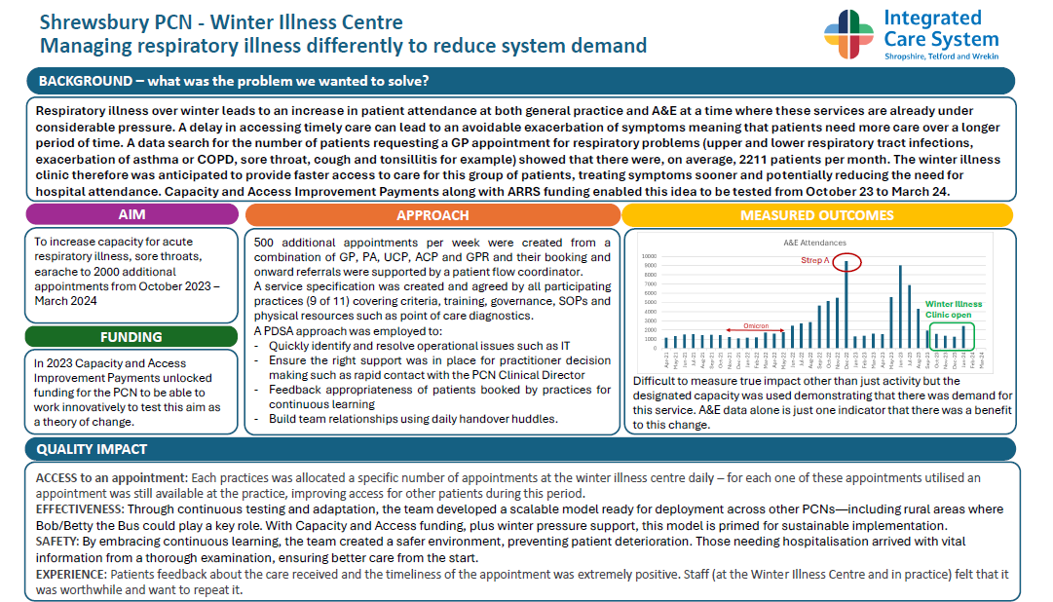


Quality Improvement Network
Quarterly Update
(Issue 11)
10 April 2025
Annual Share and Learn Event
Sharing our stories of success
Our 13th Quality Improvement Network provided an opportunity for us to pause to join together to share our improvement achievements, reflect on fellow Network members experiences and give thought to how we could all adapt and adopt some of this improvement thinking into our own areas of work. We had record numbers join this live event, with over 100 Network members joining us. We all benefited from hearing other perspectives and experiences and were able to connect, learn, share and improve together.
An overview of the stories shared
Case Studies
Winter Illness Centre
A story from Shrewsbury Primary Care Network, by Charlotte Hart and Nicky Durrant
This is an improvement initiative led from Primary Care, to improve the management of respiratory illness to reduce system demand, using a PDSA approach to test, adapt and adopt an improvement into a model ready for deployment across other Primary Care Networks. Respiratory illness over winter leads to an increase in patient attendance at both general practice and A&E at a time where these services are already under considerable pressure. The aim of this project was to increase capacity for acute respiratory illness, sore throats, earache to 2000 additional appointments from October 2023 – March 2024
Diabetic Screening Service – improving engagement and attendance
A story from the Diabetic Screening Service (MPFT) by Jade Freeman
This team-initiated service improvement focused on increasing engagement by targeting those people who were not accessing services in clinical settings. Through a process of testing new ideas and seeking out every learning opportunity, the service were able to make demonstrable improvements against KPI’s that directly improved outcomes for people using their service. QI methodology and support did not guide this work however you will see from the story that there is a clear application of QI thinking.
Reducing Incidents of Violence and Aggression in an inpatient setting
A story from the Midland Centre for Spinal Injuries (RJAH) by Anne Worrall
A Quality Improvement initiative with a staff focus. There is evidence of QI thinking throughout, with a clear aim and data to measure impact. The project had a focus on education being the driver for improvements in reducing the number of Violence and Aggression incidents on an inpatient setting.
Stroke Quality Improvement for Rehabilitation – Improving Lives After Stroke
A story from South East Staffs Community Stroke Team (MPFT) by Hayley Grice, Dominic Ellington and Alison Wootton
This project used Quality Improvement to design, test and evaluate a new stroke pathway through a funded initiative. The aims of the work were to increase direct referrals and reduce the time to initial assessment to 3 days. The work is great example of how a range of QI tools and thinking can be used within a pilot / service redesign.
Additional event links for members:
Video recording from this event
Presentation slide set
Annual Survey seeking member feedback
Our Next Network Event:
17 July 2025 @ 1pm
Demand and Capacity and how Quality
Improvement techniques can support this
All enquiries welcome to
Email: systemcqi@mpft.nhs.uk
For more resources, videos and case studies from all of our Networks visit our Continuous Quality Improvement pages (click logos to view) :

