Slide 1
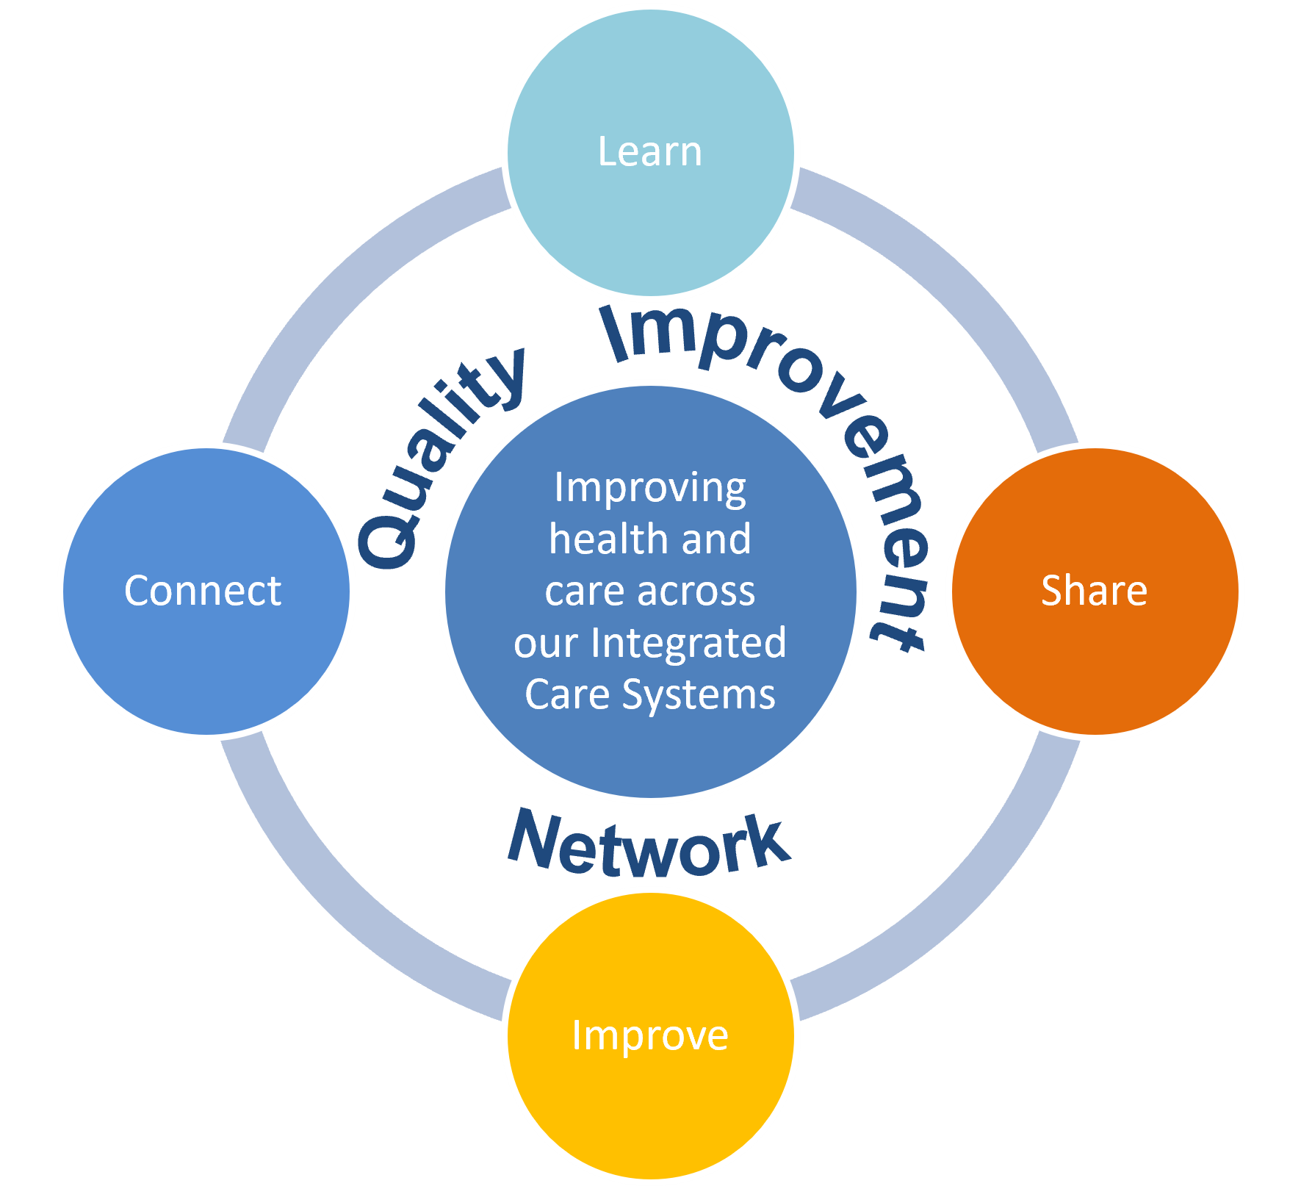




Quality Improvement Network
Quarterly Update
(Issue 12)
17 July 2025
“Demand and Capacity”
Our 13th Quality Improvement Network explored how understanding and managing demand and capacity can inform and support Quality Improvement across our health and care systems. Over 90 Network members joined the live event, which was co-developed and co-facilitated by John Costello of Midlands Partnership University NHS Foundation Trust and Nicky Durrant of Shropshire, Telford and Wrekin Integrated Care Board. The session followed the Network’s core principles to connect, learn, share and improve.
The aim was to build confidence through shared knowledge, practical examples, and networking opportunities. In the true style of Quality Improvement, this aim was measured, with a participant poll, at the start of the event, asking members how confident they were in undertaking demand and capacity exercises, This provided a ‘temperature check’ at the start of the session, with this same poll repeated at the close of the session, enabling us to measure the impact of learning. The results of these polls showed improved confidence levels among attendees, indicating the positive impact of the event.
The Learning: Nicky led us through understanding and measuring demand, capacity​​ and variation. ​Members were shown a 3-step approach to managing demand and capacity, that involves:
​
Understand Variation: Use run charts & daily data to identify patterns​
Reduce (Smooth) Variation: ​In capacity: Adjust rotas, training schedules, and room use​ & in demand: Spread planned activities more evenly​
Match Capacity to Demand: Adjust appointment types, lengths, and timing; use skill mix
We concluded the learn section by exploring how demand and capacity supports Quality Improvement by helping us to understand the system, identify bottlenecks and variation, support data driven decision making, practice continuous improvement and enhance how people experience our services. We finished by exploring the importance of understanding and managing Failure Demand, with some practical strategies on how to minimise the impact.
Application of Learning into our areas of work:
90% of our members said they were going to apply their learning into their areas of work. This was a really positive outcome to celebrate. To support our members in this application of learning we are pleased to provide the following resources and links:
Find our top tips to support and guide follow up work from this session here (click to view)
Video recording from the event
Presentation slide set
Support and tools, such as value stream maps,
run charts and time observations forms can be found
via the links below at:
  Demand and Capacity – a comprehensive guide
  QSIR
  NHS England
For more resources, videos and case studies
from all of our Networks visit our web spaces by
clicking the logos below:
Or ask us directly for guidance and support at
SystemCQI@mpft.nhs.uk
Our Next Network Event - 16 October 2025 @ 10.30am – “Leading for Improvement”
“An online MS Teams event - all Network members will automatically receive a diary invitation
Email: systemcqi@mpft.nhs.uk

