Slide 1

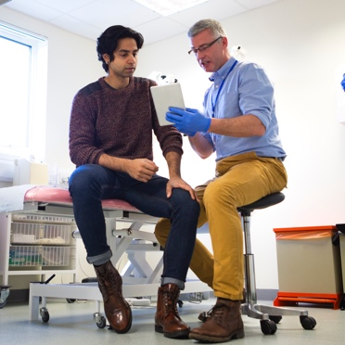

Staffordshire and Stoke-on-Trent Integrated Care Board
Annual General Meeting
26 September 2024
4pm - 6pm

Slide 2


Meeting guide for members of the public
All cameras should be off, except for the Chair and those presenting items on the agenda
Please make sure your microphone is on mute during the meeting
Questions submitted via email in advance of the meeting will be addressed by the Chair during the Question-and-Answer session
Please ‘raise your hand’ on Teams, if you would like to ask a question ‘live’ during this session of the agenda.

Slide 3
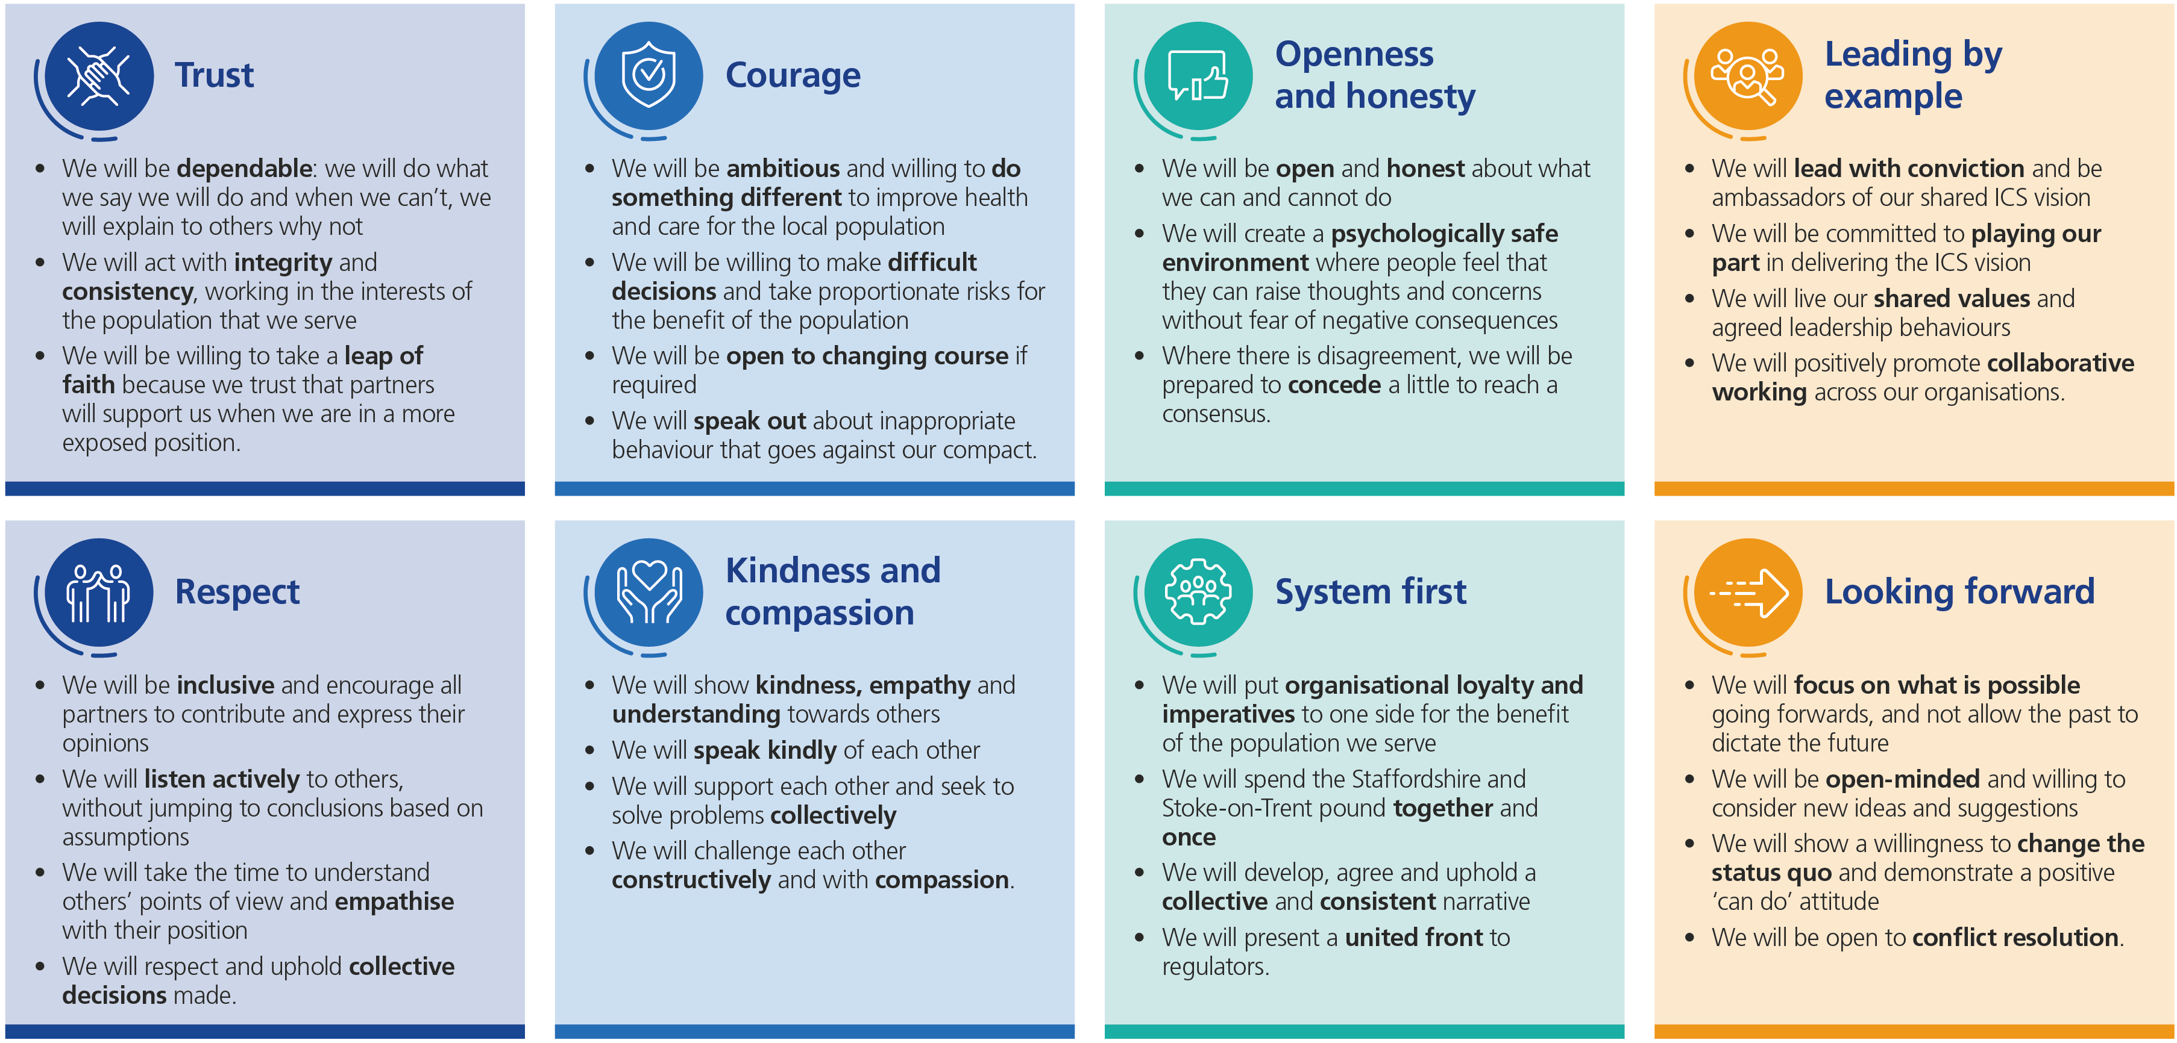
ICB Partnership Leadership Compact

Slide 4
Agenda
Time | Item | Description | Presenter
4:00pm | Welcome | Welcome to the Staffordshire and Stoke-on-Trent Integrated Care Board’s Annual General Meeting (AGM) | David Pearson
4:05pm | Annual Reports and Accounts | System Evolution Operational Update Primary Care System Finance and Accounts Workforce Quality and Safety | Peter Axon Phil Smith Paul Edmondson-Jones Paul Brown Gemma Treanor Heather Johnstone
5:05pm | Patient Story | Continuing Healthcare | Claire Underwood Paul Garner
5:10pm | Looking Forward | Portfolios, Provider Collaboratives, Place Integrated Care Partnership update | Nicky Harkness Paul Edmondson-Jones Lynn Millar
5:30pm | Public open session | Q&A session | David Pearson
5:55pm | Closing remarks | Annual Report Summary | David Pearson

Slide 5
System Evolution
Peter Axon, Chief Executive Officer

Slide 6
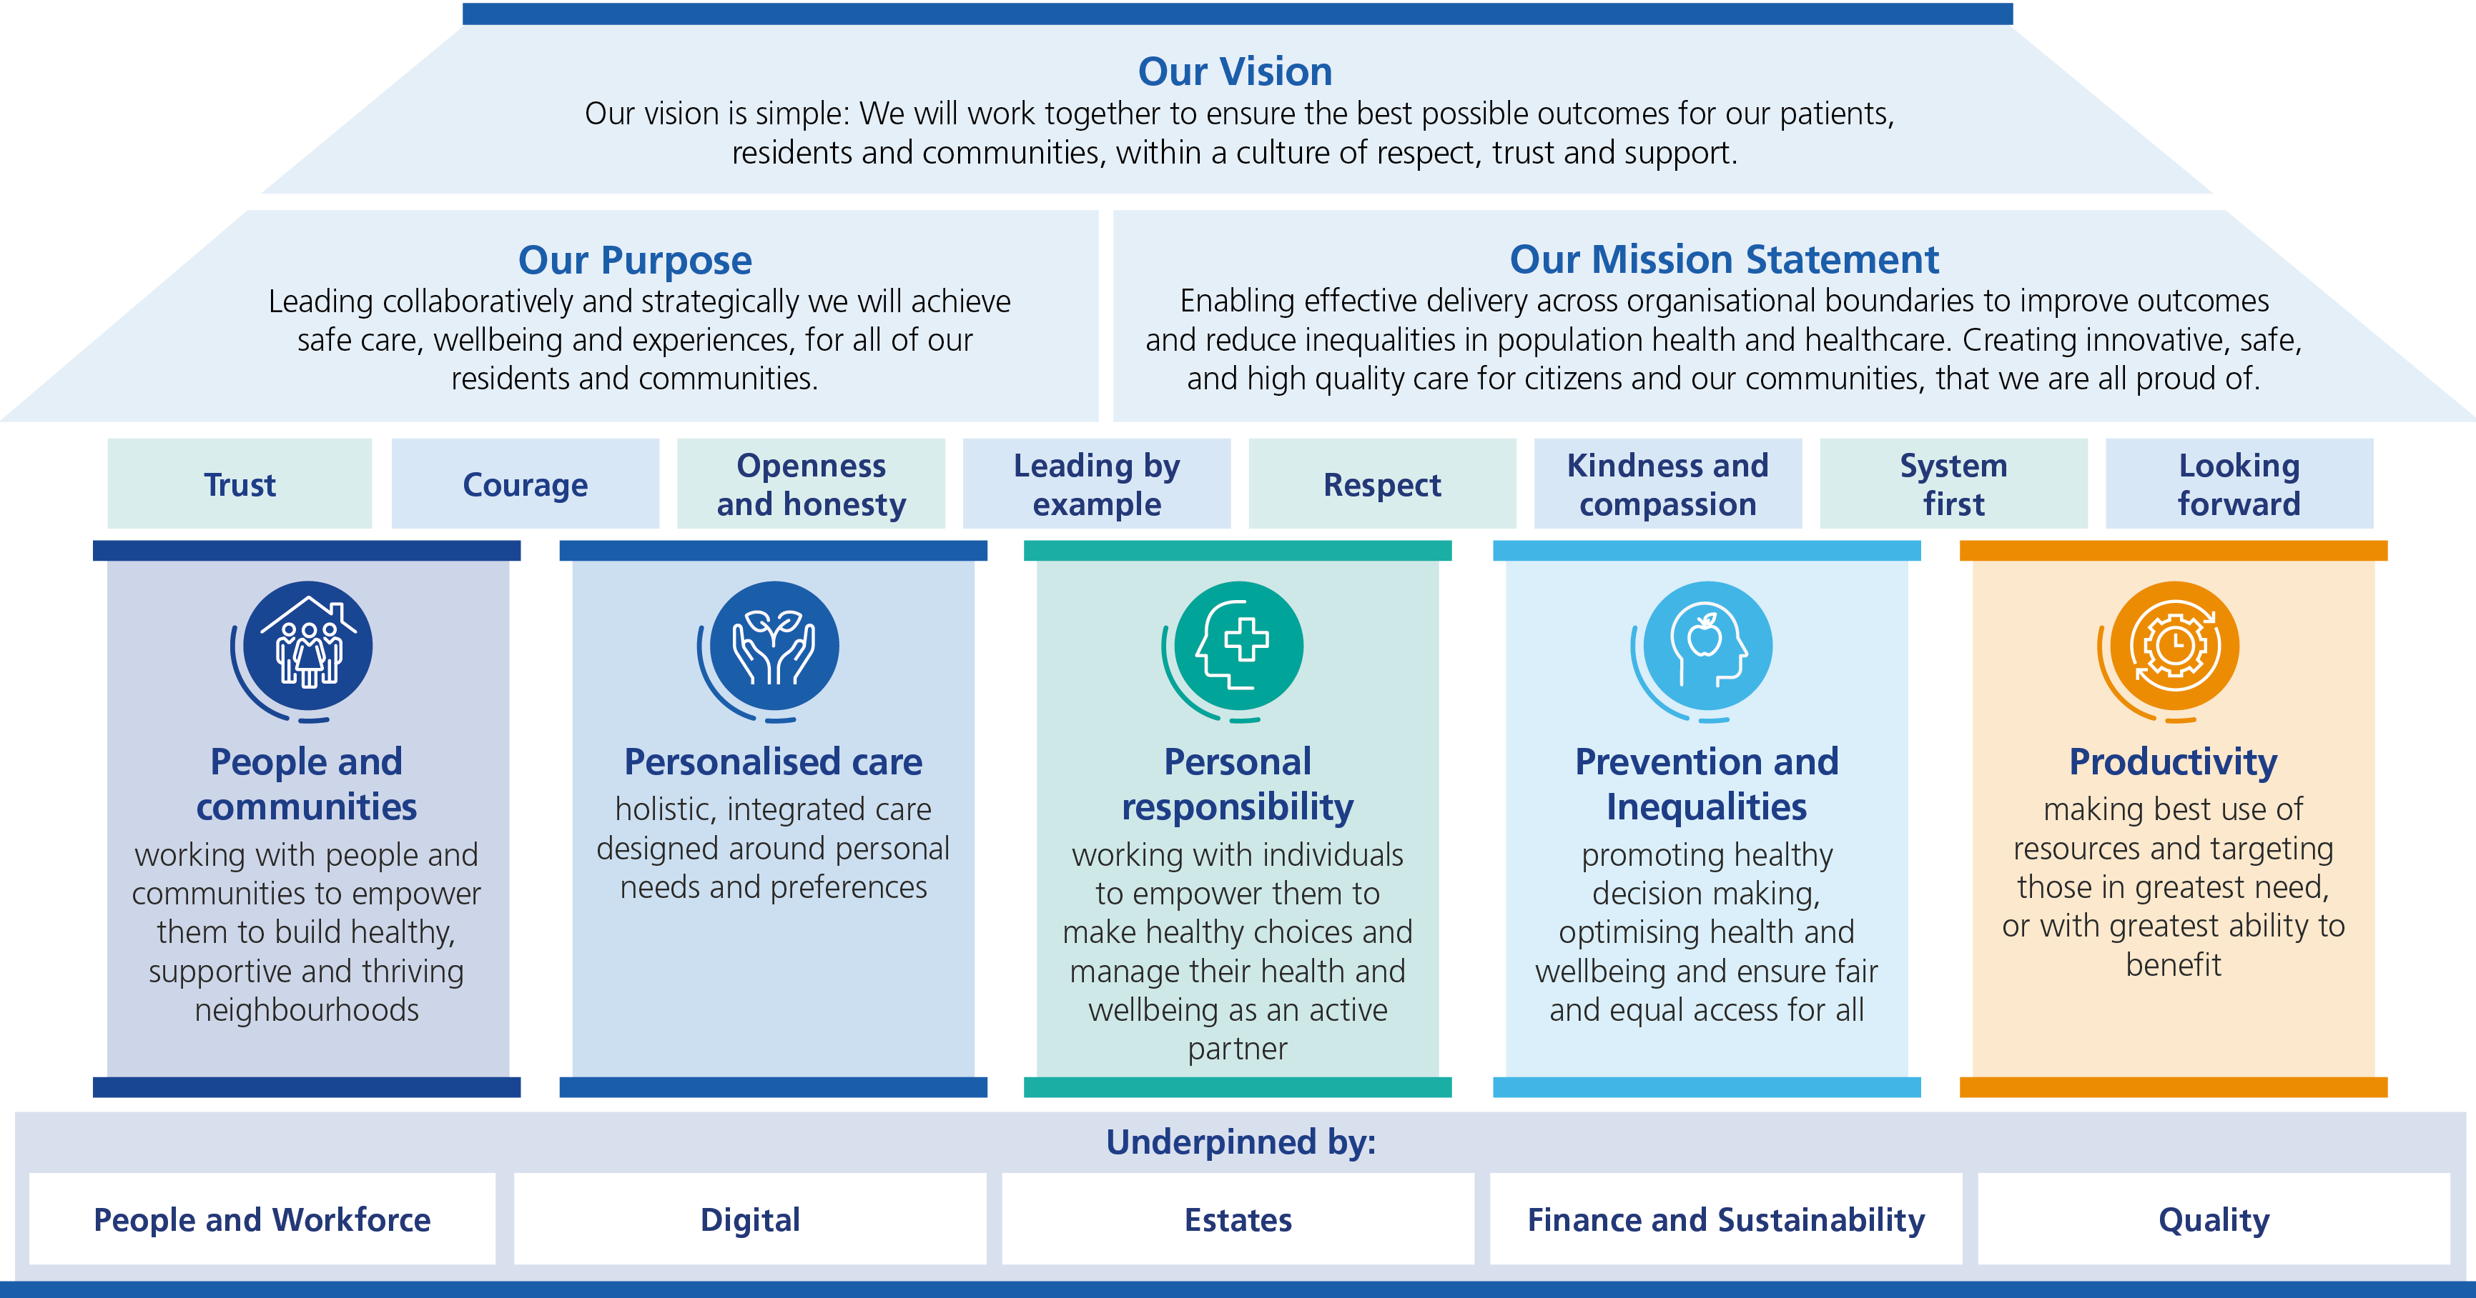
Integrated Care Board Strategy on a Page

Slide 7
System Operating Model Overview
Provider
and System collaboratives
Place
Portfolios
Portfolios are clinically orientated with a system wide focus. They bring together organisations responsible for planning and commissioning health and care services
Place involves NHS,
local government and providers of health and
care services working
to support the health
and wellbeing of local populations
The operating models primary aim is to balance the implementation of transformation and redesign and the maintenance of business as usual
Collaborative partnerships bring agencies together (in and out of system, NHS and non NHS) to work together at scale, focussing on the delivery of system-wide aims

Slide 8







ICS Portfolios
Improving Population Health
Planned Care and Cancer
Children and Young People and Maternity
Urgent and Emergency Care
End of Life, Frailty and
Long-Term Conditions
Mental health and Learning Disabilities
and Autism
Primary Care
Exec Sponsor: Tim Clegg (SBC) /Dave Heywood (SSC)
SRO: Dr Paul Edmondson Jones (ICB)
Portfolio Director: Lynn Millar (ICB)
Clinical Director:
TBC
Exec Sponsor: Simon Constable (UHNM)
SRO: Helen Ashley (UHNM)
Portfolio Director: Hayley Allison (ICB)
Clinical Director:
Dr Gary Free (ICB)
Exec Sponsor:
Jon Rouse
(SoTCC)
SRO: Elizabeth Disney (ICB)
Portfolio Directors:
Nicky Bromage
(CYP) (ICB)
Lynn Tolley (Maternity) (ICB)
Clinical Director:
Dr Paul Edmondson-Jones (ICB)
Exec Sponsor:
Pat Flaherty
(SCC)
SRO: Matthew Lewis (UHNM)
Portfolio Director:
Hayley Allison (ICB)
Clinical Director: Dr Steve Fawcett (ICB)
Exec Sponsor:
Neil Carr (MPFT)
SRO:
TBC
Portfolio Director: Nicky Harkness (ICB)
Clinical Director: Dr Rachel Gallyot (ICB)
Exec Sponsor:
Dr Buki Adeyemo (NSCHCT)
SRO:
Ben Richards (NSCHCT)
Portfolio Director:
Nicky Bromage (ICB)
Clinical Director: Dr Waheed Abassi (ICB)
Exec Sponsor: Peter Axon (ICB)
SRO: Dr Paul Edmondson Jones (ICB)
Portfolio Director: Sarah Jeffery (ICB)
Clinical Director: TBC

Slide 9





Examples of working in collaboration (1)
5 system wide collaboratives have formed to focus on improvement.
  Continuing Healthcare – improving quality of experience and outcome for individuals, enabling personalisation and reducing the reliance on care through a focus on reablement and prevention – helping people to live independently for longer.
  Demand management – ensuring that our reactive (urgent and emergency care) service offer is operating in an optimal way.
  Enabling Functions – ensuring that our support functions are as efficient as they can be including a focus on our estate.
  Clinical value and medicines – ensuring that we remove unwarranted variation in how we provide clinical services.
  Contracts – including repatriation of services to in-county providers of healthcare.

Slide 10
Examples of working in collaboration (2)
We are proud to have been shortlisted and to have won a number of awards this year. They are covered in more detail in the Annual Report.
The People Function and Staffordshire Training Hub were highly commended at the HSJ Partnership Awards
East Staffordshire Primary Care Network won the ‘Embedding research award’ in the Clinical Research Network Awards
The People Function were highly commended in the HSJ Digital Awards, and three other teams were nominated for different categories
The Learning Disability and Autism team and the Homeless Healthcare Service were shortlisted for two BBC Radio Stoke’s Make a Difference Awards
The ICS was shortlisted for ‘Governance Project of the Year’ at the Chartered Governance Institute of UK and Ireland Awards
We were nominated for a Healthcare Financial Management Association (HFMA) Governance Award in recognition of our integrated approach to risk management and board assurance
Pauline Grant, Associate Director, Organisational Development was a finalist in the International Positive Psychology Association Intervention Design Challenge.
Notes:
Awards
The People Function and Staffordshire Training Hub were highly commended at the HSJ Partnership Awards
East Staffordshire Primary Care Network won the ‘Embedding research award’ in the Clinical Research Network Awards
The People Function were highly commended in the HSJ Digital Awards, and three other teams were nominated for different categories
The Learning Disability and Autism team and the Homeless Healthcare Service were shortlisted for two BBC Radio Stoke’s Make a Difference Awards
The ICS was shortlisted for ‘Governance Project of the Year’ at the Chartered Governance Institute of UK and Ireland Awards
We were nominated for a Healthcare Financial Management Association (HFMA) Governance Award in recognition of our integrated approach to risk management and board assurance
Pauline Grant, Associate Director, Organisational Development was a finalist in the International Positive Psychology Association Intervention Design Challenge.
We are proud to have been shortlisted and to have won a number of awards this year. They are covered in more detail in the Annual Report.
Detail:
Highly commended: Health Service Journal Partnership Awards
The Staffordshire and Stoke-on-Trent ICS People Function and Staffordshire Training Hub have recently been awarded highly commended in the ‘Primary care project of the year’ category at the HSJ Partnership Awards.
The award recognises outstanding dedication to improving healthcare and effective collaboration with the NHS.
Award win: Clinical Research Network Awards
East Staffordshire Primary Care Network (PCN) celebrated winning the ‘Embedding research award’ in December 2023. The Clinical Research Network Awards recognise and celebrate the work and achievements of those involved in delivering research from across the system.
East Staffordshire PCN is made up of all 18 GP practices in East Staffordshire and covers 150,000 patients, with a focus on local patient care. The PCN appointed a research manager to enable efficient regional-level identification of participants for research, and to set up research structures and frameworks within the PCN.
Shortlisted: Health Service Journal Digital Awards
The ICB and the ICS have been shortlisted for some awards in the 2023 HSJ Digital awards. Although we didn’t win, the People Function were highly commended for the ‘Improving back-office efficiencies through digital’ award.
Other nominations included:
Staffordshire and Stoke-on-Trent ICS People Function for the ‘Enhancing workforce engagement, productivity and wellbeing through digital’ award
Staffordshire and Stoke-on-Trent ICB and MedOptimise Limited for the ‘Generating impact in population health through digital’ award
Staffordshire and Stoke-on-Trent ICS and Health Navigator (HN) for the ‘Improving urgent and emergency care through digital’ award.
Award nomination: BBC Radio Stoke’s Make a Difference Awards
Two specialist NHS teams in Staffordshire and Stoke-on-Trent were shortlisted as finalists in BBC Radio Stoke’s Make a Difference Awards in May 2023.
The Learning Disability and Autism team were shortlisted in the ‘Together’ category for the work they have done with parents to try and help young people with autism or a learning disability stay out of hospital and in their own home.
The Homeless Healthcare Service work across Stoke-on-Trent and Newcastle-under-Lyme to support homeless people who are not registered with a GP. They were shortlisted as a finalist in the ‘Community group’ category.
Award nomination: Governance Project of the Year
In November 2023, the ICS was shortlisted for ‘Governance Project of the Year’ at The Chartered Governance Institute of UK and Ireland Awards. Each year, the awards recognise and celebrate excellence in governance and annual reporting.
Over the last two years, the ICS and partners have been working collaboratively on system-wide governance matters – including repositioning the ICB’s Risk Management Framework and Board Assurance Frameworks as an outward-looking ICS-wide approach.
This work has been commended by NHS England and featured by the Healthcare Financial Management Association (HMFA) as an exemplar case study for system risk management.
Award nomination: Healthcare Financial Management Association (HFMA) Governance Award
The ICS was nominated for the ‘Integrated approach to risk management and board assurance’ award. All partners now play a greater role in assessing risk and developing mitigations.
Finalist: International Positive Psychology Association (IPPA) Intervention Design Challenge
Pauline Grant, Associate Director, Organisational Development at North Staffordshire Combined Healthcare NHS Trust and Staffordshire and Stoke-on-Trent ICS, was a finalist in the IPPA’s fifth annual Positive Organisational Intervention Challenge.
Pauline was presented with recognition of her outstanding submission at the IPPA’s World Congress, held in Canada. Her submission was titled ‘Addressing differential attainment through a positive psychology lens: Introduction of a strengths-based inclusive mentoring workshop for clinical educational supervisors’.

Slide 11


Collaborative leadership
  ICB Boards showcase a unique structure within the NHS, bringing together leaders from across a system to hold equal responsibility on the Board.
  A focus on Board Development is therefore key, ensuring that this cross agency group of leaders function as effectively as possible.
  Work has included development of our “Leadership Compact” and a focus on “psychological safety”. All ensuring that we operate as a team to solve system wide complex problems.
  Coming together is a beginning, staying together
  is progress, and working together is success
  Henry Ford.

Slide 12
Operational Update
Phil Smith, Chief Delivery Officer

Slide 13
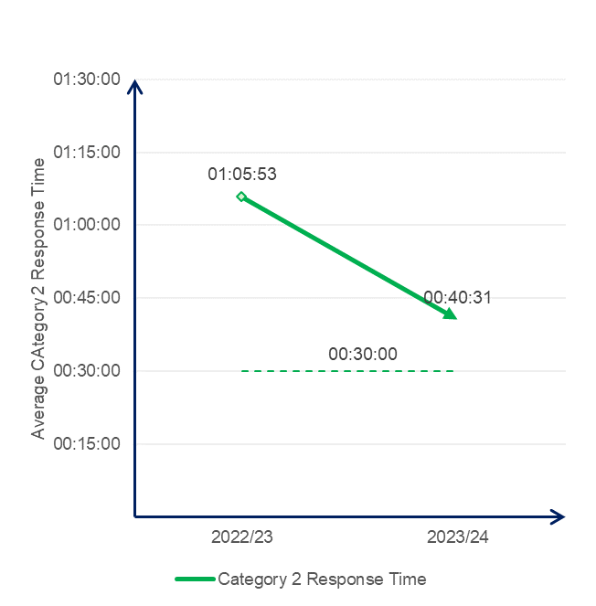
System performance – Urgent and Emergency Care
4-hour ED Performance
Performance against the target to see ED patients within four hours increased by 4% for the year 23/24 achieving 67.25%, with March 2024 achievement being 70.2% for the month. Significant further improvements have been reported during 24/25 to date.
12-hour Performance
The number of patients spending 12 hours or longer in ED reduced significantly by 9.8% to 8.76% for 23/24 across UHNM footprint. Further improvements noted in 2024/25 year to date.
Ambulance Category 2 Performance
Ambulance Category 2 performance for the system saw a 39% reduction in mean response time, down to 40 minutes and 31 seconds for the year when compared to 22/23 performance of 1 hour 5 minutes and 53 seconds. Further improvement has been reported in 2024/25 to date with average response times below 30minutes reported consistently.

Slide 14
Operational update – Urgent and Emergency Care
System Workforce
Plan
System Escalation Plan
Capacity
System Surge Plan

Slide 15
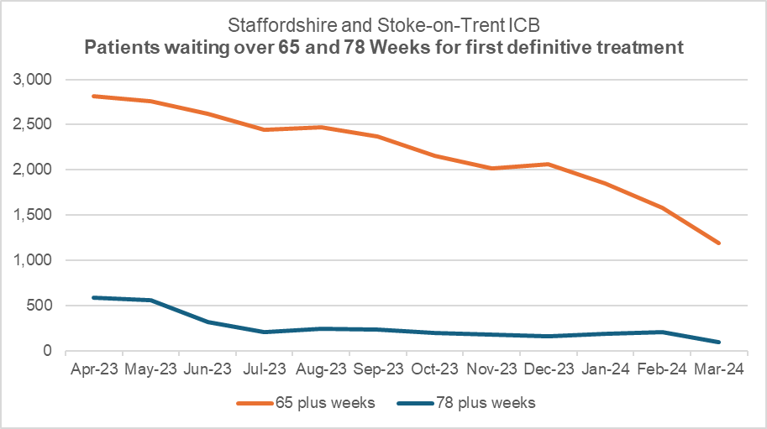
System Performance - Planned Care
Elective
Services have had difficulties recovering to pre-COVID-19 levels due to ongoing challenges – including high levels of urgent medical admissions and the impact of industrial action.
In 2023/24 the ICB can report significant progress in reducing the elective backlog across the whole system as we work to achieve zero long-wait targets:
  366,536 patient treatments were completed (admitted and non-admitted patients)
  78-week wait patients - reduced from 589 in April 2023 to 101 in March 2024
  65 –week wait patients - reduced from 2,812 in April 2023 to 1,190 in March 2024
Reducing waiting times
The data in the chart above relates to the whole of the SSOT population, whether treated within or outside of the Staffordshire border; and includes treatment by independent sector providers.

Slide 16
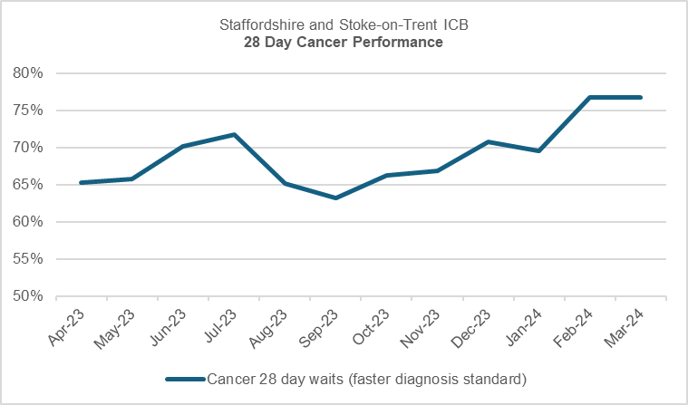
System Performance – Planned Care
Cancer
The national 75% Cancer Faster Diagnostic Standard (FDS) was achieved
Patients waiting over 62 days for Cancer treatment improved by approximately 50%.
Diagnostics
Three Community Diagnostic Centres (CDC) in SSOT:
  Cannock Chase Hospital, Cannock – March 2024
  Sir Robert Peel Hospital, Tamworth – March 2024
  Hanley, Stoke – premises due to open in 2025.
Improving time to treatment
The data in the chart above relates to the whole of the SSOT population, whether treated within or outside of the Staffordshire border;
and includes treatment by independent sector providers.

Slide 17
Primary Care
Paul Edmondson-Jones, Deputy CEO and Chief Medical Officer

Slide 18
Primary Care 2024/25 Priorities
1. Improving health outcomes via collaborative working across primary care and system partners
2. Provision of safe
and high-quality services within all Primary Care Services
3. Improving access to Primary Care (including patient experience)
Primary Care 2024/25 Priorities
4. Reduce variation
and commissioning universal access to services
5. Ensure fit for purpose estate provision, maximising shared space and digital alternatives
"Business as Usual" workstreams

Slide 19
Primary Care
6.4 million appointments in General Practice (7% increase
on last year)
78 practices using FibriCheck – an app used to monitor patients heart rhythm to detect and monitor arrhythmias using a smartphone.
21,000 consultations were undertaken in Community Pharmacist Consultation Service (CPCS) in 2023/24
PCNs have recruited to 616 new posts to support the primary care workforce, these included Pharmacist, Physios, Mental Health Practitioners, Paramedics, Advanced Nurses…
657,155 winter vaccinations given - 61% by GPs
Engaged with Local Medical Committee (LMC) regularly to ensure the GP voice is listened to and involved in primary care transformation
422 Practice Friendly Schemes in place eg Dementia Friendly, Daffodil Standards, Veteran Friendly, Safe Surgeries.
82% of people with Learning Disability had a completed annual health check that’s over 5000 people and 194 more than last year
Safely and effectively commissioned a caretaker to
run the Gordon Street practice
in Burton

Slide 20
General Practice Patient Satisfaction
76.3%
90.4%
52.2%
45.1%
said their overall experience of their
GP Practice was good (National – 73.9%)
said their needs were met at their last appointment (National – 89.9%)
said it was easy to contact their GP Practice by phone (National – 49.7%)
said it was easy to use NHS App to contact their GP Practice (National – 44.8%)
70.2%
81.3%
60%
88.9%
had a good overall experience of contacting their GP Practice (National – 67.3%)
of appointments took place within 2 weeks from first contact (National – 77.7%)
of appointments were with a GP (National – 65%)
had a good overall experience of using pharmacy services (National- 86.8%)
7.0%
used a pharmacy due to a referral from their GP Practice, NHS 111 or A&E (National – 7.3%)
73.5%
reported a good overall experience of NHS dental services (National – 69.2%)
Notes:
The national survey is conducted annually and provides a snapshot of patient experience at a given time. GP practices then use the results to improve patient experience.
In SSoT ICB 48,880 questionnaires were sent out, and 15,177 were returned completed. This represents a response rate of 31%.
Significant changes were made to the questionnaire to ensure that it continued to reflect how primary care services are delivered and how patients experience them, therefore the 2024 results are not comparable with previous years due to changes which have been made to the survey:
The ICB scored higher for a number of questions in the survey compared to national response.

Slide 21



Delegation of Pharmacy, Optometry and Dentistry
Developing a local dental plan
Recovery from COVID-19
Improving recruitment and retention
Ability to rebase contracts and shift activity where needed
Using Health Equity Audit
to prioritise
Optometry
Special schools programme (free NHS eye tests)
Quality in Optometry
Maximising Pharmacy First
7 common conditions enabling patients to get certain prescription medications directly from
a pharmacy without a GP appointment
Notes:
Responsibility delegated to ICBs on 1st April 2023
Decision making at local level to meet the triple aim – better health for everyone, better care for all patients, efficient use of NHS resources
Better design services around local communities
Office of the West Midlands Team supporting our responsibilities

Slide 22
System Finance and Accounts
Paul Brown, Chief Finance Officer

Slide 23
System Finance and Accounts
Paul Brown, Chief Financial Officer
Where we spent our money in 2023/24
In addition to the £2.7bn above, the NHS Provider Trusts based in Staffordshire generated £932m of income from other sources, meaning that the total spend in 2023/24 was £3.6bn.

Slide 24


How we performed against our targets
Description | Target | Achievement
Management Costs | Not to exceed the target set by the regulator | tick
Revenue Resource Limit | Not to exceed the target set by the regulator | cross
Cash | Cash Balances held at 31st March 2024 are less than 1.25% of the amount drawn down in March 2024 | tick
Better Payment Practice Code | Over 95% of suppliers are paid within 30 days both in value and volume | tick
MHIS | Expenditure on Mental Health Services has increased by at least the % increase in overall resources when compared to 2022/23 | tick
Across the Financial year the Integrated Care Board overspent against the allocation of Patient Services of £2.7bn by £91m. This deficit was within the financial envelope agreed with NHS England covering 2023/24.

Slide 25
Structural Financial Challenge
Financial Period | Financial Deficit
2013/14 – 2019/20 *Six Clinical Commissioning Groups | £298.72m
2020/21 – 2021/22 *Covid period | £Nil
2022/23 –2023/24 *Integrated Care Board | £91.09m
Total Cumulative Deficit | £389.81m
The Staffordshire Health Economy has faced a financial challenge over many years. The six Clinical Commissioning Groups were superceded by the NHS Staffordshire and Stoke-on-Trent ICB in 2022 having spent over £298.72m more than the resources allocated to them since their inception in 2013.
The Integrated Care Board continues to face those same challenges exacerbated by recent inflationary pressures, interest rate rises and increased demand for patient services.

Slide 26



Current Financial Situation and Outlook
Challenge
The 2024/25 financial plan is to deliver a £90m deficit
Significant risks to this position
Outlook for 2025/26 and beyond is extremely challenging
Our Approach
Focus on patients and
patient pathways
Evidence that the best outcomes lead to the optimal financial solution
Recovery plan has been agreed to improve patient pathways for people requiring Continuing Healthcare and for the +75-age cohort
Notes:
Paul to give an overview of the accounts – deficits, targets etc.

Slide 27
Workforce
Gemma Treanor, Head of ICS People Function

Slide 28

People, Culture and Inclusion
Context
National
Long Term Workforce Plan
Skills for Care Workforce Strategy
Funding – no workforce development funds
Financial challenges
Darzi report
Local
Financial position
Operational pressures – efficiencies, productivity, recovery, strikes, surge
Ability to meet the requirements of the Long Term Workforce Plan
Workforce supply and future pipeline – in the financial context
Strike and collective action
Wellbeing and retention of our workforce
Equality, Diversity and Inclusion agenda – including civil unrest

Slide 29









Staffordshire and Stoke-on-Trent NHS: July 2024
NHS Workforce
Temporary Workforce
8.0%
12 Month Rolling KPI’s (%)
24,080
Total Workforce
Turnover Rate
8.9%
WTE
Agency Spend
£3.2M (3.0%)
Currently -1.6% (Mar24)
Currently +1,129 wte (Aug23)
Currently -1.1.% (Jan24)
22,155
5.4%
Sickness Absence Rate
Substantive
Currently -£1.5M (Aug23)
Vacancies
2,238 wte (9.2%)
WTE
Currently 12-Month High
Currently +1,266 wte (Aug23)
Mandatory Training
1,518
Joiners
185 wte
Currently -663 wte (Aug23)
93.8%
Bank
WTE
Currently +0.9% (Nov23)
Currently +116 wte (Sep23)
Currently +20 wte (Jun24)
Leavers
135 wte
AFC Appraisal Rate
86.6%
407
Agency
WTE
Currently -107 wte (Mar24)
Currently +9.4% (Dec23)
Currently -151 wte (Aug23)
80.1%
Medical Appraisal Rate
Other Health and Care Workforce
Currently -4.7% (Mar24)
279 WTE
2,872 WTE
20,000 WTE
610 Headcount
SSOT ICB Workforce
Primary Care Workforce
Social Care Workforce
Dentistry Workforce
Staffordshire and Stoke-on-Trent Integrated Care Board
29

Slide 30
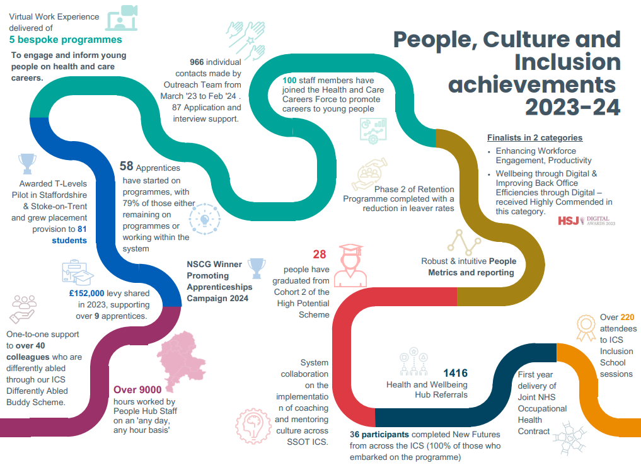
People, Culture and Inclusion achievments 2023-24

Slide 31
















Journey to Work
SSOT Journey to Work describes our approach to attracting, training and retaining our workforce; and the areas we will focus on collaboratively at a Place level.
The model supports:
Partnership working to develop the One Workforce approach with NHS, Primary Care, Councils, Social Care and Voluntary sectors.
Productivity and innovation will only be gained by sharing our workforce over organisational boundaries.
Supporting our local population to access jobs and careers, reducing health inequalities and improving population health.
Attracting and training a different type of local workforce.
Increased support into entry level jobs for local people.
Looking after our people to keep them well and with us.
College and University engagement
to strengthen clinical education pathways and access to courses at all levels
Outreach and inclusive recruitment activities – working with refugees
& seldom heard communities
Developing new
non-registered opportunities and access to jobs
for people
NEW 2 CARE
Offering workplace learning initiatives including
T-Levels & Apprenticeships
Looking after our people with psychological and
wellbeing services
Secondary School Engagement - Virtual Work Experience Programmes
Primary
School
careers Engagement
linked to CYP physical & mental health offers
Clear and
accessible, innovative
system wide career pathways - joint funded roles, rotations, careers across boundaries
Improving employee experience leading to better
retention
Developing leaders and securing our talent pipeline
Equality, Diversity Inclusion and Compassion as a Golden Thread
Notes:
Mish

Slide 32

Current and Future Programme Focus
All underpinned by our Journey to work model, our current and future focus will be on:
System workforce planning and data – including Social Care
Future workforce pipeline, raising aspirations in young people
Widening Participation and Access to jobs – representing our local communities
Supply and attraction into health and care careers
Anchor Employer – linked to population health and our fourth aim
The Journey IN Work for our whole system workforce
Education, Training and Development
Experience, Health and Wellbeing, Retention
Leadership and Culture and Organisational Development (OD)
Equality, Diversity and Inclusion
Delivering People Services at Scale
Strengthening partnership working, involvement and governance

Slide 33
Quality and Safety
Heather Johnstone, Chief Nursing and Therapies Officer

Slide 34

Quality Strategy on a Page
Our Quality Vision is to ensure that services provided are safe, effective, and meet the needs of the population, providing the best experience and outcomes possible.
The clinical priorities of the quality strategy are to address and work to improve quality in:
Health inequalities
An increasing population of people with complex health
and care needs
An increasing demand on primary care and variation in access
An increasing unplanned and emergency care demand
The recovery of elective and cancer care services
Quality outcomes:
People with lived experience are actively involved in service design, development, delivery, and evaluation.
So:
Reducing health inequalities and variation especially as there are multiple diversities in population and cultures.
The promotion of safe care ensuring care is of a high quality, safe and accessible to all our population.
So:
Aligned Quality Improvement principles will guide change at all levels.
We have capacity and capability for evidence-based health and care.
System collaboration will generate new learning and insights.
Improving staff experience.
So:
There is a culture of transparent sharing and learning.
Staff have the time and tools to deliver safe care and feel valued and empowered.
A shared system approach to quality and safety
So:
There is collaborative working towards quality across the system.
There is an understanding of what quality looks like with a mutual approach to sharing and escalation of quality concerns and focus on Quality Improvement.
Fair and equitable services for all, building a system for the future.
So:
Reducing health inequalities and variation especially as there are multiple diversities in population and cultures.
We will drive the provision of quality services through a high-quality programme of research and continuous quality improvement.
So:
There are aligned Quality Improvement principles.
The development of develop the capacity and capability for evidence-based health and care.
System collaboration generates new learning & insights.
NHSE Patient Safety
Strategy
NHS IMPACT
Joint Forward Plan
Financial Recovery Plan

Slide 35
Strategic Aim 1
Lived Experiences
People with lived experience are actively involved in service design, development, delivery, and evaluation
01
LeDeR - Learning Disability Mortality Reviews
02
Patient Safety Partner
03
MNVP – Maternity and Neonatal Voices Partnership

Slide 36
Strategic Aim 2
The Promotion of Safe Care
The promotion of safe care, ensuring care is of a high quality, safe and accessible to all
01
Deteriorating Patient Network
02
Quality Improvement Network
03
Improved Quality Impact Assessment for service changes

Slide 37
Strategic Aim 3
Improving Staff Experience
Improving staff experience, promoting a culture of transparency and shared learning
01
Supporting staff wellbeing to ensure they are empowered to deliver and expect high standards
02
PSIRF Shared learning event & future conference
03
Learning from reviews of serious safeguarding cases involving Children and Vulnerable Adults

Slide 38
Strategic Aim 4
Shared approach to Quality and Safety
Shared approach to Quality and Safety
Building services for the future
01
System approach to new Patient Safety Incident response framework and associated learning
02
Maternity Transformation Programme
03
Focus on system wide quality Improvement

Slide 39
Strategic Aim 5
Fair and Equitable Services
Fair and equitable services for all
Collaborative working across the system
01
Quality Committee oversight of reducing inequalities
02
Collaborating with system partners to ensure equal access for all
03
Embracing the diverse make up of our population

Slide 40
Strategic Aim 6
Continuous Quality Improvement through research and evidence-based care
Continuous Quality Improvement
Driving provision of high-quality care through evidenced based practice supported by research
01
Nursing Excellence – ensuring best practice and high standards of care
02
NHS IMPACT – improving patient care together by creating conditions for improvement
03
Implementing the Chief Nursing Officer’s research strategy

Slide 41
Patient Story
Claire Underwood, Director of Nursing, All Age Continuing Care
Paul Garner, Transformation Clinical Lead for Palliative and End of Life Care

Slide 42
Continuing Healthcare
NHS Continuing Health Care (CHC) enables care for individuals over 18 years old who have been assessed as having a primary health need, this then means they are entitled to health care funding to support needs.
CHC Funding includes care for individuals who are approaching end of life. This is nationally known as ‘Fast Track Care’ and is referred to within Staffordshire and Stoke-on-Trent as End-of-Life Care.
Such care helps people to be cared for in their own homes or a care home, depending on their preferred place of care and death.
The Palliative Care Coordination Centre (PCCC) develop and lead this care liaising with all colleagues involved in an individual's care and most importantly with the patient and their loved and important ones.
Right Care at the Right Time in the Right Place with proactive and compassionate coordinated case monitoring supporting patients/families individualised and personalised needs.
Supports safe discharge from hospital and reduces undesired and unnecessary admissions to hospital.
Allows individuals to improve and step down off the Pathway if that is the right thing to do.

Slide 43

Continuing Healthcare continued
78-year-old individual who had a diagnosis of dementia and a complex history of heart disease.
Between March and April 2024 saw 3 emergency visits to Accident and Emergency, being admitted to hospital on 2 of these occasions.
Admission being due to general deterioration
Evidence that during last admission in March that an End-of-Life decision had been made but sadly this was not acted upon effectively with further admission to hospital after this.
On the second admission the approach to end-of-life support was addressed and discharge was arranged to care home of choice within 24 hours.
This then involved ongoing active expert monitoring and support for the patient and their loved ones to ensure as comfortable death as possible.

Slide 44
Feedback
“I wanted to pass on my heartfelt gratitude for all of the work the palliative team has done for my loved one and our family. Stays in hospital were really difficult, nobody really listened, everyone was so busy. That is until the palliative team became involved. From our first conversations, I felt supported. You moved mountains to get my loved one discharged as quickly as possible and to the home we wanted.
Since then, you have called to check on how my loved one was doing and also asked if I had any concerns. Whenever I had any questions and I called you were so lovely, nurse A, so kind, it meant the world to me.
Then there is nurse B .... what can I say? They have been so supportive and so lovely with my loved one. During visits the love and compassion shown to my loved one beamed from them, always commented on Nurse B’s beautiful smile. Nurse B dealt with my needs and completed the checklist and I know did her best for my loved one. It was difficult to hand over the role of carer when full time care was required, and I know I may have come across a little too much at times.
Unfortunately, my loved one passed away peacefully in their sleep on Tuesday morning, in a beautiful room where they had settled well and although I wasn’t there which I wanted to be, I know they would have wanted to go that way, and this gives me peace.
Once again, thank you so so much for all being the genuinely kindest, supportive. loveliest people in the world.”

Slide 45
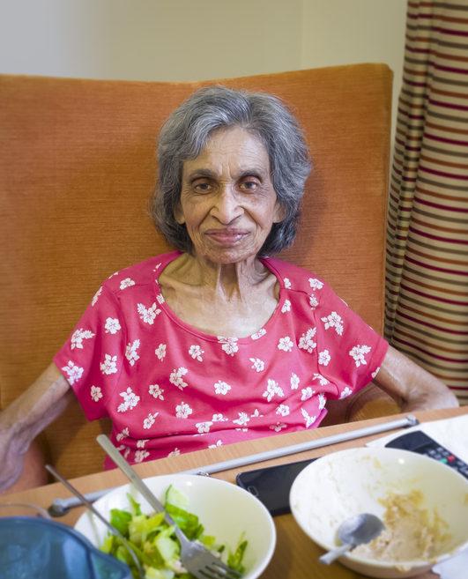
What does this mean?
Makes best and efficient use of appropriate resource.
Still more to do in some cases, to prevent admissions and ensuring timely response to diagnosis.
Improves experience, reduces pain and discomfort.
Allows people to achieve an end they would and may wish for.
Gives choice and control to individuals and their loved ones.
Enables improved comfort and symptom management.
Better advance care planning makes this more likely to happen.
Prevents unnecessary attendances or admissions to hospital.
Allows access to experts in End of Life and Palliative Care for patients and their loved ones.
Supports person centred decision making and personalised care.
Grieving and bereavement process.

Slide 46
Looking Forward
Nicky Harkness, Provider Collaborative Programme Director
Paul Edmondson-Jones, Deputy CEO and Chief Medical Officer
Lynn Millar, Portfolio Director, Improving Population Health

Slide 47








Portfolios and Provider Collaboratives
Provider Collaboratives
Improving Population Health
Planned
Care and Cancer
Children, Young People and Maternity
Urgent and Emergency Care
Our approach to collaboration has worked well across several areas of change that required a multi-organisational approach – for example our System Collaboratives, our Lead provider arrangements across the region for Mental Health Services and Acute collaborations spanning ICBs into Shropshire and Cheshire.
Portfolios
Frailty,
Long-Term Conditions & End of Life
Mental Health, Learning Disabilities and Autism
Primary
Care
Our seven portfolios have continued to plan and deliver tactical and strategic change across the system. We have strengthened our approach to service and performance improvement using population data and need analysis, for example, delivery of services in the north and south of the ICS aimed at preventing the progression of frailty.
Portfolios and the Provider Collaborative remain critical parts of our ICS operating model and the ICB will continue to support their ongoing development as major vehicles for community transformation design and delivery.
Notes:
Nicky Harkness covering this slide

Slide 48
Place
We have continued the strong partnership approach with our two places – Staffordshire and Stoke. In support of our ongoing operating model development, we will continue to build the function of our Joint Commissioning Boards as the vehicles for turning our plans into commissioned services. Throughout 25/26 we will further develop the delivery arms of our places, linking in broader partners at area, locality and neighbourhood levels.
We will focus on transformation of our community services across our geography during 25/26 with a specific view to providing:
Care closer to home
Care that is proactive and preventative
Care that is digitally enabled.
We will begin by developing a core offer for our frail population, including reactive care for severe frailty, proactive care for moderate frailty, and preventative care for mild frailty.
We will use delivery teams at sub-place level to deliver new services.

Slide 49
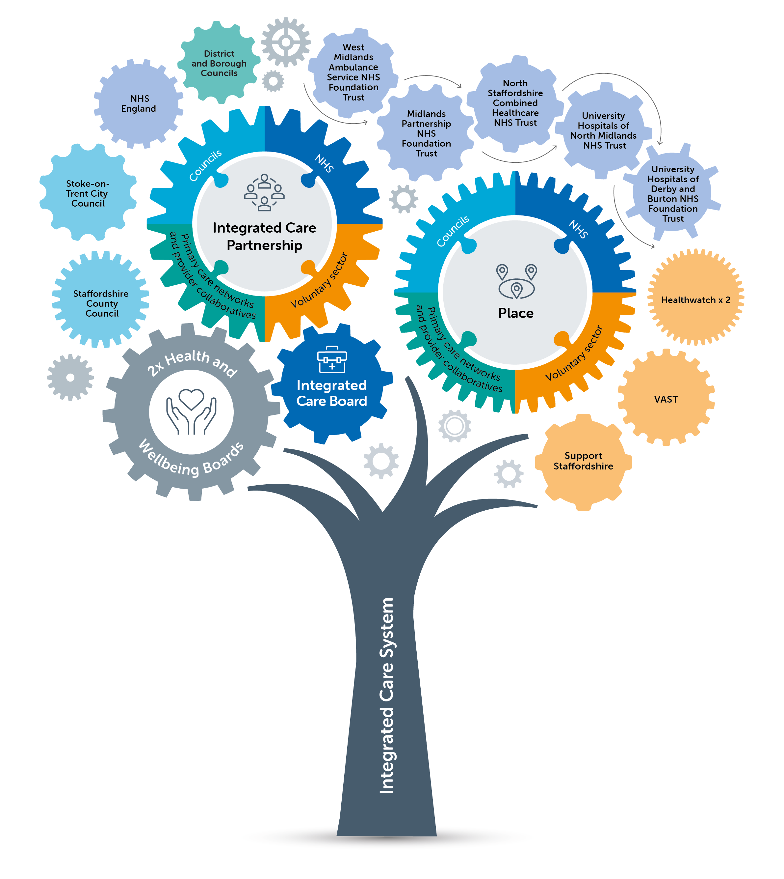
Our Journey
2
Health and Wellbeing Boards and Strategies
2
Overview and Scrutiny Committees for Health and Social Care
2
Healthwatch partners
2
Voluntary sector association partners – with representation on our Board
1
Health and Care Senate – clinical and professional leadership
Notes:
We are reforming how we work across the health and care system to meet the needs of the whole population, with a commitment to empowering decision making at the local level through Place working.
We recognise the significant opportunities for greater integration created by changes across the public sector and partner organisations, connected by an effective, locally owned, integrated system leadership and architecture across all levels and areas.
There are already strong relationships with the two upper tier local authorities, Staffordshire County Council and Stoke-on-Trent City Council, which strengthened during our collective response to COVID-19. We want to embed and further develop effective system working arrangements through our Integrated Care Partnership.

Slide 50

How we are working differently to improve population health
People and communities
working with people and communities to empower them to build healthy, supportive and thriving neighbourhoods
Personalised care
holistic, integrated care designed around personal needs and preferences
Underpinned by Population Health Management (PHM)
Improve population health outcomes through intelligent decision making
Personal responsibility
working with individuals to empower them to make healthy choices and manage their health and wellbeing as an active partner
Prevention and health inequalities
promoting healthy decision making, optimising health and wellbeing and ensure fair and equal access for all
Productivity
making best use of resources and targeting those in greatest need,
or with greatest ability to benefit

Slide 51
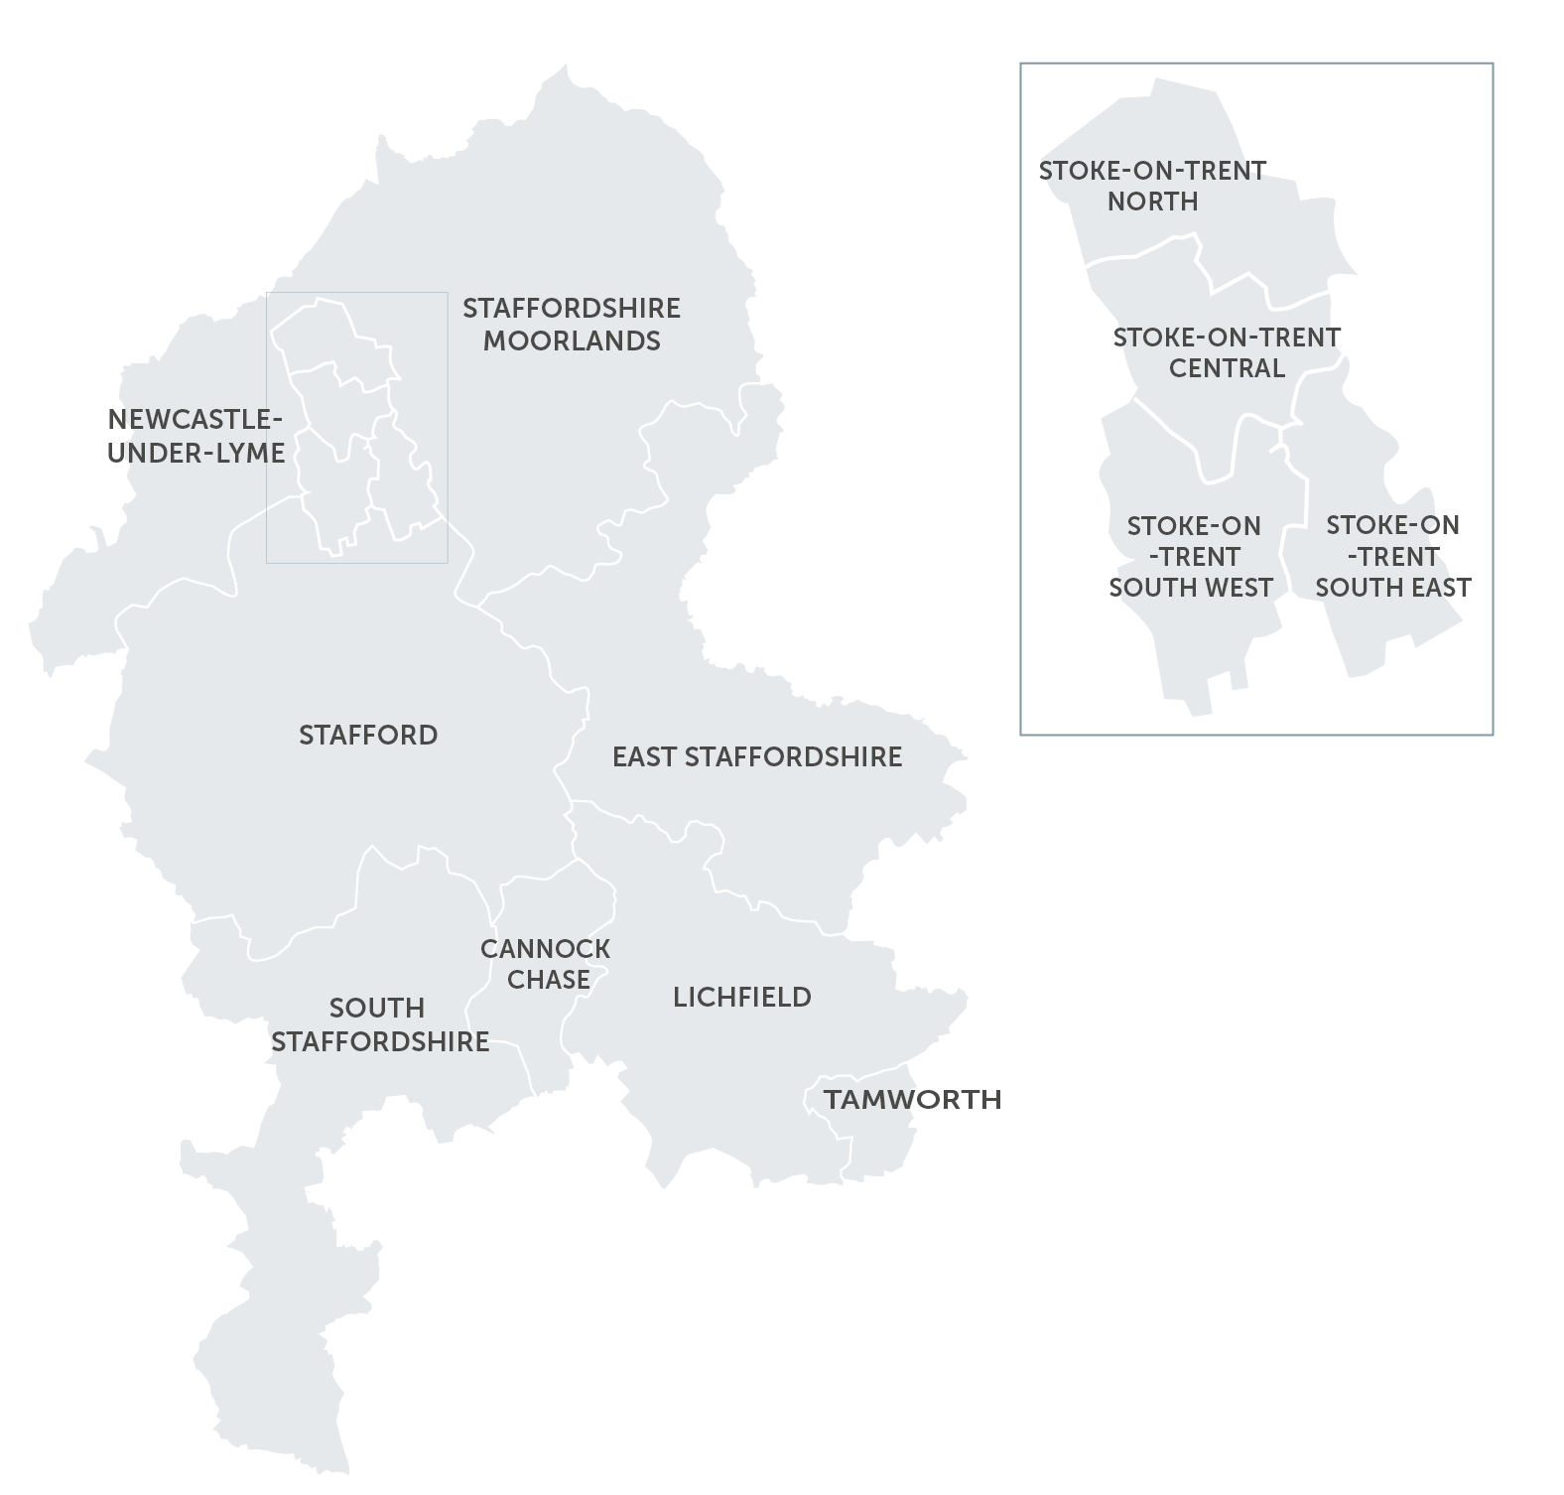




Tackling Health Inequality & Prevention
Working across our locality footprint* to support healthy neighbourhoods
Building on the wider determinants of health to create the environments for good health
Supporting healthy lifestyle choices and preventative measures to promote health happy lives
Creating joined up teams to provide better access, experience and outcomes
* locality footprint

Slide 52


Working in the community with our VCSE Partners
Support Staffordshire’s Community Connectors are on a mission to eradicate health inequalities.
The Community Connectors are out and about, listening to the community and helping the community to build action plans and improve engagement with the health services locally available.
Community Health Champions are local volunteers who help improve the health and wellbeing of people in Stoke-on-Trent.
Our network of Community Health Champions are well informed. The project aims to help people better understand health issues and to share clear and accurate health information in their communities.

Slide 53
Q&A open session
Questions submitted via email in advance of the meeting will be addressed by the Chair during this session.
Please ‘raise your hand’ on Teams if you would like to ask a question now.

Slide 54

Thank you for attending
Staffordshire and Stoke-on-Trent
Integrated Care Board’s
Annual General Meeting
A recording of this meeting will be available on our website.

