Slide 1
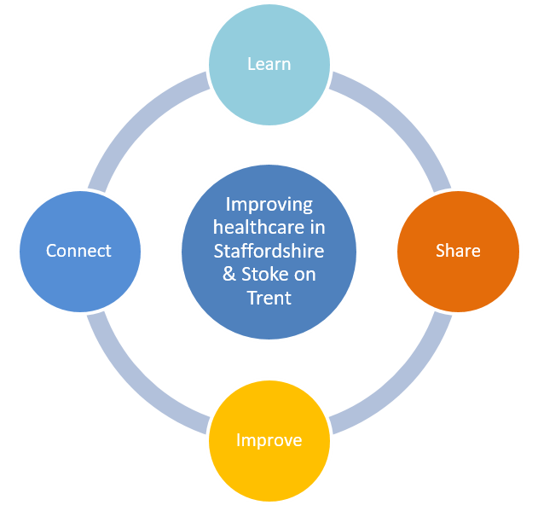

Quality Improvement Network
Setting ourselves up for success
Network Charter 1/06/2022
Notes:
John

Slide 2
Our Shared Purpose
Why we do what we do, this community of common interest wishes to……
Work together, to make things better and improve services and outcomes both in range and quality.
Get it right for the people we serve and our people, now and in the future. All services and providers have the same aim, “better patient care”, so we will work together to achieve this.
Influence change across the QI Network, build relationships, learn, grow, and share together.
Coproduce improvements in care for service users across the system, developing a culture of QI that can be achieved, embedded, and sustained.
Notes:
Top down and bottom up listening

Slide 3
What is Quality Improvement
Notes:
Jayne

Slide 4
Our Shared Purpose - key themes
Networking
Building relationships and a community across the system.
Support and connection, knowing who to reach out to for different projects.
What have you had success with previously and what other projects could this be useful for?
Sharing ideas with service users too, accessibility.
Networking with other staff that you wouldn't necessarily come into contact with, to share ideas.
Enable systems to work together in partnership, encourage staff and service users to get involved and coproduce improvements making QI everyone's business!
Notes:
Jayne

Slide 5
Collaboration
Focus on system wide challenges and make changes.
Identify a common language and approaches in order to progress to sharing QI tools resources.
Raising profile of QI, working collaboratively to improve communication
Everyone adopting a shared purpose, tools and techniques
Sharing ideas to learn from others and save reinventing the wheel
Creating partnership and a meeting point to discuss and resolve obstacles raised and to examine and learn when thing do not go well
Sharing progress and responsibilities when pulling project plans together
Work synchronously with the Continuous Quality Improvement committee so that work is endorsed by key leaders at ICB level.
Notes:
Jayne

Slide 6
Learning together
Improve together reflecting on each other's experience, to learn, understand and improve.
To celebrate QI work and approaches that have been successful as part of this.
Support each with our collective experience of QI Tools and resources, for example what tools and resources to use and when.
Share knowledge and context and raise awareness of what is happening.
Supporting other organisations with learnt lessons, sharing ideas etc.
Repository of examples and learning from other PDSA's etc.
Notes:
Jayne

Slide 7
How we will work together
Setting ourselves up for success
Being open and honest.
To challenge and support our developing understanding of improvement.
Wholeheartedly, share what we have and what we know.
A safe space to enter and be respectful and kind to each other.
Be prepared to challenge each other.
Reaching out for answers.
Notes:
Jayne

