Slide 1
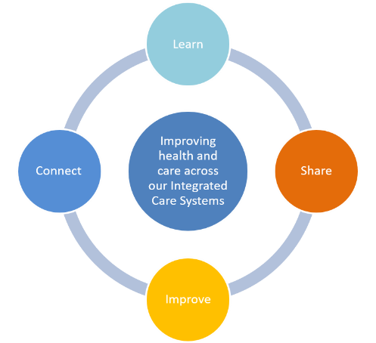
CASE STUDY - Continuous Quality Improvement
Reducing Incomplete Complex Discharges (UHNM Footprint)
BACKGROUND
Project led by: Lisa Duncan, Elkie Playfair, Christina Longhurst & Ruth Bednall (UHNM), Lisa Agell , Mark Cardwell, Carol Hough& John Costello (MPFT)
Service/Team: Various Royal Stoke wards, Track and Triage (Royal Stoke), QI (UHNM & MPFT)
Incomplete complex discharges has been a challenge within the pathway for a number of years, this work set about understanding the reasons why these occurred bring the partners together to collective problem solve with the aim of reducing the % of incomplete discharges within the pathway.
AIM
APPROACH
MEASURED OUTCOMES
The primary aim of this work was to reduce the % of incomplete discharges across the complex discharge pathways, but secondary aims included:
Improving communication and understanding across the pathway
Reducing the lead time within track and Triage
Improving the Quality of the documentation
Using the model for improvement (PDSA) we gathered data, undertook observations and brought together staff from across the pathway to collectively problem solve.
We documented the current state, identifying where the waste is and worked together on an agreed set of changes that the group believed would best improve the pathway and address the problem in focus.
Developing training, tools and standard work.
Incomplete discharges % - Reduced from 16.1% (Q4 21/22) to 14.5% (Q4 22/23)
Primary reasons reeducation – those linked to communication dropped from 4% to 2.5% and Medication from 16.6% to 9.7%, although those attributed to Transport have increased from 20.3% to 29.5% (Data Quality improved – better automation of reports)
Reduced lead time within Track and triage – average from receipt to listing reduced from 142 to 93 minutes – 34% reduction (Pathway 1 Discharges)
Communication and understanding – Participants stated they had a better understanding of each others roles and of the complex discharge pathways by being involved in the work.(Training developed)
CHALLENGES
NEXT STEPS
Language – key terms, capacity for staff to engage (Operational Pressures), project timeframes, share and spread, local provider transformation alignment, System interoperability – information flows, collective leadership and governance
Monitoring the continued use of Standard work within the pathways
Ensure that the routine monitoring of the data is embedded within the pathways
Strengthening the feedback loop between teams within the pathways
OPPORTUNITY FOR SHARED LEARNING
In its current form learning from the project has been shared across various wards and in part at County Hospital. To share and spread the learning wider specific discussion will be required on adapting the learning to the specific divisions across the site. Track and Triage shared learning is limited due to the varying operating models across the teams. The project has been shared across the ICS and with improvement partners across the STW ICS.

