Slide 1
Patient Safety Incident Response Framework (PSIRF) Bi-Learning Conference
Monday 14 October 2024

Slide 2

The aim of our PSIRF Learning Conference was to bring stakeholders across Staffordshire and Stoke-on-Trent Integrated Care System together to continue our growth of a cohesive system culture to learning from patient safety incidents based on shared values, ambitions, principles and outputs.
The conference had collective ownership through a range of presentations from system partners including large, small and independent providers. A powerful patient story enabled a patient-centric ethos where a collective approach capitalises on quality improvement.
Our learning incorporates feedback, recognising what we have done well in line with an appreciative enquiry philosophy and builds on opportunities from perceived challenges.
The event has been recorded and branded into this digital pack to support the spread of learning and a compendium of resources.

Slide 3
Introduction from Staffordshire & Stoke-on-Trent Integrated Care Board (ICB)
Cath Marsland

Slide 4
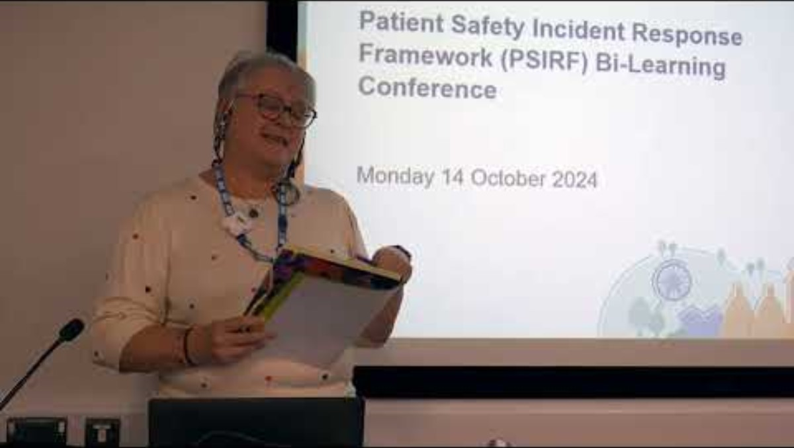

Slide 5
The National and Regional Update on PSIRF – Verbal Update
Deborah Widdowson, NHS England

Slide 6
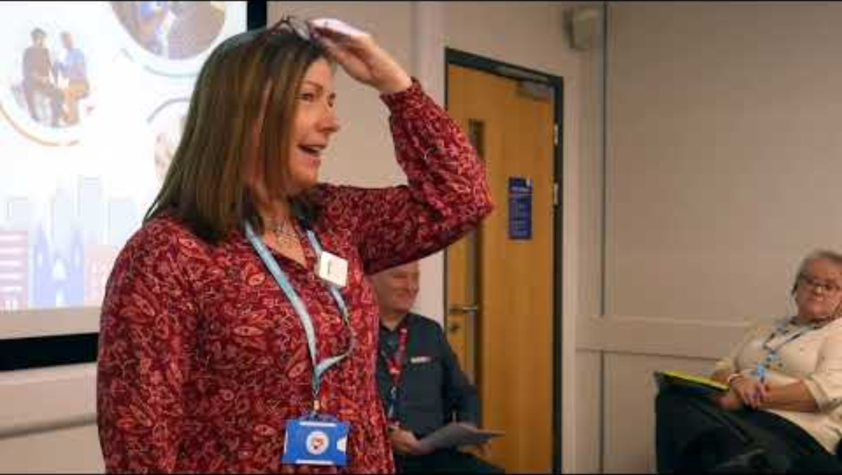

Slide 7
Patient Safety Oversight Not Scrutiny the SSOT Way
Mary Barlow and Kellie Johnson, Staffordshire and Stoke-on-Trent ICB

Slide 8
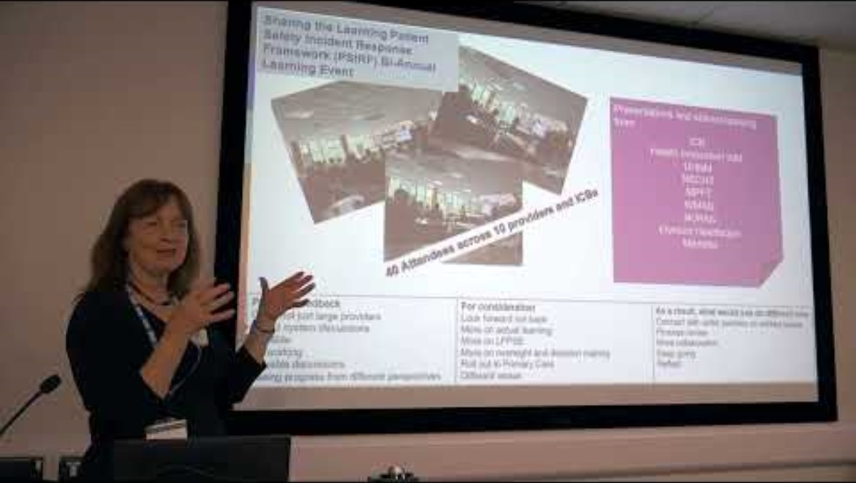

Slide 9
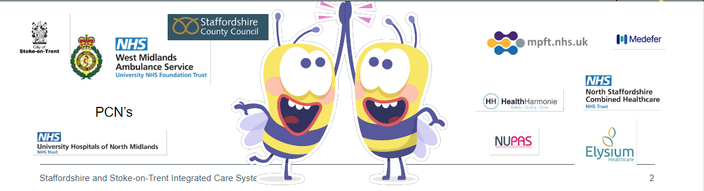
PSIRF - ICBs have a responsibility to establish and maintain structures to support a co-ordinated approach to oversight of patient safety incident response in all the services within their system
The ICB has a responsibility to:
Collaborate with their providers in the development, maintenance and review of provider patient safety incident response policies and plans Agree provider patient safety incident response policies and plans
Oversee and support effectiveness of systems to achieve improvement following patient safety incidents
Support co-ordination of cross-system learning responses Share insights and information across organisations/services to improve safety

Slide 10
Oversight not Scrutiny
We decided on a light touch approach –
Monthly (now Bi Monthly) PSIRF Check in meeting between the PSIRF lead for the ICB and the PSIRF lead for each provider and agreed a template to do this
 | Agenda Item
 | Welcome and Apologies Leadership Compact
 | Quoracy
 | Conflicts of Interest Is there anyone who has not been included in the CoI Register, or their entry is not complete and are there any additional declarations that anyone would wish to make Record the actions taken to manage conflicts
 | Notes of previous meeting
U | Brief update on ongoing RCA on Serious Incident Framework what support is needed to address
 | Engagement and involvement of those affected by patient safety incidents
 | Policy, planning and governance
 | Competence and capacity
 | Proportionate responses
 | Safety actions and improvement
Guided by PSIRF guidance on types of questions to ask
Outcomes
Highlighted challenges in process with the management of patient/family expectations and require resource allowing discussions to be escalated cross system and regionally – but good examples of patient engagement
Ongoing training and development for teams a year on
Excellent feedback on PSP development

Slide 11
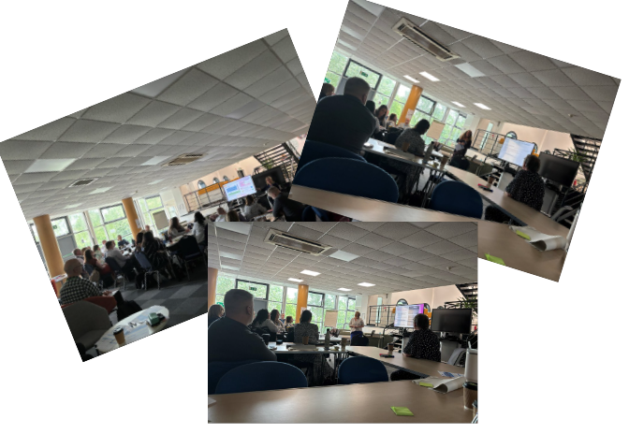
Sharing the Learning Patient Safety Incident Response Framework (PSIRF) Bi-Annual Learning Event​
Presentations and shared learning
from:
ICB
Health Innovation WM
UHNM
NSCHT
MPFT
WMAS
NUPAS
Elysium Healthcare
Medefer
40 Attendees across 10 providers and ICBs
Positive Feedback
Great not just large providers
Useful system discussions
Valuable
Networking
Valuable discussions
Seeing progress from different perspectives
For consideration
Look forward not back
More on actual learning
More on LFPSE
More on oversight and decision making
Roll out in Primary Care
Different venue
As a result, what would you do different now
Connect with wider partners on wicked issues
Process review
More collaboration
Keep going
Reflect

Slide 12

Learning Event October 2024
The National and Regional update on PSIRF | Harm Free Care | Appreciative Enquiry
Medical Examiner | The Role of the Family Liaison Officer | The role of the Patients Safety Partners
Patient involvement /Patient Story - Maternity Services
Keynote Speakers
Break Out Rooms
UHNM shared Learning | NSCHT shared Learning | MPFT Shared Learning
WMAS shared learning |  | PSIRF in care homes
Poster Presentations
LeDeR Learning | Safeguarding CDOP | Staffordshire University
Mortality Learning | Primary Care Services | Police Right Care Right Person
Hospice Learning | NUPAS Learning | Patient Safety Courses
 | Nursing Home Group

Slide 13
Staffordshire and Stoke-on-Trent Coroners Service
Emma Serrano

Slide 14
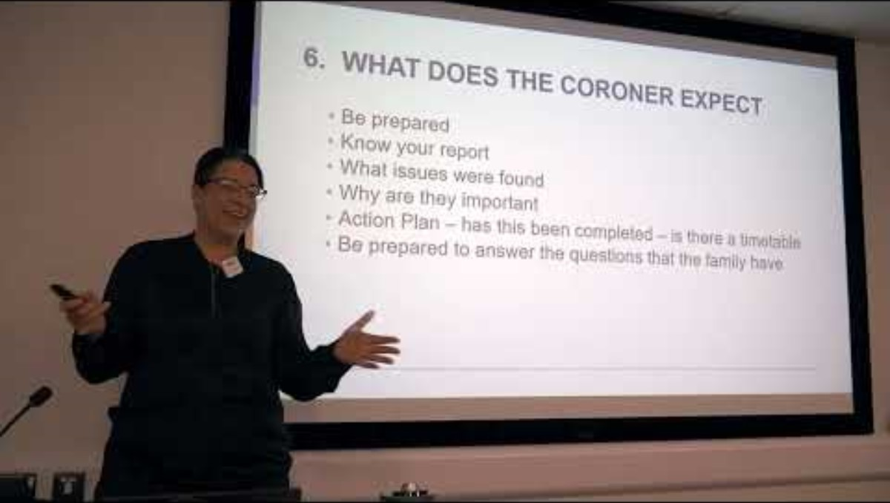

Slide 15
Role of the coroner
The Registration of Births and Deaths Regulations 1987 – when a matter should be referred to a coroner:
Referral:
  Decide to investigate:
    Speak to Doctors
    Post Mortem
    Inquest
    Natural Death vs Un natural death
    Preventing Future Death reports

Slide 16
Tpyes of medical deaths for inquest
  Medication errors
  Falls
  Complications following surgery
  Development of a pressure injury
  Just a few examples

Slide 17
Reason to suspect
Is the death violent un-natural or unknown
Culpable human failure
Medical intervention has hastened death
Life saving surgery that failed to save life
Low threshold

Slide 18
Purpose of an inquest
Who, when, where
How
Short form vs narrative
Neglect
PFD

Slide 19
PSSI – use by the coroner
  Do we have a reason to suspect
  At Inquest – how they are used
  Family – to answer questions
  Preventing Future Deaths

Slide 20
What does the coroner expect?
  Be prepared
  Know your report
  What issues were found
  Why are they important
  Action Plan – has this been completed – is there a timetable
  Be prepared to answer the questions that the family have

Slide 21
Causation
Evidence of this
The issue noted in the report, what effect has this had on the deceased

Slide 22
Learning from Lives and Deaths of people with a Learning Disability and Autistic People (LeDeR)
Dan Pickford

Slide 23
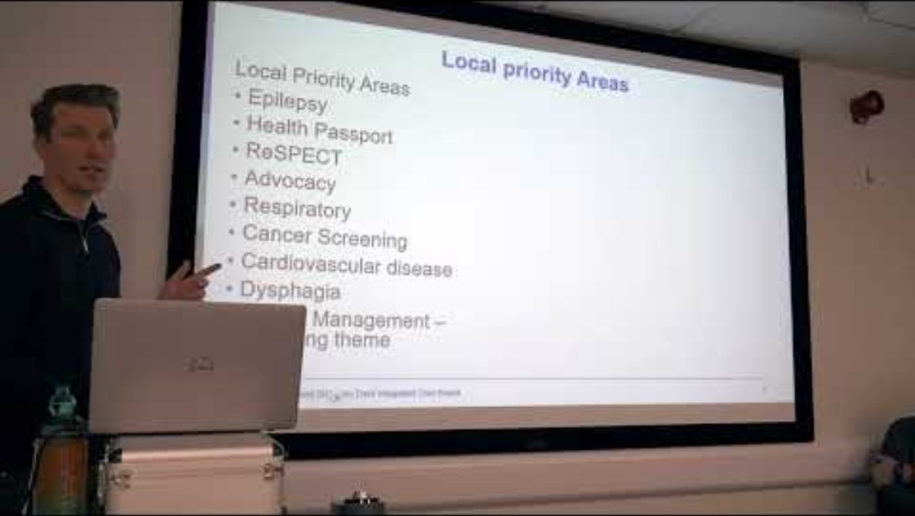

Slide 24
What is LeDeR?
LeDeR is a service improvement programme for people with a learning disability and autistic people.
Established in April 2017 and funded by NHS England (formerly known as the Learning from Deaths Review Programme). It grew out of the Confidential Inquiry into Premature Deaths of People with a Learning Disability (CIPOLD) https://www.bristol.ac.uk/media-library/sites/cipold/migrated/documents/fullfinalreport.pdf
LeDeR works locally across the Integrated Care System (ICS) to:
Improve care for people with a learning disability and autistic people
Reduce health inequalities for people with a learning disability and autistic people
Prevent people with a learning disability and autistic people from early deaths and dying prematurely
Notes:
The review teams’ responsibilities:
carry out LeDeR reviews in a professional, compassionate, and caring way
treat bereaved family members and loved ones with respect, compassion and courtesy
share their findings with the local governance panel

Slide 25
Initial Review
This involves (where possible) speaking to the family member or someone close to the person who died, allowing the reviewer to build up a picture of their life and the type of person they were.
A detailed conversation with the GP or a review of the persons GP records
A conversation with at least one other person involved in the care of the person who died e.g. carer, health professional, social worker, charity co-ordinator etc

Slide 26
Focused Reviews and Criteria
A focused review will look in more detail at the person’s life and care received. The review will also involve more people and professionals.
The professional judgement of the reviewer is that there is significant learning likely for the ICS
If there are concerns about the quality of care provided to the person by one or more providers, or there is evidence of lack of integrated or co-ordinated care.
The person is from a Black, Asian or minority ethnic background

Slide 27
Focused Reviews and Criteria continued
The person was autistic with no learning disability (18 years or over). This does not cover children
The person had been under mental health or criminal justice restrictions at the time of death or 5 years previously
A family member can always ask the reviewer to complete a focused review.

Slide 28
How LeDeR fits with other reviews and PSIRF ?
There are several different review processes for people who die. For example:
Child death review
Safeguarding adults’ review
Review of deaths of people in hospitals (Structured Judgement Reviews)
Coroners Inquest
Police investigation
Legal investigation/litigation
If this is the case, organisations work together to try to avoid unnecessary duplication.
A LeDeR review waits until all these reviews or investigations have been completed first before undertaking the review. Therefore, a review is usually placed on hold until these processes have completed.
PSIRF process - refer for LeDeR Review. Locally-led PSII (or other response) may be required alongside the LeDeR review, organisations should liaise with this one another.
Where there is reason to believe that one or more patient safety incidents/problems in care could have contributed to the death of a person with learning disabilities. In these circumstances a PSII must be conducted in addition to the LeDeR review.

Slide 29
3 I’s and Systems
Insight, Involvement and Improvement
Focusing on priority areas, how these are different across providers and systems.
Individual action plans vs system wide action plan

Slide 30
Governance Panel and Steering Group
LeDeR Governance Panel - completed reviews are presented at our local governance panel with the areas of learning, good practice and improvements communicated.
LeDeR Steering Group – the actions for learning and necessary improvements are then reported into the steering group to drive these actions across the Integrated Care System (ICS).
These groups consist of membership across the ICS from health, social care, public sector services, charities, experts by experience/people with lived experience.
Notes:
The group or panel will decide on actions to take, who will take these actions and the help they need to reduce health inequalities and to stop people dying too young.

Slide 31
Local priority Areas
Local Priority Areas
Epilepsy
Health Passport
ReSPECT
Advocacy
Respiratory
Cancer Screening
Cardiovascular disease
Dysphagia
Weight Management –emerging theme

Slide 32
Improvements from reviews
Health Passport https://staffsstokeics.org.uk/your-health-and-care/learning-disability/health-passport/ - resources and materials
Dysphagia Training (LD and Autism care providers) - via Midland Partnership Foundation Trust (MPFT) and Staffordshire County Council
Easy Read Breast Cancer Screening Video - https://www.youtube.com/watch?v=DXqbNfdZQgA
Epilepsy awareness training (LD and Autism care providers) – via MPFT and Staffordshire County Council
LeDeR leaflets converted into easy read and the top 6 languages spoken across the county.
LeDeR webpage - https://staffsstokeics.org.uk/leder/ - resources and materials

Slide 33
Future improvements/projects
Bowel Cancer screening and cervical screening video in easy read, with supported materials.
ReSPECT, Advocacy information in easy read and converted into top 6 languages spoken across the county.
Awareness campaigns to be ran in relation to the health passport, ReSPECT/End of life and Advocacy.
Weight management – now coming out as a theme in reviews. Work to be undertaken.

Slide 34
Useful links/resources
Report the death of someone with a learning disability or an autistic person (leder.nhs.uk)
LeDeR - About LeDeR
LeDeR - Resource Bank

Slide 35
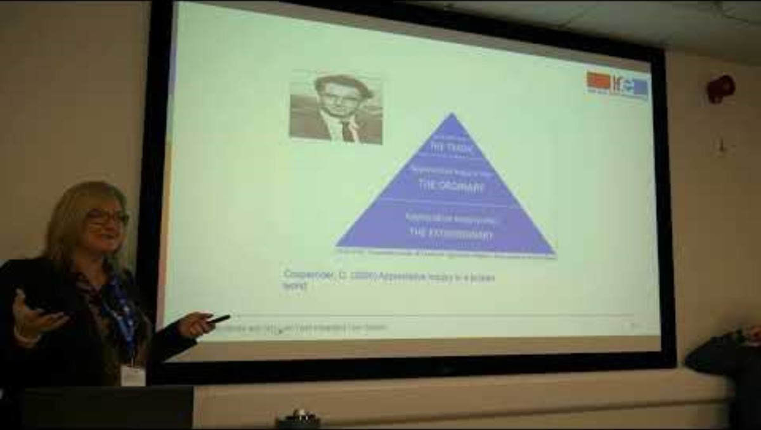

Slide 36
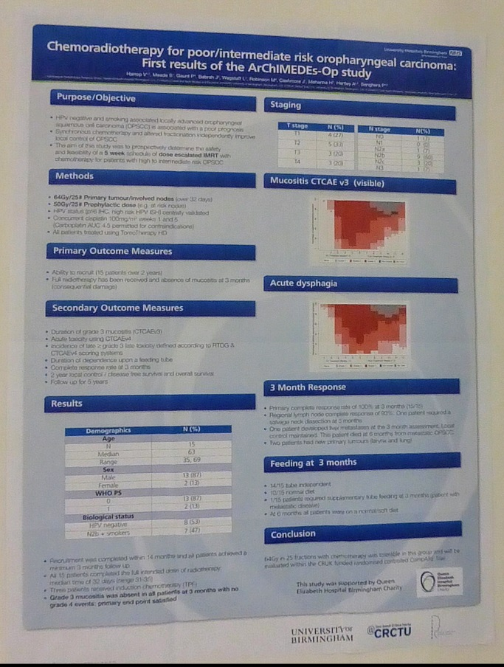
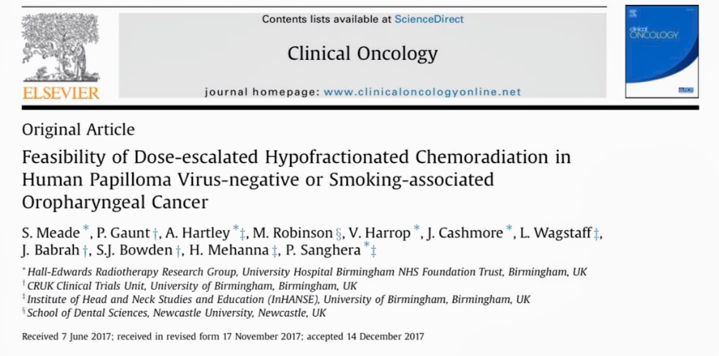
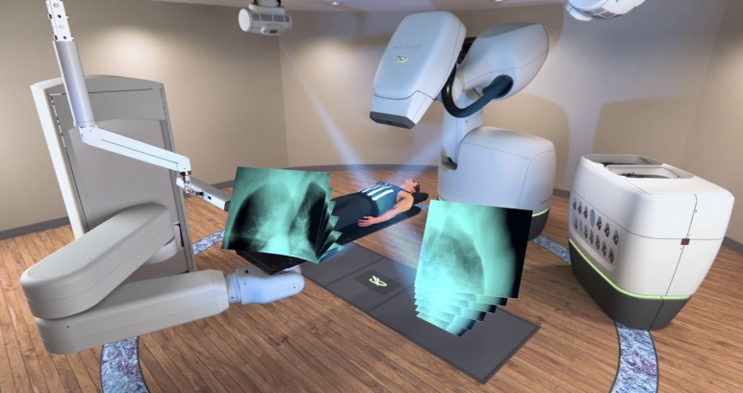
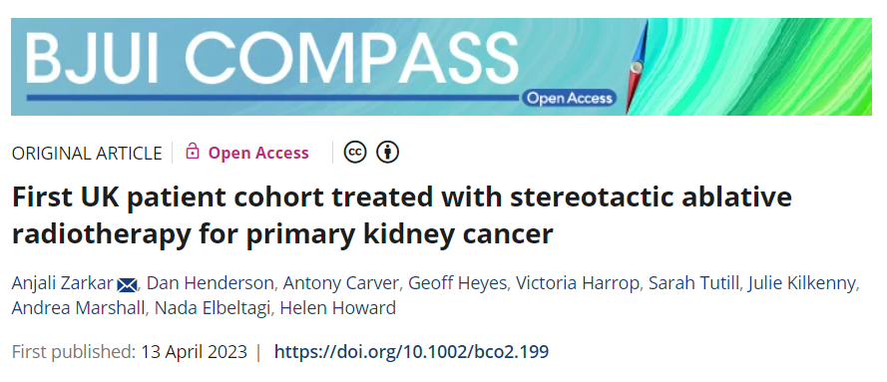
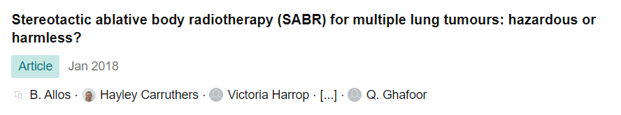
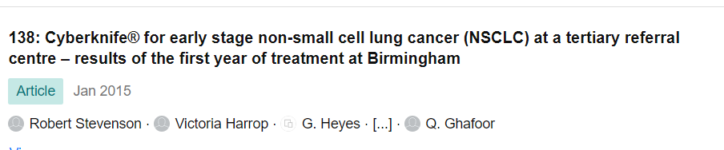
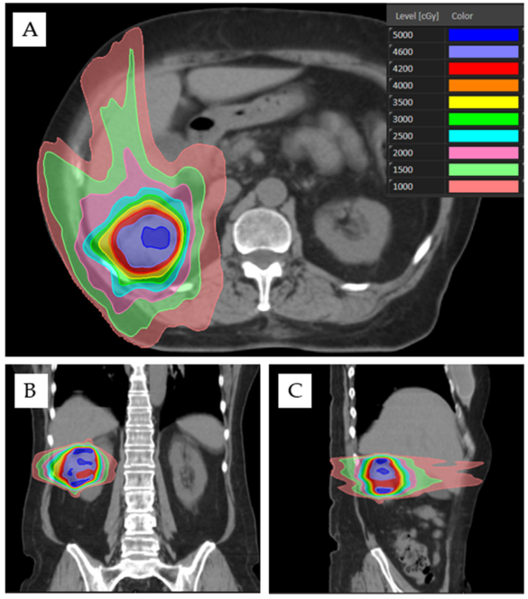
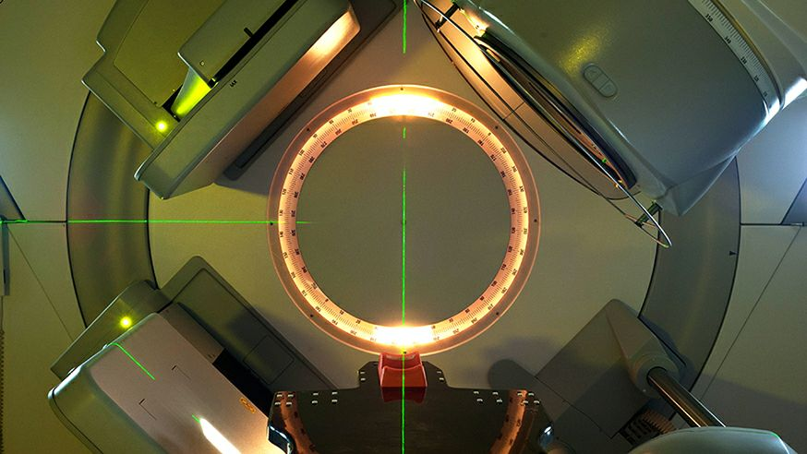
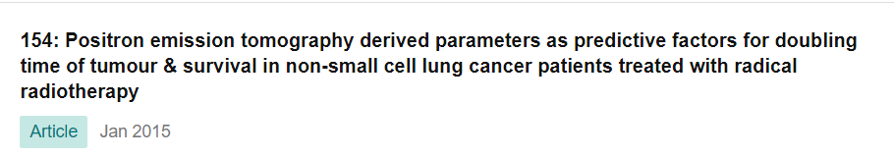

Slide 37

‘Appreciative Inquiry is a process for engaging people in building the kinds of organisations and a world they want to live in. Working from people's strengths and positive experiences. AI co-creates a future based on collaboration and open dialogue.’
David Cooperrider, founder of Appreciative Inquiry

Slide 38

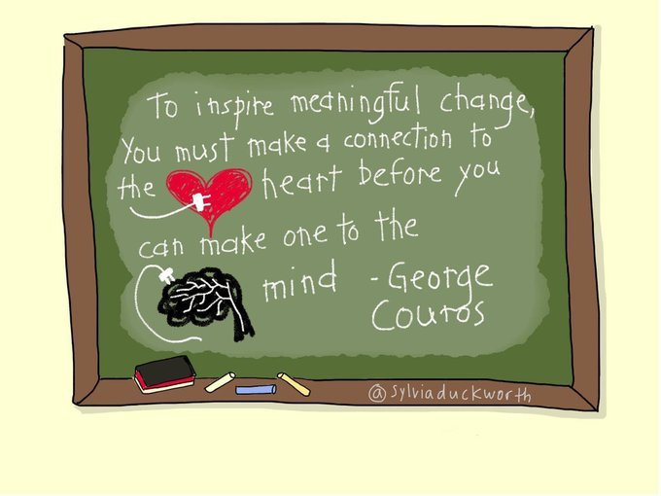
Appreciative Inquiry
‘Appreciative’
Comes from the idea that when something increases in value, it ‘appreciates’
‘Inquiry’
Describes the process of seeking to understand through questions, and the value of paying attention to processes and people.
Combining heart & mind at work

Slide 39


Is the cooperative search for the best in people, their organizations, and the world around them.
It involves systematic discovery of what gives a system 'life' when it is most effective and capable in economic, ecological, and human terms....
.....the art and practice of asking questions that strengthen a system & its positive potential
“The grass is greener where you water it.” ​
Which grass do you water?

Slide 40
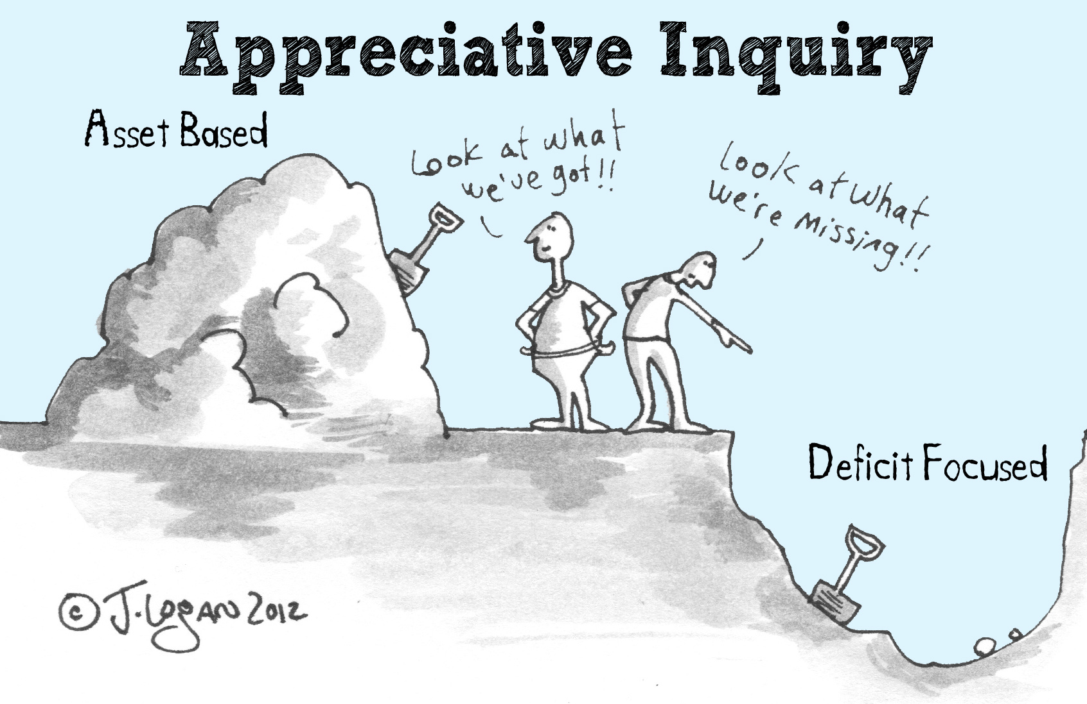
Notes:
RAD

Slide 41
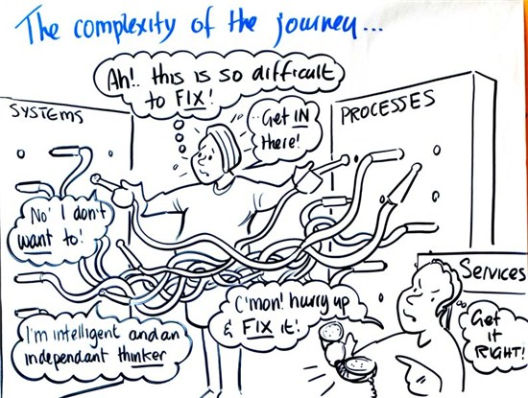
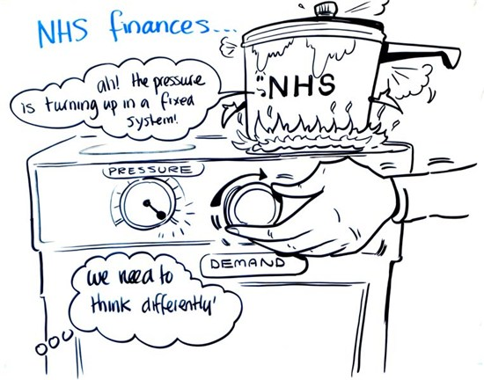
‘If all you have is a hammer, everything looks like a nail”
Abraham Maslow , 1966

Slide 42
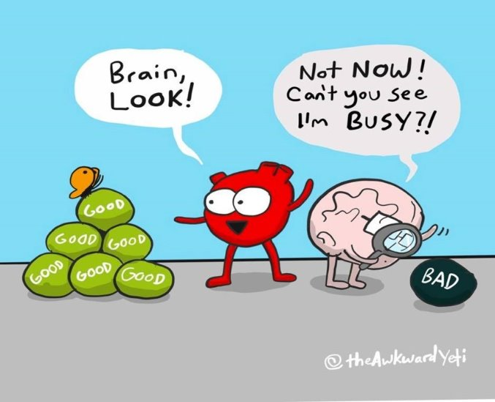
Being positive & appreciative..​
Counters our negative bias
Achieves a desirable positivity ratio
Supports improved individual and team performance & morale.
Start with what’s strong, not what’s wrong

Slide 43


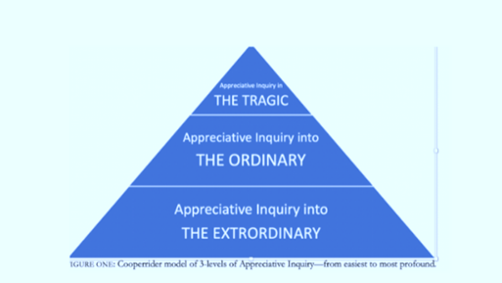
Cooperrider, D. (2020) Appreciative Inquiry in a broken world.

Slide 44



Slide 45
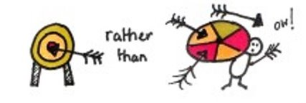
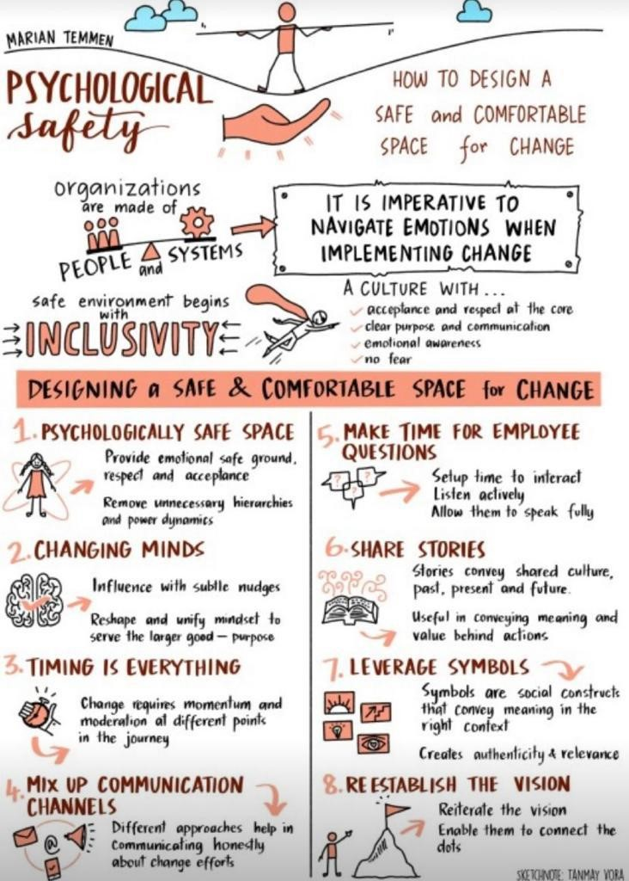
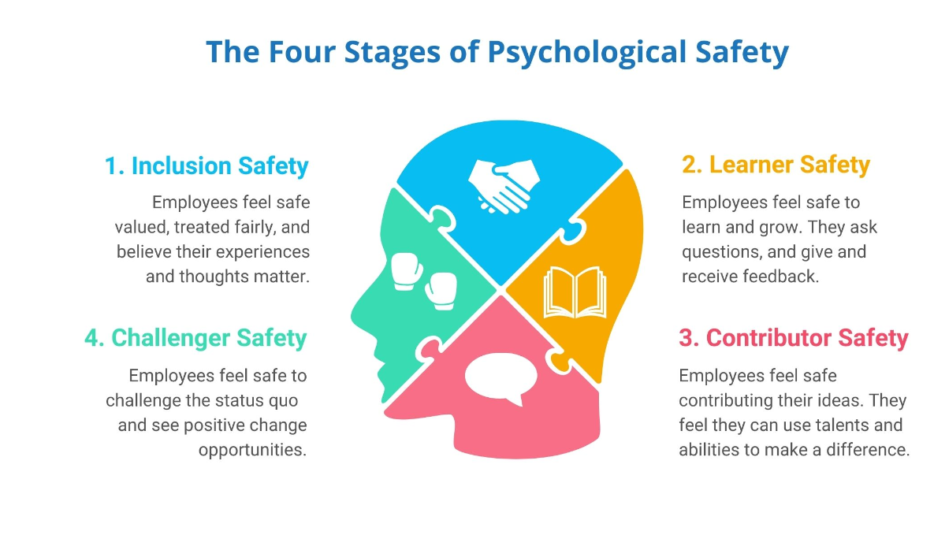
Psychological Safety

Slide 46
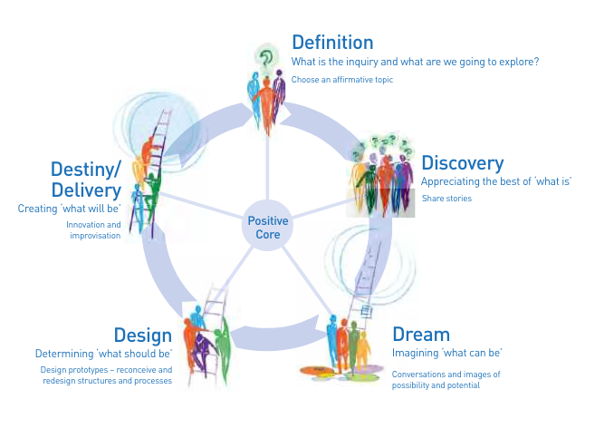
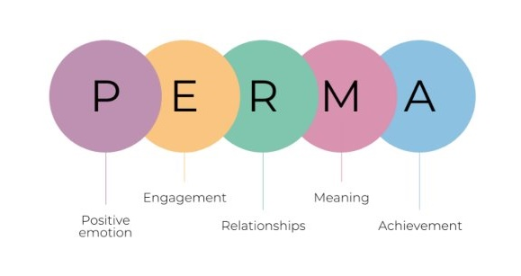
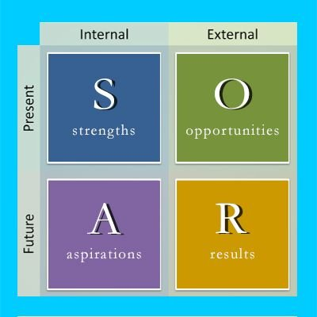
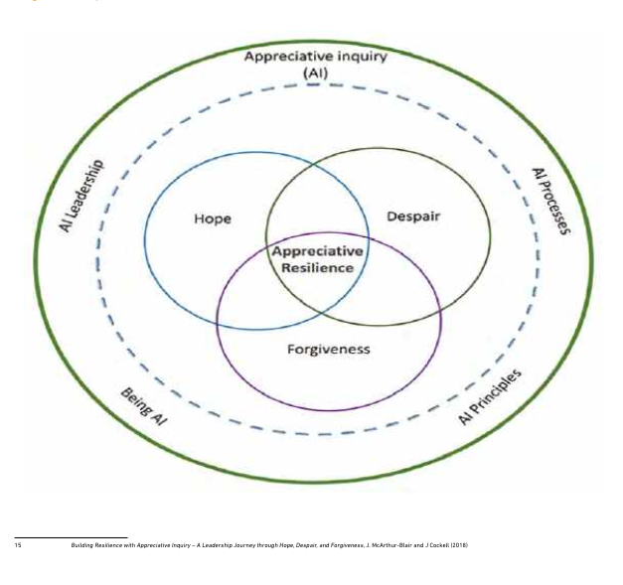
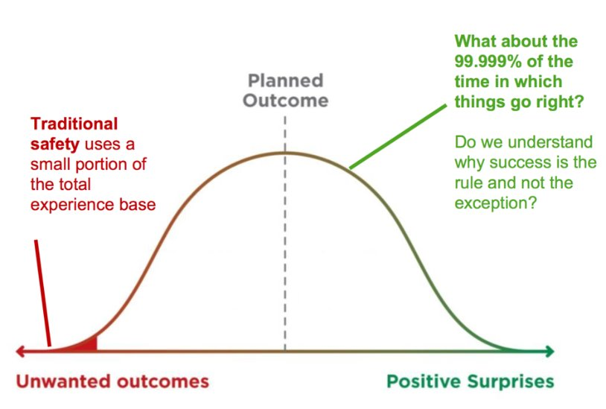
The growth of Appreciative Inquiry in
Health and Care

Slide 47

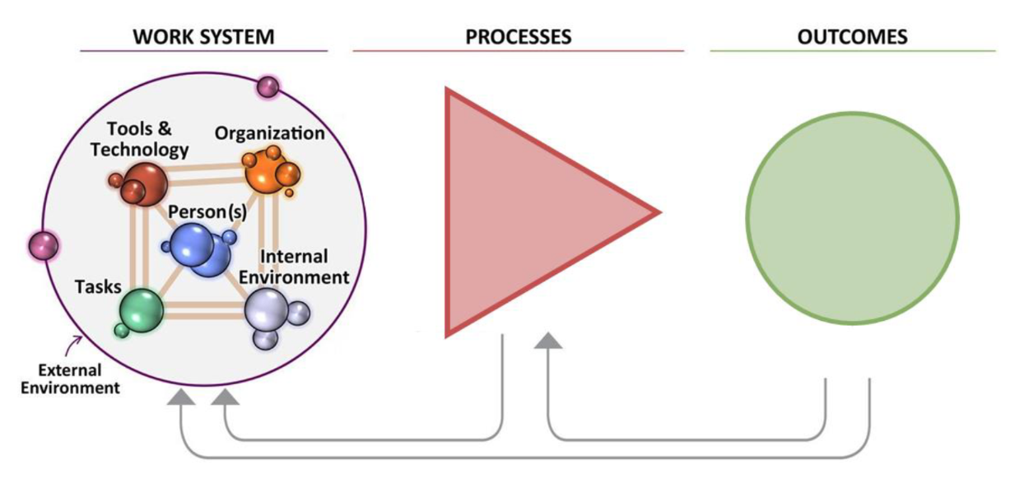
Understanding how all the system parts collectively support good performance
Discovering and valuing every person's contribution
Everything is connected – the whole is greater than the sum of its parts
Co-producing person-centred design of effective and inclusive services

Slide 48

Changing the conversation…

Slide 49

Let's Reframe our language to truly achieve 'Safety Differently'
Traditional Constructionist Safety Terms | Reframe (there could be a number of alternatives)
Safety I | Safety II
Quality Assurance | Quality Improvement
Culture of blame and judgement | Just Culture
Oversight / Scrutiny | Collaboration/ Togetherness
Investigation | Inquiry
Datix / Incident | Greatix/ LfE
Root Cause Analysis | Right Cause Analysis
SIF | PSIRF

Slide 50
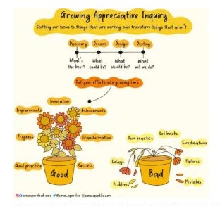
Examples of where AI is useful
Culture change (and ‘doing more with less’)
Developing vision and values
Being a learning organisation
Quality Improvement projects
Merging or restructuring teams & Teambuilding
Customer & service user engagement
Used alongside Learning Response Tools
Supporting personal development
50

Slide 51
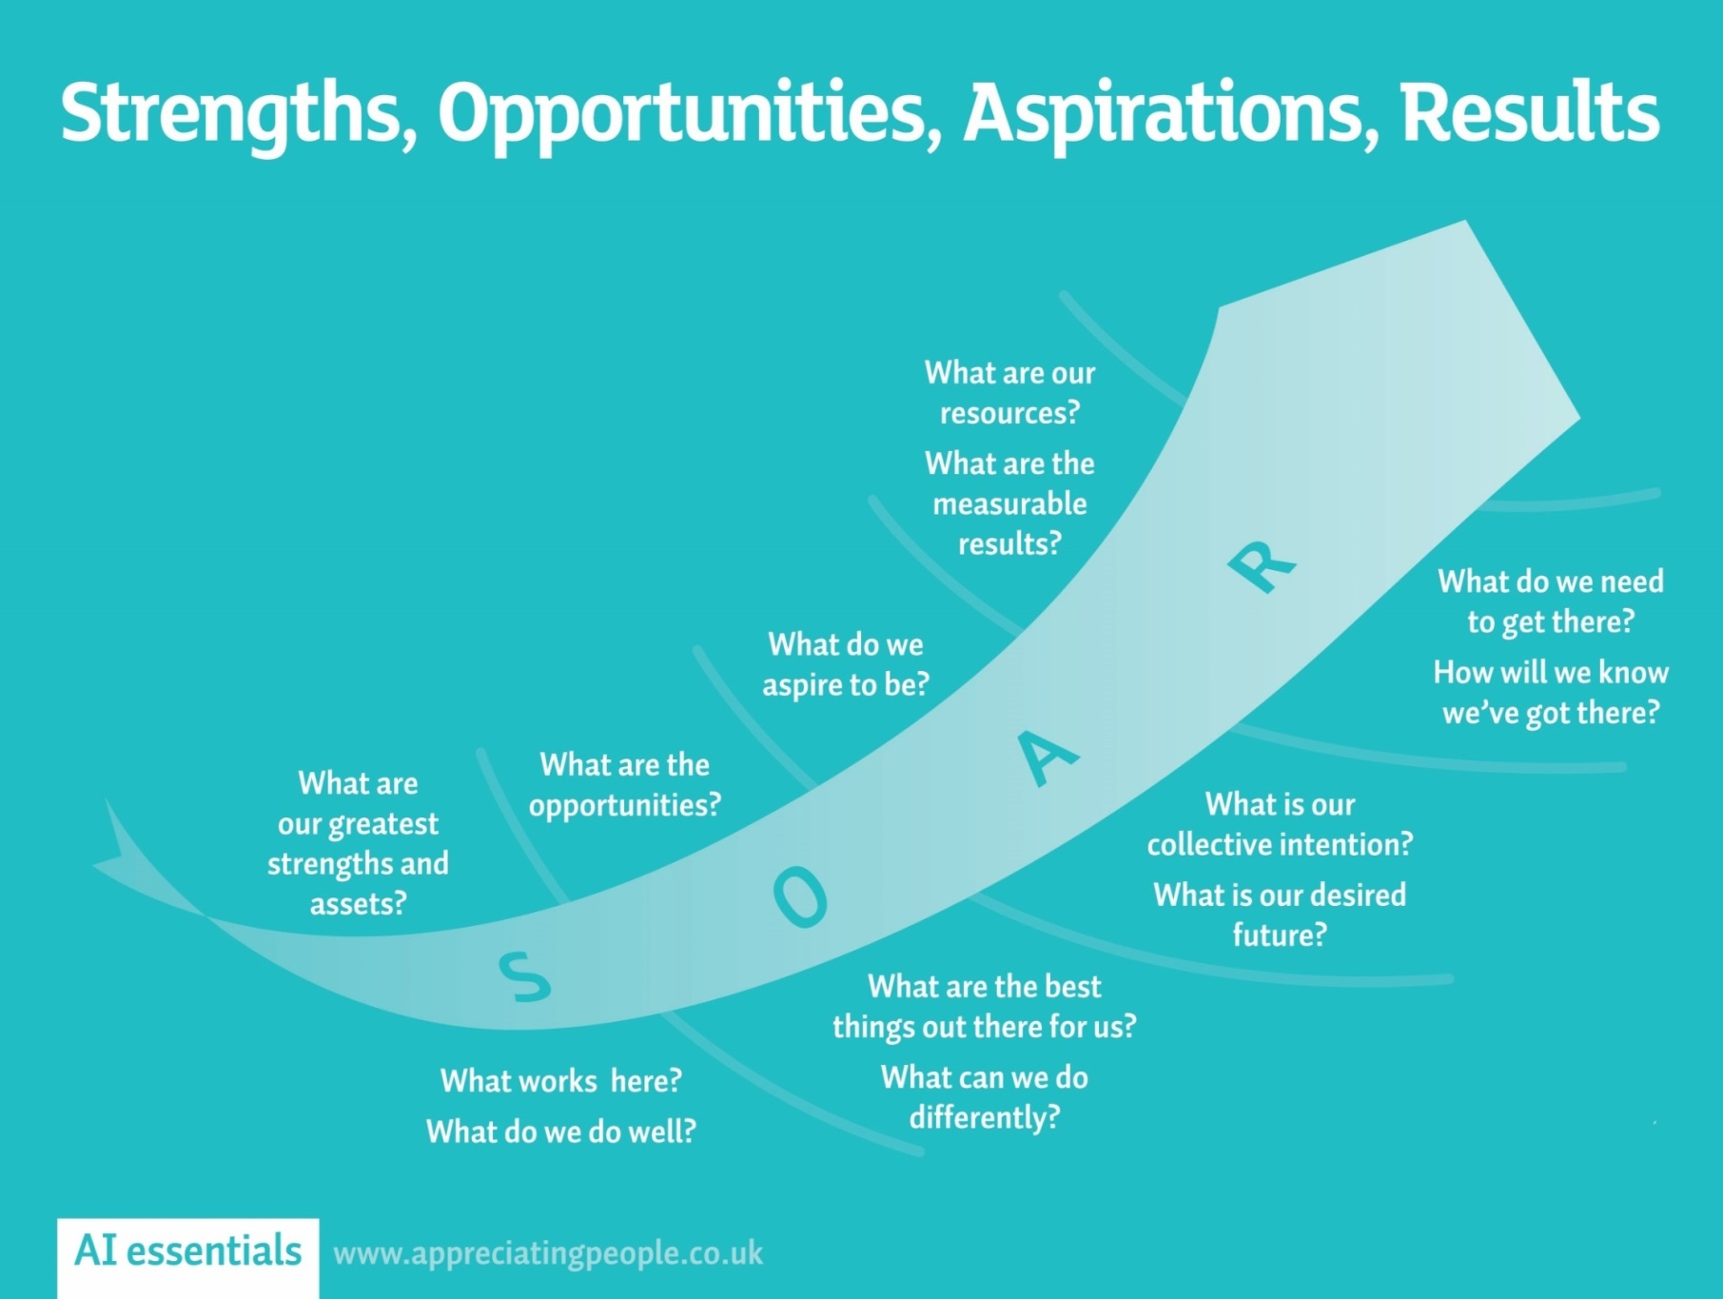


LET'S SOAR!
Overview: SOAR is a strategic planning instrument that allows an organization or team to focus on current strengths and to project its vision for the future. Grounded in Appreciative Inquiry , SOAR complements SWOT approaches: focusing on the organization or issue, enhancing what is currently done well, and imagining how to move forward. http://www.davidcooperrider.com/ai-process/.
(Stavros & Hinrichs, 2009)
Notes:
Whilst ensuring we create a psychologically safe space to allow conversation to flourish
This is an opportunity to build upon past experiences and new learning
LET'S SOAR!

Slide 52

Thinking about Strengths
Think about 1 of your strengths
Think about the strengths of your team/dept/organisation
How might these strengths support the work you are currently involved in?
Whether you think you can or can’t,
you are right!
- Henry Ford

Slide 53
AI in PSIRF preparation and implementation
Using SOAR to realise our Discovery
SOAR - Strengths
What is working well at system level & Trust level?
What are we proud of (greatest accomplishments)?
What current assets and capabilities lend themselves to implementing PSIRF?
What are the strengths of your plan and how do these strengths help build a shared system learning approach?
SOAR - Opportunities
How do you build on what you are most proud of?
What are the external circumstances or challenges and how can we reframe them in a way that creates potential for action?
How can we reframe challenges to be seen as opportunities?
How does your plan have the flexibility it needs to grow and maintain the learning as you move through transition? How will these emerging changes be shared throughout the system?

Slide 54
PSIRF - Using SOAR to realise our Discovery
SOAR - Aspirations
What is your preferred future? What can you be as a system?
What strategic initiatives would support your aspirations?
What key areas need to be in a system level plan to align to key outcomes for PSIRF?
What will a positive safety culture look like for your organisation?
SOAR - Resources / Results
What indicators will allow us to measure progress toward achieving our goals?
How do we know we are creating a just culture whilst progressing through PSIRF implementation phases?
How do we know that we are actively engaging those affected by patient safety incidents?
What will a good PSIRF implementation plan look like? Who is involved? What are the priorities that will ensure safety improvement?

Slide 55
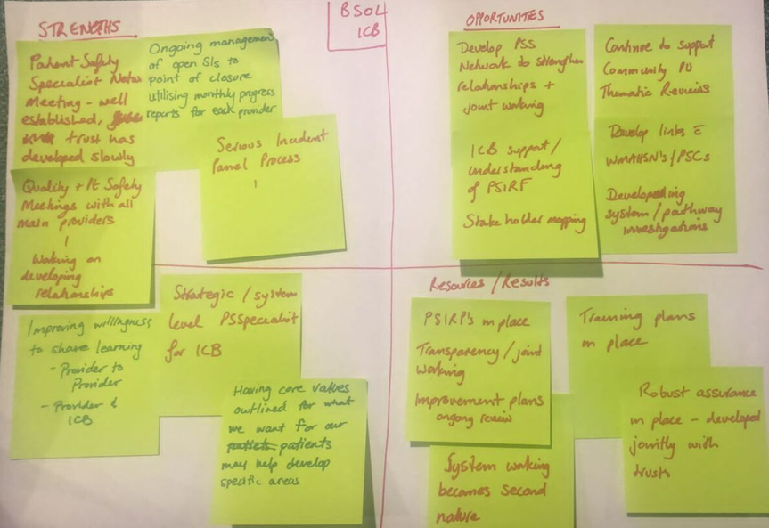
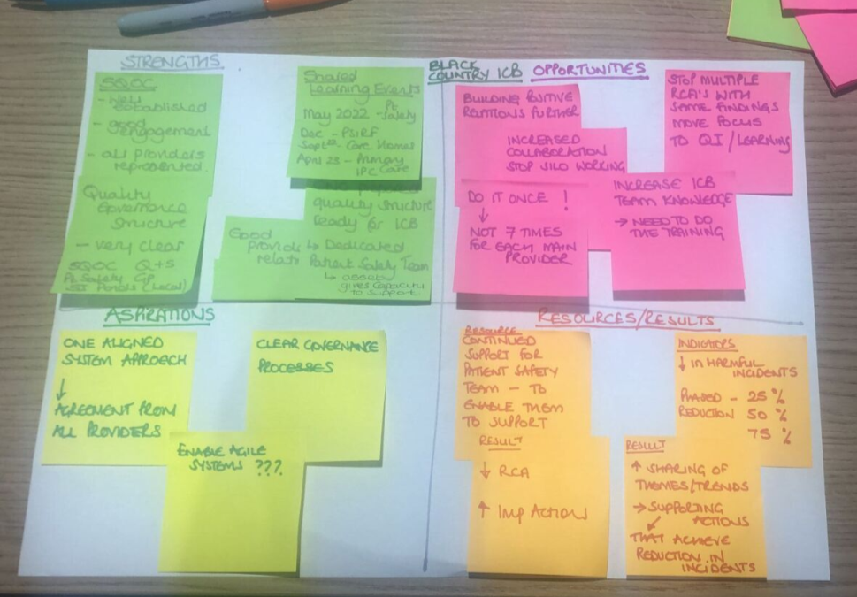
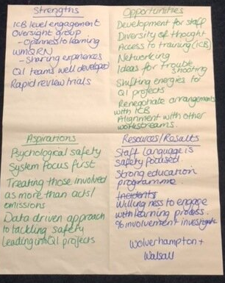
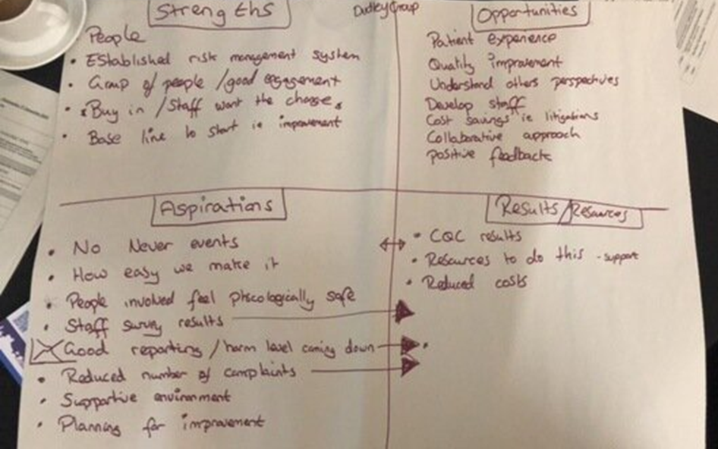

Slide 56
Oversight Aspirations
“What does good oversight look like under PSIRF for us?”
​What processes need to be in place to enable agile system improvement? (Improvement is the focus)
How do we know we are creating a just culture whilst progressing through PSIRF implementation phases? (Blame restricts insight)
How do we ensure that measurement translates into proactive improvement across the learning system. What indicators will allow us to measure progress toward achieving our goals? What resources are needed? (Learning from patient safety incidents)
How does your oversight encourage those enacting it to ensure a positive safety culture is ingrained in collaborative practices, processes and narratives (Collaboration is key)
What are the governance arrangements that enable psychologically safe environments with a flourishing learning culture? (Psychological safety allows learning to occur)
How do you use your role to influence improvement through curiosity and what strategic initiatives would support your aspirations? (Curiosity is powerful)

Slide 57
Using SOAR for Insight and Oversight

Slide 58
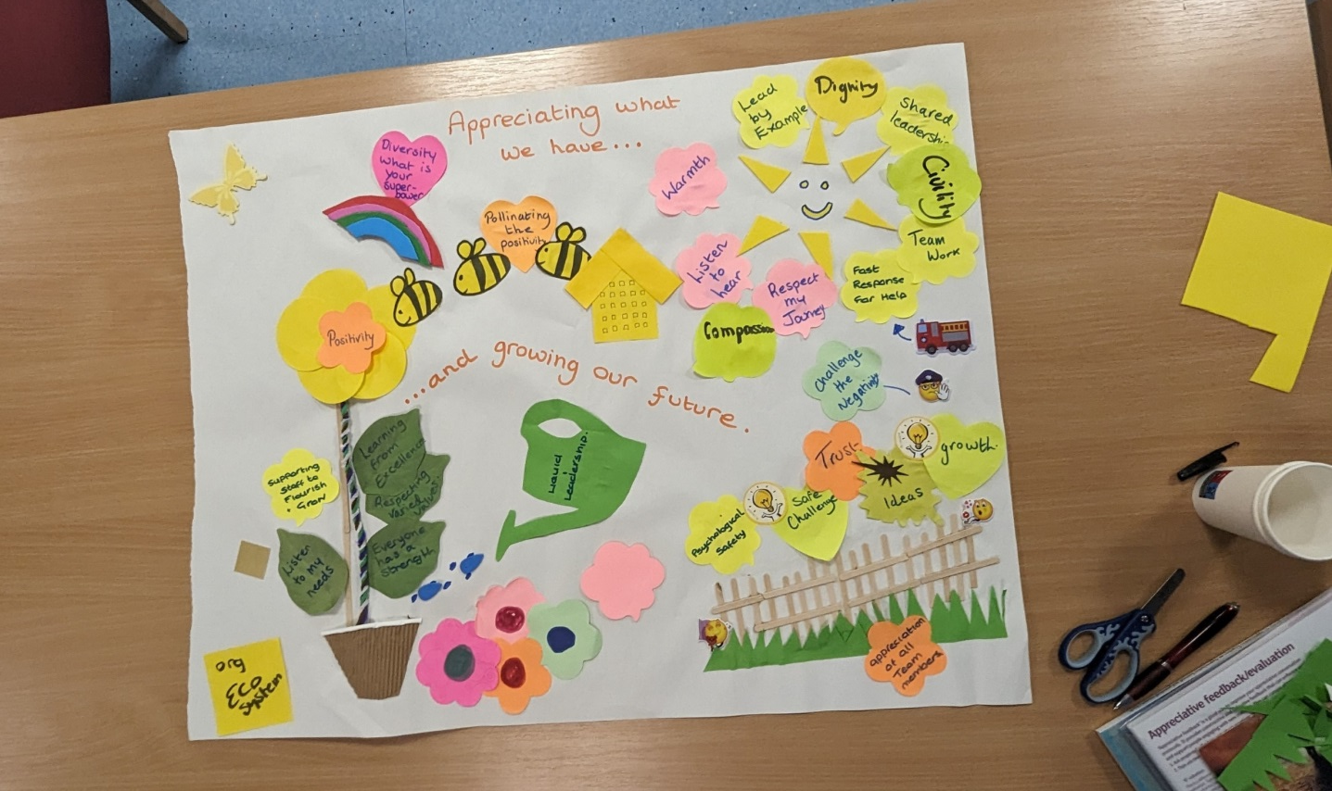

Using Appreciative Inquiry to create a Team Eco Garden
Developed during an AI training course in 2023 with a team at Blackpool hospital. It was further refined and is now referred to often in meetings and is a brilliant visual to support team culture.
(Appreciating Health and Care: AI in practice)

Slide 59

Welcome to the Family Liaison Service
Duncan Kett

Slide 60
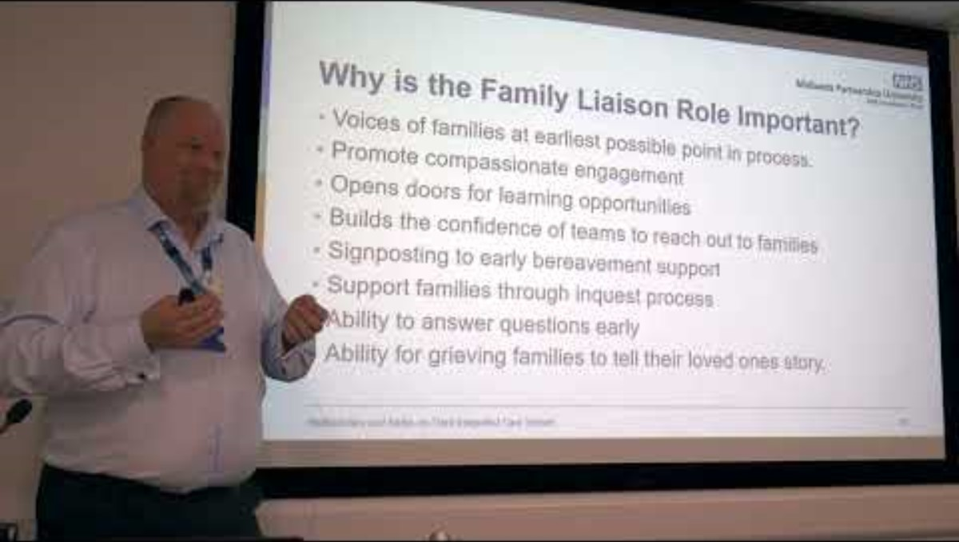

Slide 61
What is a Family Liaison Officer?
First point of contact after a significant incident
Sensitive and compassionate support throughout any learning response
Opportunity to ask questions
Informed throughout
Shares lessons
Provides information and support about coronial process
Signposting to other support

Slide 62
Why is the Family Liaison Role Important?
Voices of families at earliest possible point in process.
Promote compassionate engagement
Opens doors for learning opportunities
Builds the confidence of teams to reach out to families
Signposting to early bereavement support
Support families through inquest process
Ability to answer questions early
Ability for grieving families to tell their loved ones story.

Slide 63
How the service works?
Incident reports
Agreement from clinical team that FLO support is required
Levels of engagement led by their families according to need
Signposting support provided (incl. foodbanks, mental health support and bereavement support)
Questions and queries brought to learning review / clinical teams for response
Pen portraits requested from families
Pen portraits and responses to queries included within learning responses
FLO offers to meet with families to go through the learning responses with clinical teams
Support provided to families up to day of inquest.

Slide 64
What’s next for the Family Liaison Service?
Use of patient stories
Website development – single point of contact for resources
Continue promotion of the role
Continue culture change of engagement
Supporting role out of Patient Safety Partners

Slide 65

The Role of Patient Safety Partners at UHNM
Debra Meehan, Lead Nurse Quality & safety
Rebecca Pilling, Head of Patient Experience

Slide 66
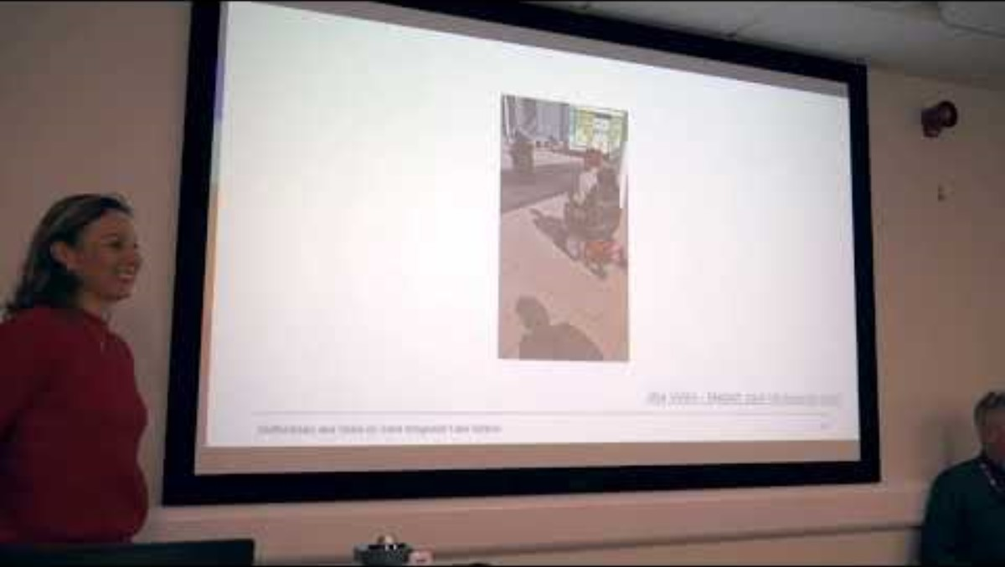

Slide 67
Introduction
Prior to the implementation of PSIRF, UHNM had already developed the role of Patient Leader in 2018/2019
Actively listening to the expertise and lived experience of our patients, their carers and families would enable us to deliver high quality and safe care
Our Patient Leaders
Enable the Trust to value, listen and provide meaningful involvement opportunities
Support a culture which is 'patient-centered ' .
Support the development of high-quality patient and public engagement.
Understand the workings of the organisation (clinical and non-clinical services) and work collaboratively with Trust staff to identify problems and apply creative and innovative thinking in developing solutions

Slide 68
Recruitment Process
Recruitment process mirrored the UHNM process for safe recruitment of volunteers, managed by the Patient Experience Team
Role Description
Advertisement NHS jobs/Interview Process
Identity/DBS checks
Flexibility of hours to be worked discussed at Interview
Corporate Induction
Local Induction

Slide 69
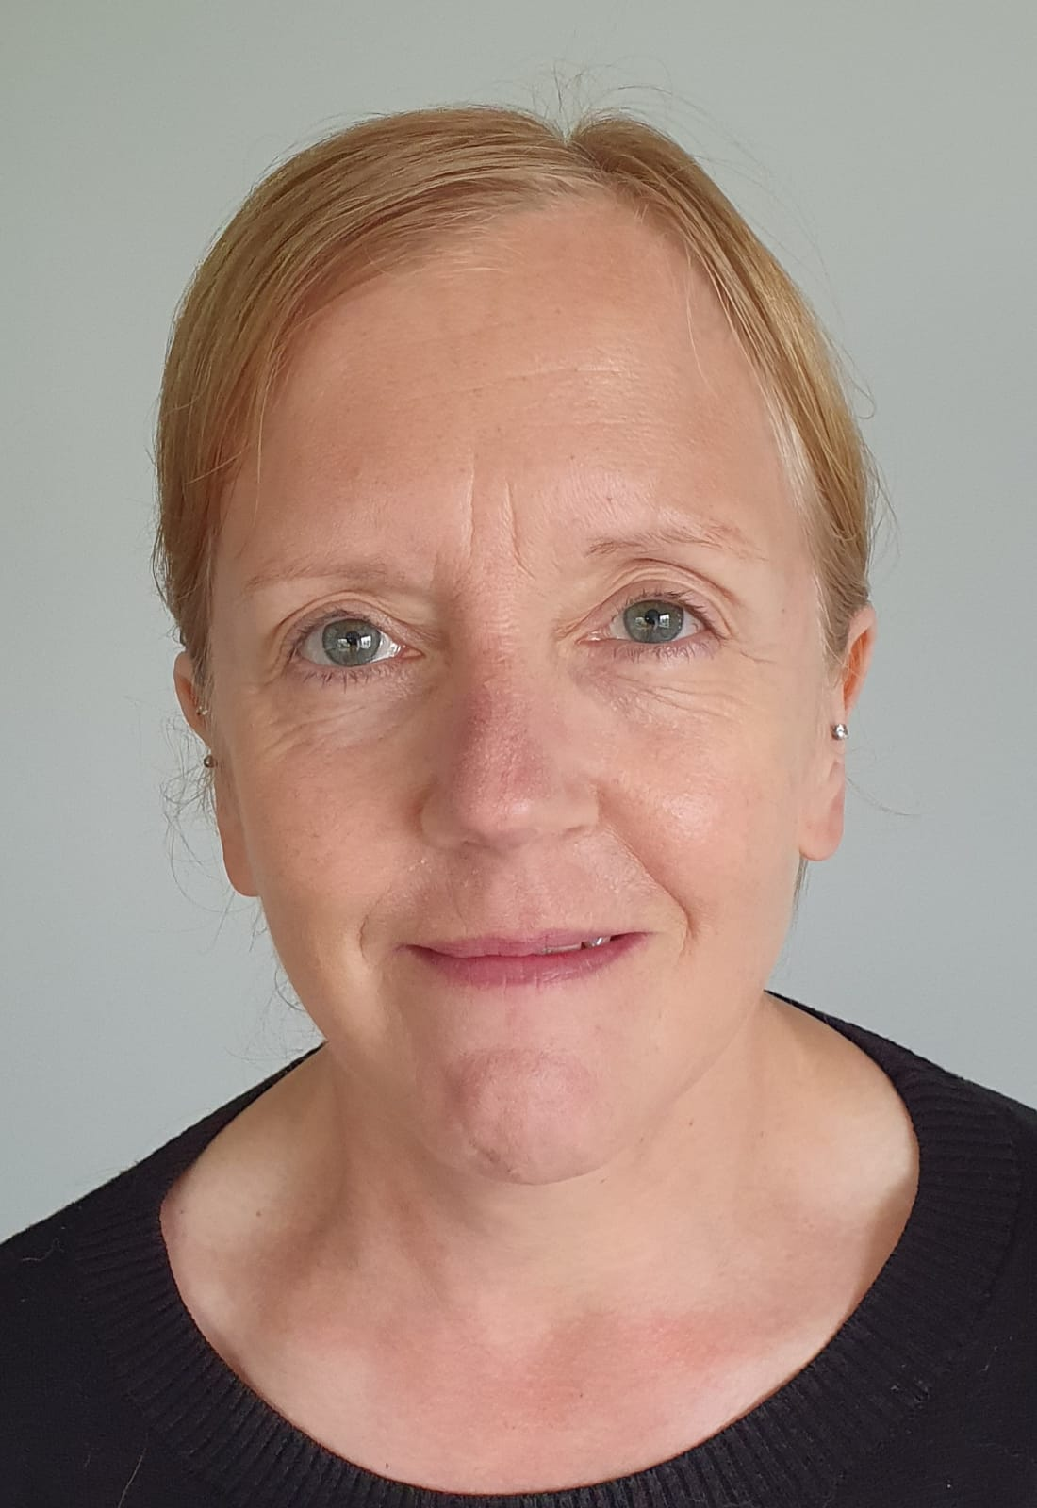

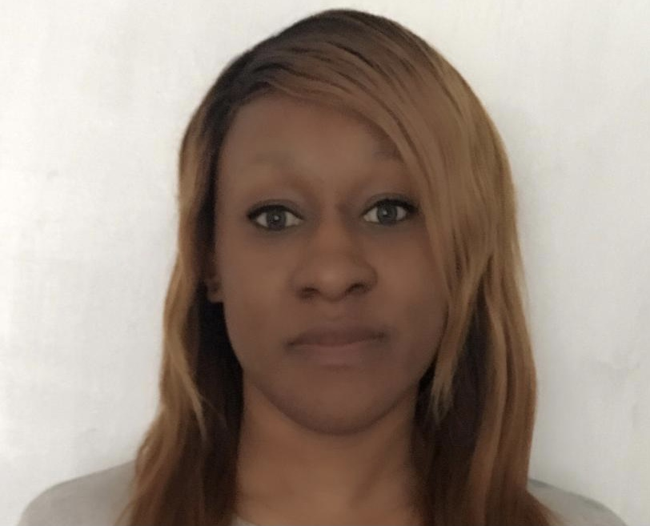

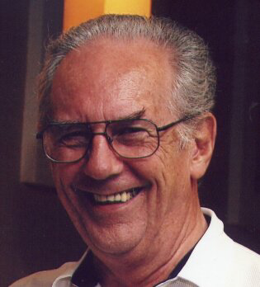
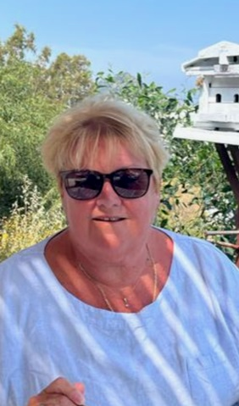
Meet our Patient Safety Partners & Leaders
Alexia
Lydia
Jill
Marie-France
John (PL)
Dianne (PL)

Slide 70
Current Areas of Involvement
CEF- supporting with caring domain & patient feedback
CEF bronze support meetings
Harms steering groups
Inequalities project looking at DNA's
PLACE
Hospital User Group
Post Discharge Surveys
Project around improving the referral process from primary to secondary care
Patient Priority Project- Parkinson's medication

Slide 71
Involvement in Table-Top Exercise as part of PSIRP
Our annual review of our plan takes place in early October.
A review of a selection of PSIRF incident response tools will take place with a panel of clinical, non-clinical staff and Patient Safety Partners present to review different aspects of the tools including ease of completion, learning and staff and patient involvement.
This review will shape improvements to the toolkits going forward to ensure learning is maximised

Slide 72
Next Steps/Future Plans
Learning from Table Top Exercise- Implementation of Learning
Review of the role of Patient Leader – Is it the same as PSP or is it different?
Report activity of PSP’s through Patient Experience Group
Celebrate achievements of the PSP’s
Trust Board Stories

Slide 73
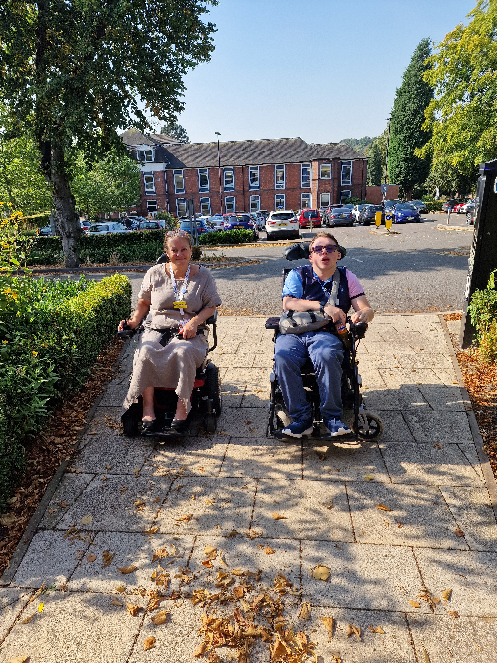
Corporate Safety Champion for lived experience – Mr Lewis Bunn
Lewis is our first Corporate Safety Champion in the Trust
His primary role is to look at accessibility and inclusivity within the Trust and suggest improvements
Lewis is a full-time wheelchair user and identifies as having a mild learning disability

Slide 74
Lewis has led a tour of the site with some of our Exec team to show them the challenges that wheelchair users face
Lewis is keen to demonstrate the difficulties of navigating the grounds and buildings for relatives, patients and staff- and he is already making simple but meaningful changes
Lewis is also leading on creating an app that will help patients find their ward or department
Lewis' idea is that there will be a QR code on the letters patients receive so that the app can take patients directly to their destination, maintaining independence and reducing anxiety

Slide 75
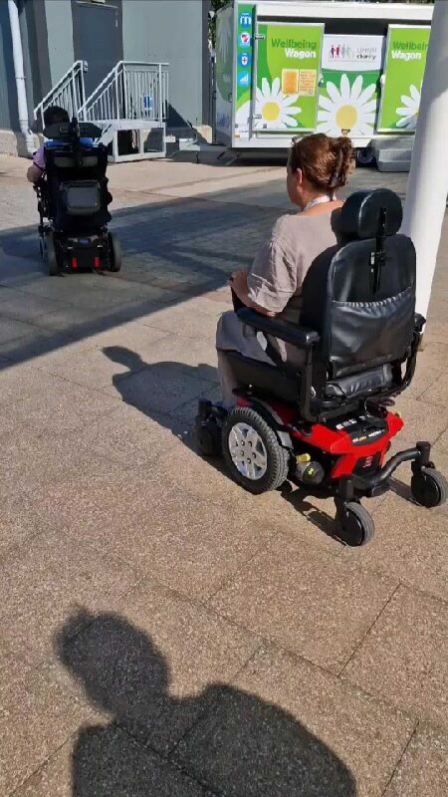
08a Video - Media1.mp4 (sharepoint.com)

Slide 76
Harm Free Care
Andy McGovern, Kettering General Hospital

Slide 77
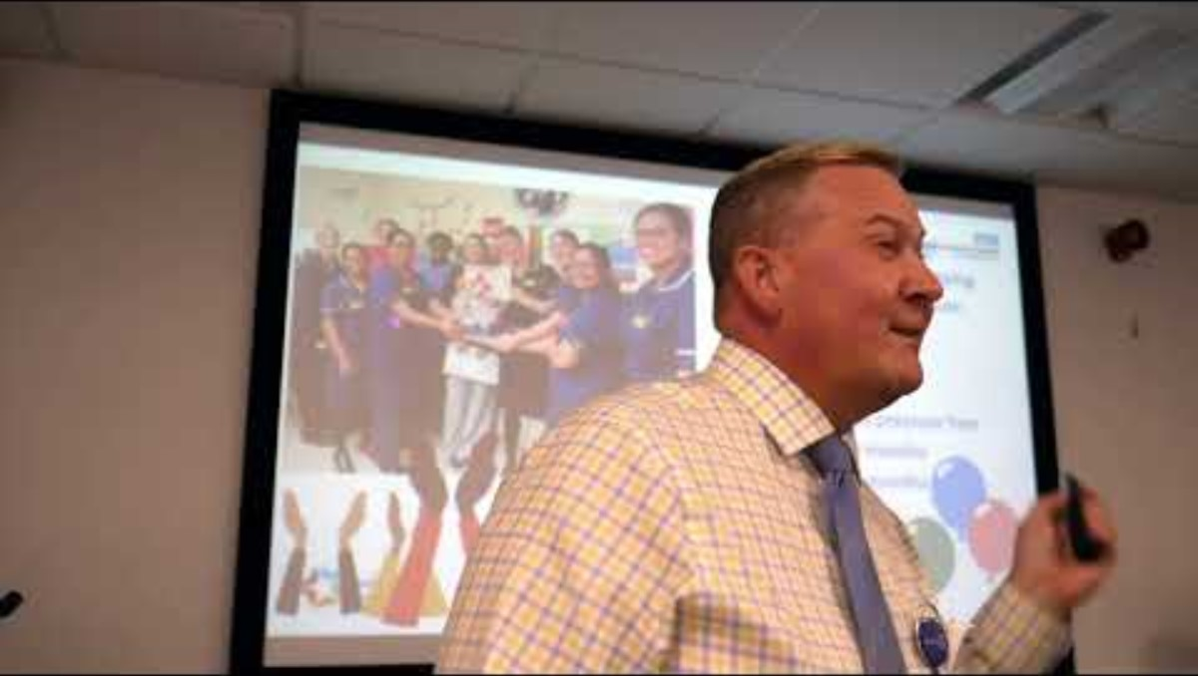

Slide 78
Patient Safety Incident Response Framework. What have UHNM done and learned?
Jamie Maxwell

Slide 79
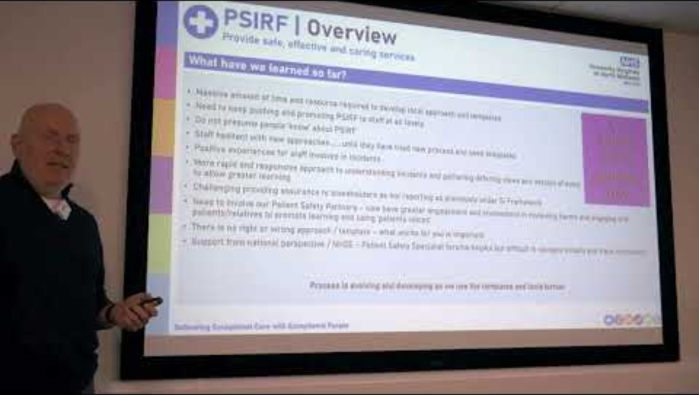

Slide 80







PSIRF | Our journey
Provide safe, effective and caring services
Delivering Exceptional Care with Exceptional People

Slide 81
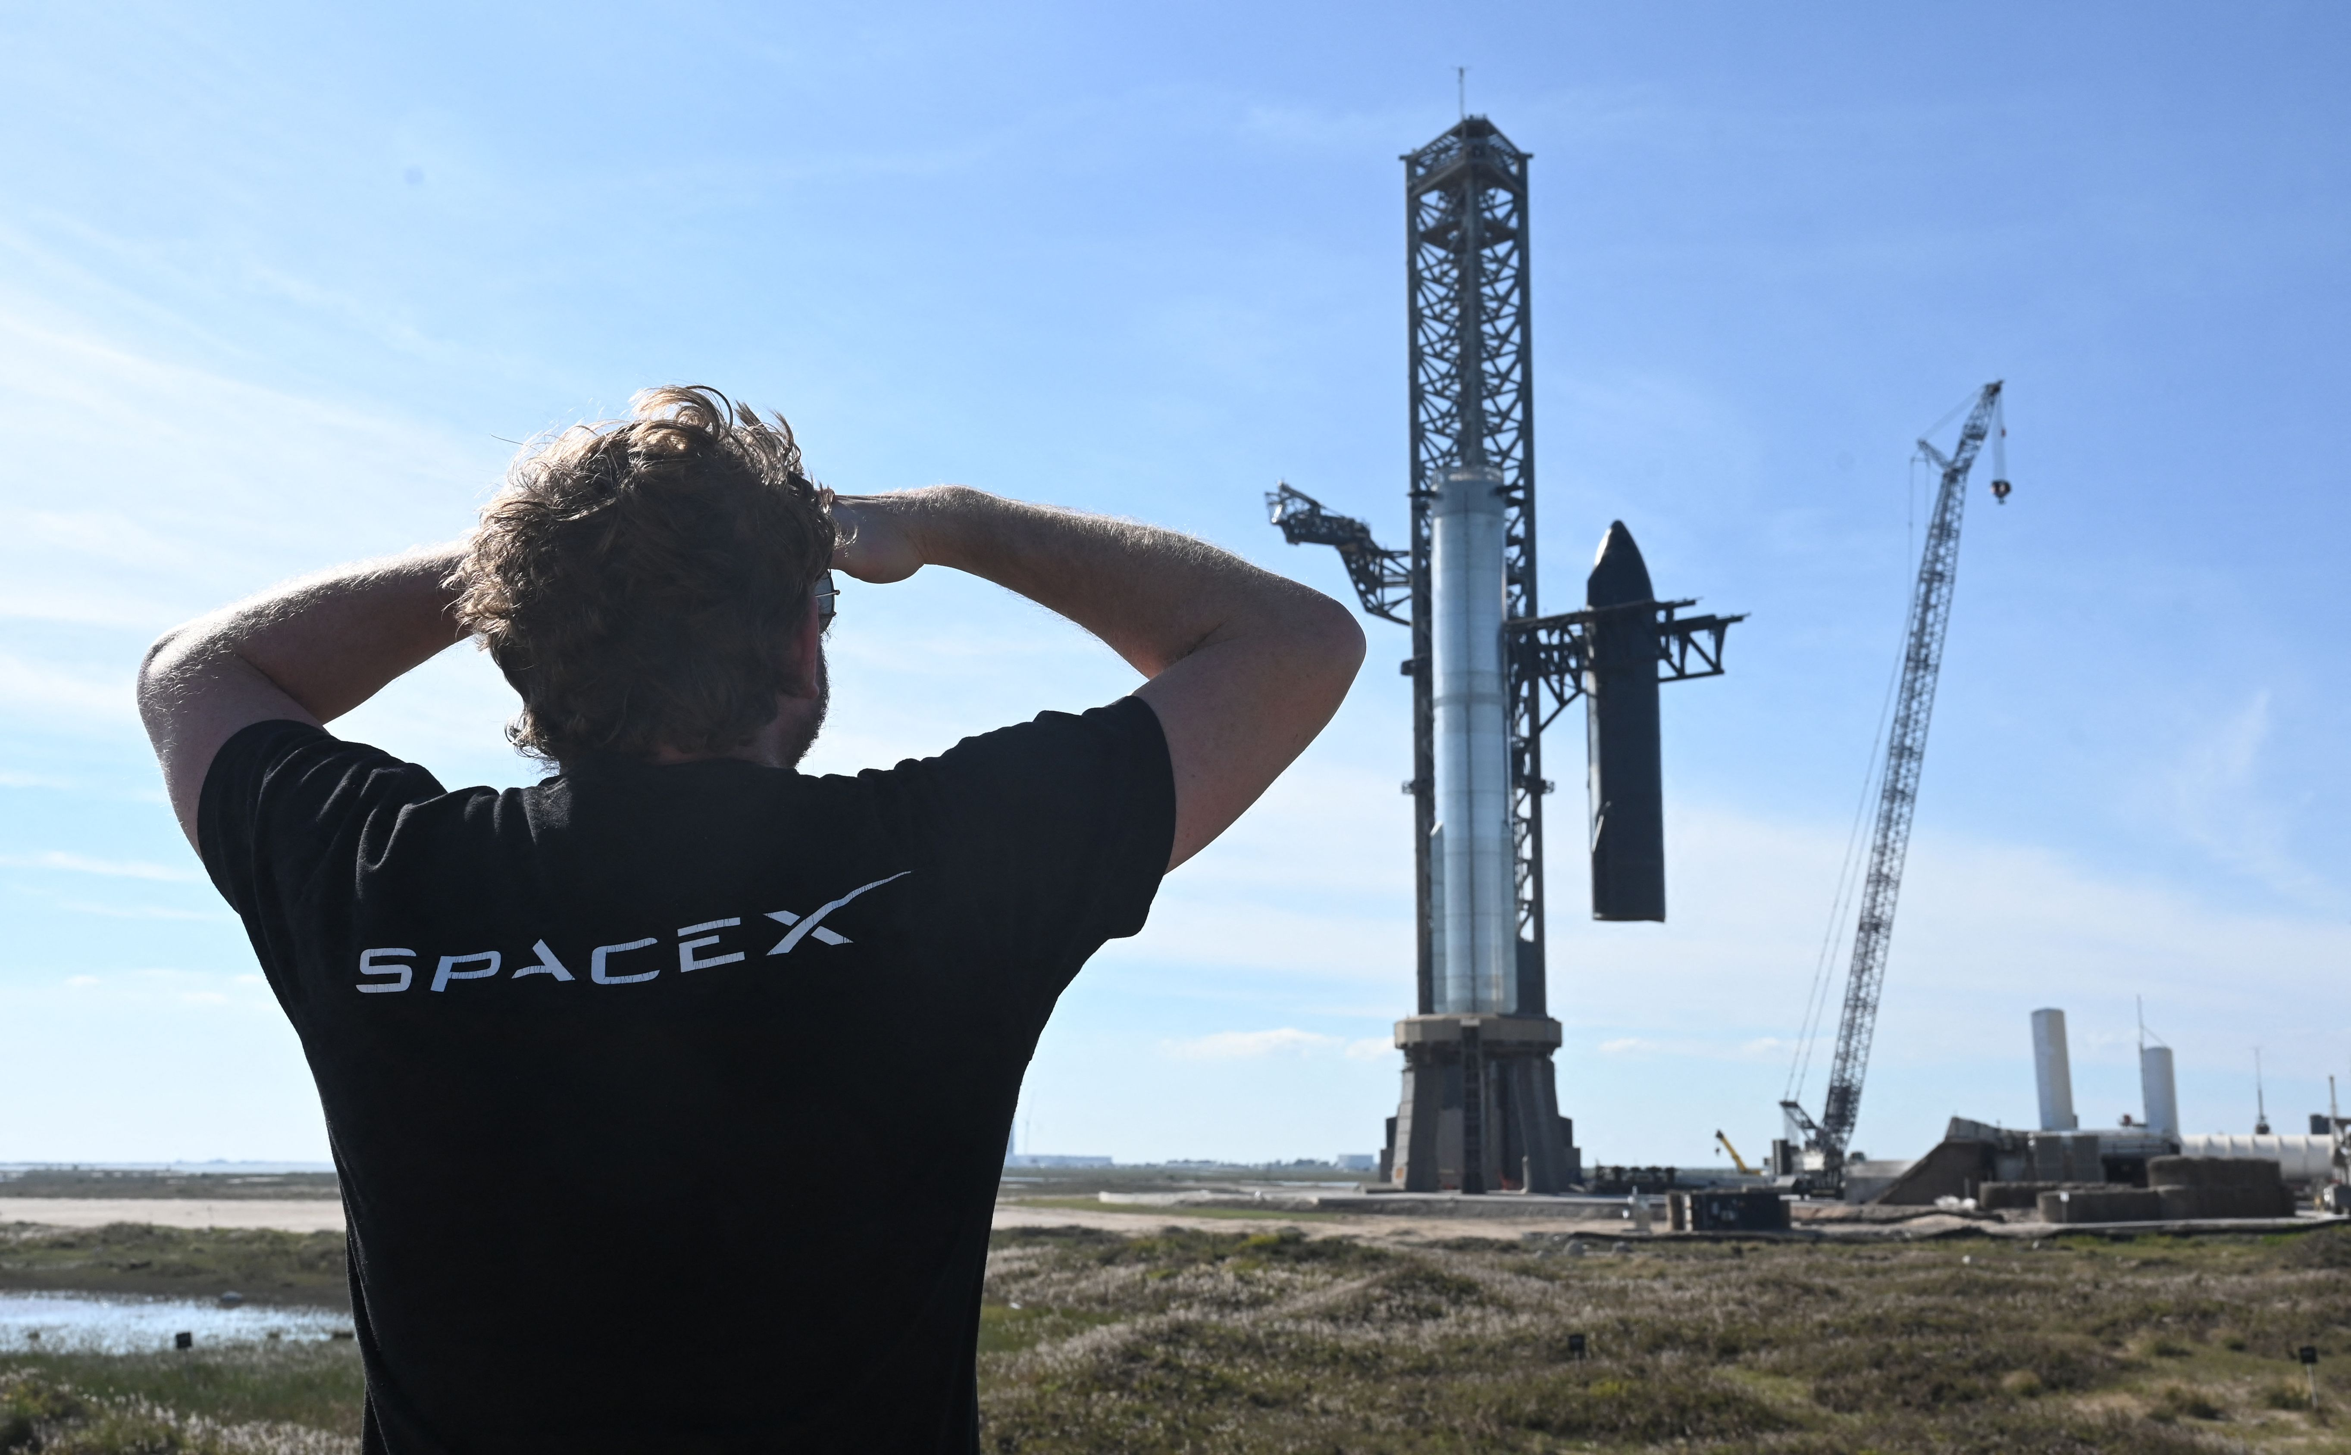
PSIRF | Overview
Provide safe, effective and caring services
What did we do prior to formal launch?
Established key working group with identified individuals from across the Trust
Set up Teams channel to share information
Developed organisational Delivery Plan (based on national guidance)
Developed PSIRP and our local templates
  PSII / AAR / Thematic Review / Transaction Audit / Observational Audit / Falls Toolkit / PU Toolkit
Trialled the templates and shared approaches
Presented to QSOG and Quality Governance Committee to ensure senior ‘buy-in’ and ownership / support
Identified and agreed key staff for external accredited training – ICS wide consistent training
Shared communications across the Trust (formal / informal)
  Included in Trust Communications / Social Media
  Promoted during World Patient Safety Day
Delivering Exceptional Care with Exceptional People

Slide 82

PSIRF | Overview
Provide safe, effective and caring services
What have we done since launch?
Formally launched PSIRF 1st December 2023 (not quite 12 months yet!)
Updated local Datix forms with PSIRF template information (whilst waiting for Datix to introduce nationally and LFPSE Taxonomy v6)
Appointed 4 Patient Safety Partners (volunteers)
Set up daily Patient Safety Huddles to escalate/discuss reported incidents
Developed Staff & Patients Information Packs/booklets
Delivering Exceptional Care with Exceptional People

Slide 83

PSIRF | Overview
Provide safe, effective and caring services
PSIRF – promoted staff involvement
The Trust will ensure that it is a safe & fair place to work, where everyone’s voice is encouraged, valued and listened to
Staff
Just Culture
Delivering Exceptional Care with Exceptional People

Slide 84

PSIRF | Overview
Provide safe, effective and caring services
PSIRF – Patient / Relatives Involvement
Getting involvement right with patient and relatives in how we respond to incidents is crucial, particularly to support improvement.
Patients / Carers
Being Open
Delivering Exceptional Care with Exceptional People

Slide 85

PSIRF | Overview
Provide safe, effective and caring services
What have we learned so far?
Massive amount of time and resource required to develop local approach and templates
Need to keep pushing and promoting PSIRF to staff at all levels
Do not presume people ‘know’ about PSIRF
Staff hesitant with new approaches……..until they have tried new process and used templates
Positive experiences for staff involved in incidents
More rapid and responsive approach to understanding incidents and gathering differing views and version of event
to allow greater learning
Challenging providing assurance to stakeholders as not reporting as previously under SI Framework
Need to involve our Patient Safety Partners – now have greater engagement and involvement in reviewing harms and engaging with patients/relatives to promote learning and using ‘patients voices’
There is no right or wrong approach / template – what works for you is important
Support from national perspective / NHSE – Patient Safety Specialist forums helpful but difficult to navigate initially and track information
Process is evolving and developing as we use the templates and tools further
Delivering Exceptional Care with Exceptional People

Slide 86

PSIRF | Overview
Provide safe, effective and caring services
Our progress so far…moving into PSIRF orbit
Trust Risk Management Panel has received 25 different PSIRF reports during
January – August 2024
  After Action Reviews
  Case Record Reviews
  Thematic Reviews
  Patient Safety Incident Investigation
  Transactional Audit
  Process Audit
Reviewers noted greater learning than under RCA process and better involvement of
staff / patients involved.
Restorative Conversations really good for reviewers and discussing with staff
Engaging with patients /relatives can be difficult especially in setting / agreeing expectations of the responses – Engagement Leads
Training limited to small number of ‘investigators’ has created capacity and workload issues as not have dedicated investigators
Flexibility and fluidity of the templates aids reviewers
Assurance Section of reports helps focus discussions regarding monitoring of actions identified from Safety Recommendations
Ensure have multidisciplinary engagement with discussions
Allowed for thematic reviews to incidents
Are we being overly cautious with instigating formal PSIRF responses – tabletop scenario review and staff feedback exercise
Delivering Exceptional Care with Exceptional People

Slide 87

PSIRF | Overview
Provide safe, effective and caring services
Internal Table Top review of our processes - held 8th October 2024
Review of how we share learning effectively across whole organisation
Review provision of local training for staff conducting After Action Review / Case Record Reviews / Thematic Reviews
Greater involvement of our Patient Safety Partners
Develop the Patient Liaison Officer role
Continue to promote the national training via ESR
Thematic review of Never Events
Link and triangulate further with other sources – Medical Examiners / HM Coroner / Other NHS providers
Reviewing priorities for PSIRP refresh and update
Delivering Exceptional Care with Exceptional People

Slide 88

Our NSCHT 12 Month Journey through PSIRF
Alicja Trueman

Slide 89


Slide 90
Key Milestones
Transitioned to LFPSE 01/10/23 with minimal disruption
Went live with PSIRF 01/12/23
Good compliance with required training requirements (Level 1 = 89%, Level 2 = 82%)
Internal reporting reflects new practices and has done since Q3 2023/24
51 staff completed new PSI reviewer training to support PSII oversight and learning lead roles

Slide 91
Learning from launch of PSIRF
Project management support key to navigate process with key stakeholders
Working as a system has built stronger links and a shared understanding
Staff engagement key to embedding change
Early engagement with Ulysses on development and system updates
Early stress testing of systems in test environments
Clear strategies of work i.e. communications, training
Restructure to weekly incident review group – learning and discussion focused
Formal review of proportionate reviews weekly been helpful to share learning in a more effective manner
Benefit of having a more flexible approach to reviewing incidents shaping the way incidents are viewed and managed

Slide 92
Incident data 2022 - 2024

Slide 93
SI/CSR data trend

Slide 94
Proportionate reviews
Proportionate review | Q1 | Q2 | Q3 | Q4 | Total 2023/24 | Q1 | Q2 | Q3 | Q4 | Total 2024/25
Rapid Review | N/A | N/A | 8 | 11 | 19 | 11 |  |  |  | 11
After Action Review | N/A | N/A | 2 | 9 | 11 | 2 |  |  |  | 2
MDT Review | N/A | N/A | 0 | 0 | 0 | 0 |  |  |  | 0
Patient Safety Review | N/A | N/A | 2 | 2 | 4 | 0 |  |  |  | 0
Comprehensive Safety Review | N/A | N/A | 10 | 14 | 22 | 5 |  |  |  | 5
Falls Comprehensive Safety Review | N/A | N/A | 0 | 0 | 0 | 0 |  |  |  | 0
Thematic Review | N/A | N/A | 0 | 0 | 0 | 1 |  |  |  | 1
Patient Safety Incident Investigation | N/A | N/A | 0 | 0 | 0 | 0 |  |  |  | 0
Total | 0 | 0 | 20 | 36 | 56 | 19 |  |  |  | 19

Slide 95
Learning from proportionate reviews
Many incidents have able to be signed off with a comprehensive managers sign off using SEIPS methodology
Notable practice is being pulled through highlighting compassionate care
Proportionate reviews via SEIPS allows for a wider exploration of contributory measures
Key examples
Differing focus for reviews – family voice being heard throughout reports
Positive feedback from families involved in proportionate review process
Excellent use of MDT reviews to discuss complex care
Effective communication within internal teams
Need for addition of names, designations of external clinical colleagues entere into Lorenzo
Effective use of professional meeting to support collaborative approach to managing patient care

Slide 96
Role of Quality Improvement and
Human Factors/Ergonomics
Use of HF/E to support PSIRF tools
Integration of HF/E principles into everyday work to aid understanding of complex systems, improve human performance and improve patient safety
Translating learning responses into improvements projects across the organisation, aligned with the NHS Impact.

Slide 97
Patient Safety Partners (PSP)
Decision made to integrate with wider inpatient transformational work to embed culture of care
Allocated to specific areas
Invited to patient safety meetings
Liaison with Patient Safety Team when onsite to support priority items of work and support
Support the policy and plan review for PSIRF
Co-production and user-centred design
Notes:
Transformational work – decision made due to allowing the process to become embedded in a wider aspect of new ways of working to help develop a new culture and ethos and a strong voice being made prominent to enable us to understand the feedback from patients and allow the opportunity to be raised in the appropriate forums.
Patient safety meetings – suicide prevention group, patient safety service line meeting

Slide 98
What next?
12-month review of PSIRF inclusive of plan and policy
Development of PSIRF into primary care
Wider engagement and collaboration with external agencies to celebrate/share learning events
Continuous review of engagement with those affected
Continue the journey of embedding a just and restorative culture

Slide 99






Improving our engagement with staff under PSIRF

Slide 100


Slide 101
What was our culture Pre-PSIRF?
I was involved in Patient Safety SI, I was initially worried but found the experience helpful and it felt like a debrief
I was scared of losing my job, my registration, my house and my family
Hearing accounts of those who have gone and are going through the process has caused me to feel anxious and worried about attending work
Closed, adversarial, punitive, terrifying
I believe it is geared very heavily to find fault with the attending clinician and not the root cause of the system failure
The team were kind, I felt supported and my wellbeing was a priority. This feeling was completely ruined when the root cause was agreed and it blamed me.
Being involved in an SI took me to a very dark place mentally, I didn’t want to be alive

Slide 102
Areas identified that needed improvement
“Investigation Officers” – same job title as those investigating disciplinaries
Worked remotely – invisible
Patient Safety education did not include education on the process
IO’s did not have contact with the staff prior to the RCA meeting
Welfare Officers lacked confidence and up to date training
New Operational Managers had not had welfare training
No option to view SI reports prior to closure
“Closing the loop”
Alternative duties staff utilised for SIs due to demand
Meetings conducted on TEAMS

Slide 103
Improvements made
IOs are now “Patient Safety Learning Leads”
Learning Leads work from Trust sites one day a week.
PSIRF Campaign was held prior to launch and during launch week
Learning Response meetings held face to face
No alternative duties staff to be utilised at all for PSIRF
Brand new Welfare Course for all those supporting staff through learning responses
New staff intranet page with wealth of information
PSS visiting all Trust sites and engaging with staff

Slide 104
Early feedback from PSIRF
I was never involved in an SI but I had heard the gossip about them. PSIRF is not like that, this is better
The team are reassuring and treat you with dignity and respect
The PSS is friendly and approachable meaning I have confidence in the rest of the team
I was so scared before the meeting and had no need to be, thank you so much
PSIRF definitely feels as though it is about system and organisational learning
Reading the draft report was really helpful, thank you for making the changes I requested
Having our hub learning lead has really helped our culture

Slide 105
PSIRF in Care Homes – Bradwell Hall Nursing Home
A positive shift in culture to improve resident safety and reduce incidents/ harm
Caroline Morris

Slide 106


Slide 107
Introduction
The home introduced new systems, policies, processes, working to framework and changes in practice due to the inadequacies within the service. From support of residents, professionals, visitors and staff we have been able to implement a lot of change to improve the service which has resulted in the home turning around and obtaining a good CQC rating.
Some of the tools implemented were the STOP AND WATCH, Safety Boards, 2 pm huddles, SBARD, Champions and Flashcards to name some. The tools were implemented to enhance the safety and care for all residents within our care. The tools were implemented via in house training with nursing staff and the management team supporting the tools in practice to ensure effective implementation. The staff at Bradwell Hall Nursing Home were able to contribute to the tools to make them as effective as possible. We approached the implementation of the tools using Dr WE Deming's approach to organisational development and leadership of: Plan, Do, Study, Act (PDSA).

Slide 108
Introduction
Bradwell Hall was in special measures and was facing having it’s registration cancelled and closure. The home had an ongoing poor performance record since 2018 with PIRT involvement and LSE.
The areas that we looked at along with the using the new tools to support in the transition period included:
Reducing harms for residents, no pressure injuries, low falls rate;
Reducing Safeguarding’s​;
Improving Staff morale and Empowerment of staff​;
Reducing Complaints​;
Improved reputation​;
Awards.;
Reducing Harms Locally & Nationally​;
Hospital Avoidance ​.

Slide 109
So, where do you start?
That depends on your home and what you already have in place. You may already have elements of the framework /project in practice (sometimes without realising) which is great.
Set yourself a timeframe and meet with your staff, residents, relatives and discuss what improvements you would like to make in relation to safety for your resident. Ask EVERYONE for ideas. Ensure Safety First is on all your meeting minutes.​
Find out what skills and strengths you have in your team and utilise this.​ Allocate champions in the areas of staff strengths, skills and knowledge.

Slide 110
Where do you start continued
Think about your home where can improvements or developments be made, audit against the Quality Statements ​
Your staff need to drive the change. Involving residents and relatives.​
Introduce tools these can be found at MiDoS For Care : www.midosweb.co.uk
Stop and Watch​
Red bag scheme​
Falls Assessment​
NEWS 2​
ASSKING​
Bowel Assessment forms​
SBARD
Delirium Wheel
When to call the CRIS Team, GP or Ambulance.​
Deteriorating resident training​
Understanding RESPECT forms EOL pathways

Slide 111

PDSA
As a home we wanted to ensure that the improvements we implemented were integrated and embedded properly.
We incorporated the Plan, Do, Study, Act cycle model of improvement to ensure that the changes we were implementing were going to be conducive. The model allowed us to amend initiatives before it was rolled out completely across the home.

Slide 112
Champions.
Up skill your champions and hold champion meetings for them to monitor and drive change.​

Slide 113

Topic Boards.
Implement topic boards with key themes which are changed monthly.
You can also use National NHS Campaign days and work along side your staff to highlight these themes and events.
We worked alongside our activities coordinator where activities / staff engagement sessions were implemented.

Slide 114

Flash Cards.
Easily accessible snippets of information, on hand for staff to refer to if needed. Our flash cards include:
Our aims and objectives,
Our mission statement,
STOP AND WATCH,
Diet & Fluids,
Safeguarding,
Mental Capacity Act,
ASSKING,
Equality and Diversity,
The Dignity Do’s,
The Humans Right Act,
Healthy Plate,
Protected Characteristics,
Accessible Communication Standard and
Choice .

Slide 115
STOPANDWATCH
We implemented a new paper handover sheet which all staff signed to acknowledge that they had received the handover. We added the STOP AND WATCH to our handover allowing staff to document and raise soft signs of deterioration. We then changed it to using the soft tile on PCS when we changed from paper to IT recording.
Nursing staff would act on the soft signs of deterioration.
This was then reviewed by the home manger as part of the manager follow up ensuring clinical oversight over the home. The Home Manager would review any STOP AND WATCH information and ensure all concerns had been actioned appropriately.

Slide 116

Leaflets.
Order leaflets for your residents and relatives. Where possible obtain different formats to ensure accessible communication for all.

Slide 117
Safety Huddle
On a daily basis there is a Safety huddle which the nursing staff and care staff participate in, part of this tool is that staff are able to discuss and highlight any concerns regarding diet and fluid intake, behaviours or any other concerns, allowing the nursing staff to review and monitor any concerns. This is recorded in a huddle book.
Contributing to a positive culture to discuss safety openly – safety became embedded across the care home

Slide 118

Safety Boards.
Analyse your data to check its working and seek feedback.
Our Safety boards are a quick glance at the data including:
Avoidable pressure injuries,
Upheld Safeguarding against the service,
Complaints

Slide 119


Impact

Slide 120
The Impact Continues

Slide 121
Impact continues 3.5 year later into 2024

Slide 122
Benefits for our residents.
Allowed for escalation of care to be acted on in a more detailed, accurate and swifter approach. In turn this has allowed for concerns of deterioration to be managed more in house rather than requiring hospital admission which is distressing for the residents.
Any benefits for families /visitors - if relevant. Families are kept more up to date allowing for peace of mind.
The benefits for staff - empowered to recognise and escalate soft signs to seek help and support to handover concerns using structured SBAR communication tool Enabled staff to feel more inclusive and assured that concerns about residents are being acted on. This has lead to a better team morale.

Slide 123
Benefits for our staff.
Empowering staff to recognise and escalate early signs of deterioration Engagement with Frailty assessments, Stop and Watch, SBAR, NEWS2, Red Bag Scheme, when to call the CRIS Team, GP or Ambulance. Understanding RESPECT forms EOL pathways.

Slide 124
New projects
We are currently working with collaboration with Staffordshire and Stoke-on-Trent Integrated Care Board. To implement
A Patient Safety Incident Response Framework PSIRF data base. Where we will upload all serious incidents for shared learning. This will replace the Serious Incident Framework which includes care homes.
Analyse Hospital admissions in line with hospital avoidance where possible and ensure RESPECT forms are robust and fit for purpose.

Slide 125
Quotes from CQC report

Slide 126
Closing remarks
Cath Marsland

Slide 127


