Slide 1
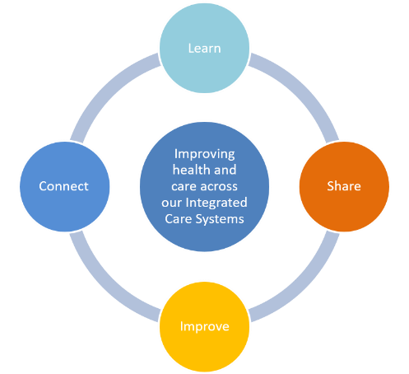
CASE STUDY - Continuous Quality Improvement
************* Project Title***************
BACKGROUND……. WHO, WHAT, WHY?
Project led by: ??????? Service/Team: ?????
General back ground and context, what is the problem you are trying to solve?
AIM
APPROACH
MEASURED OUTCOMES
Which cohort of patients/customers will this improvement impact on and how?
Improved patient outcomes and/or experience
Improved staff satisfaction
Savings through time/reduced risk/financial and environmental
Demonstrate changes introduced against each QI principles:
PDSA
Process/standard work introduced
Reduced waste
Add value
Increase flow
Mistake proofing
Engagement – voice of the customer
Baseline and outcome measures to test if change was an improvement? ** use visuals **
NEXT STEPS
CHALLENGES
Re-measure at ?date?
Communicate outcomes to ???
Engage wider teams for adopt/adapt of approach
Ie. lack of engagement/technology
OPPORTUNITY FOR SHARED LEARNING
Can we identify opportunities for scale and spread into other services within our organization and/or wider opportunities for quality improvement across the integrated care systems? Can we learn from the challenges experienced?

